Slide 1
Physical Optics
Part 1: Interference and Diffraction

Slide 2
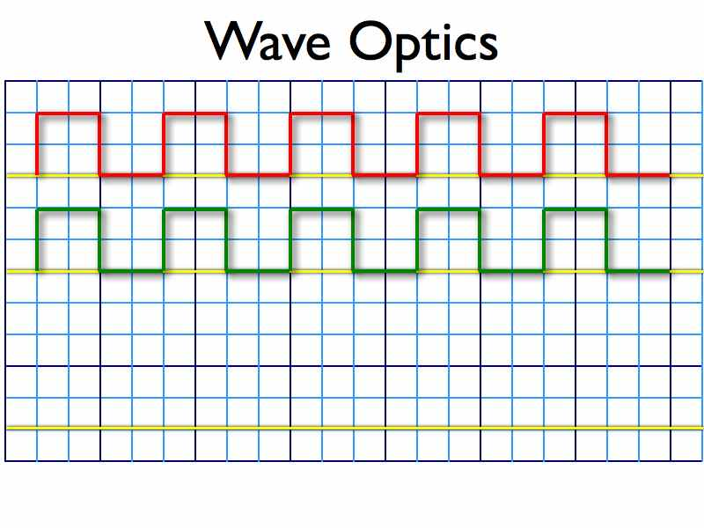

Slide 3
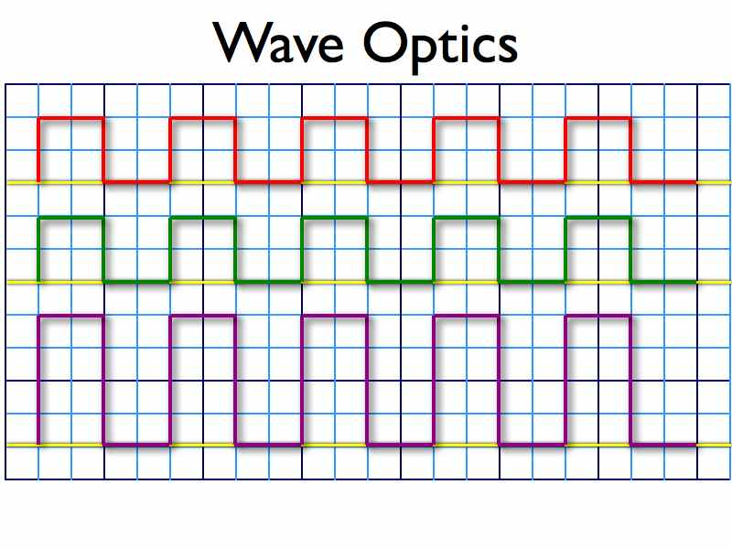

Slide 4
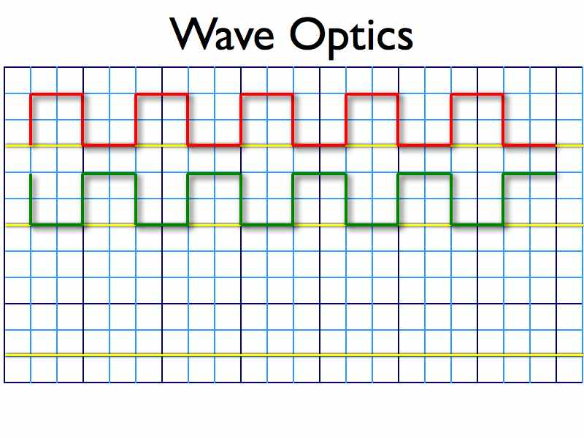

Slide 5
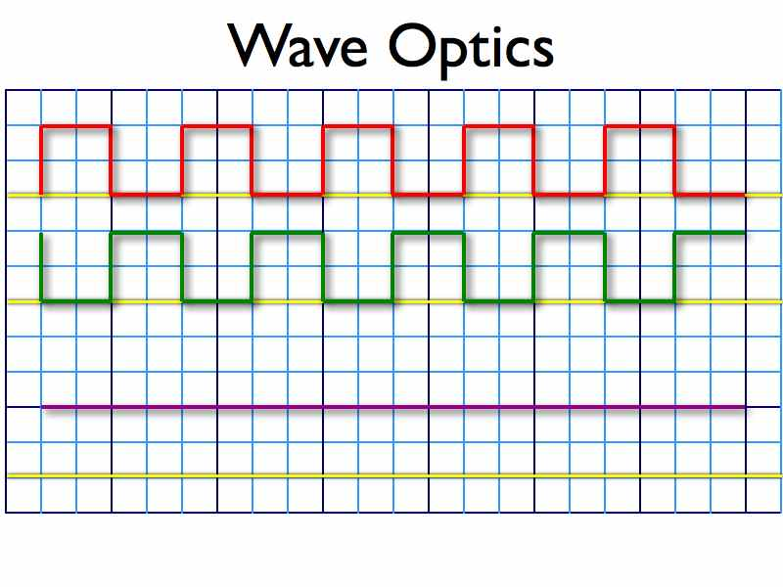

Slide 6
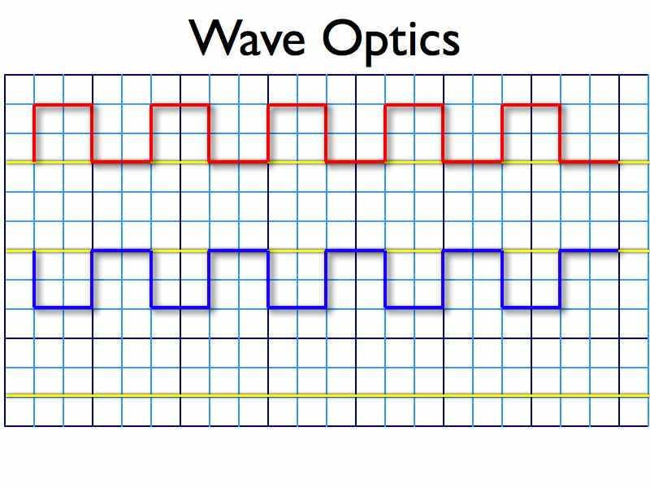

Slide 7
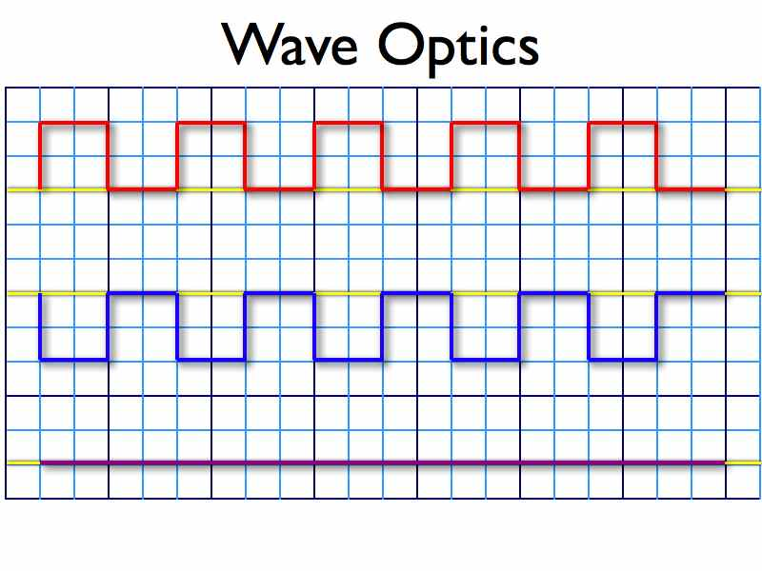

Slide 8
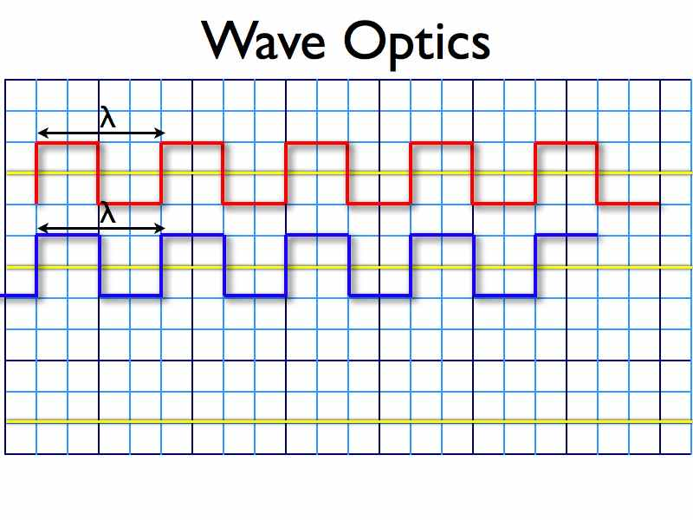

Slide 9
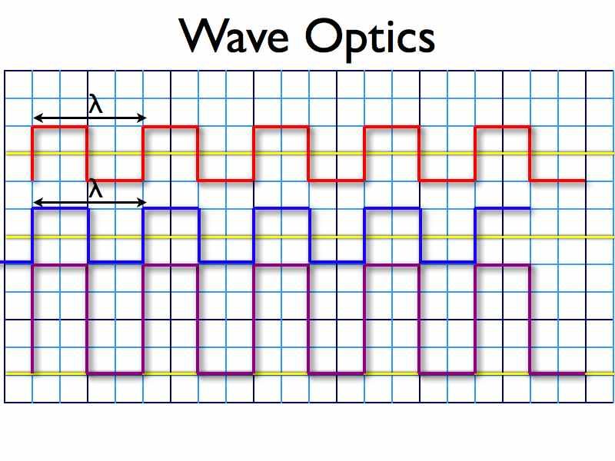

Slide 10
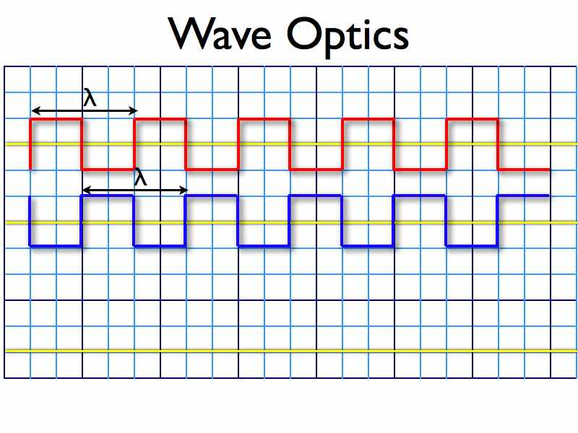

Slide 11
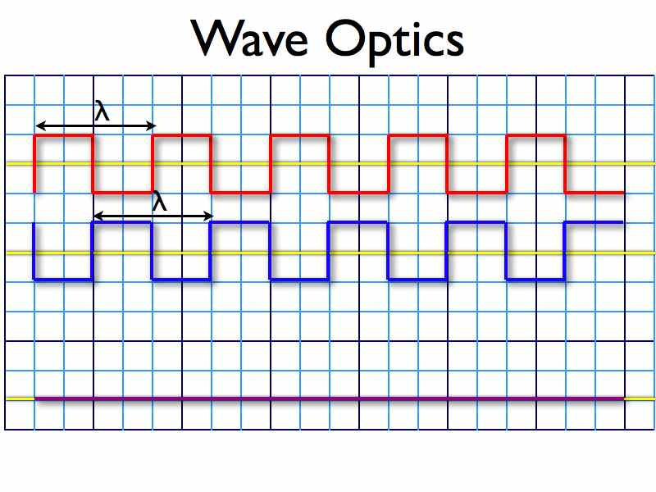

Slide 13
RippleFree
Please take out your phones and download an app called RippleFree
Explore the Diffraction Section
Single Slit
Double Slit
Obstacle

Slide 17
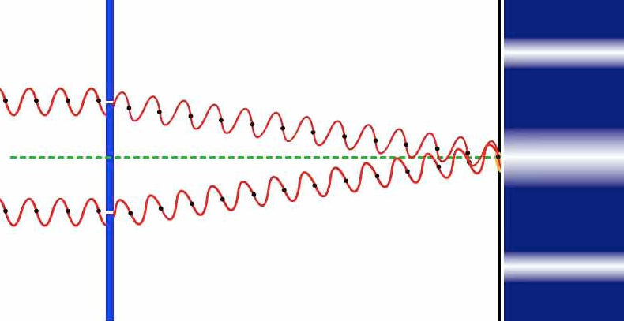

Slide 18
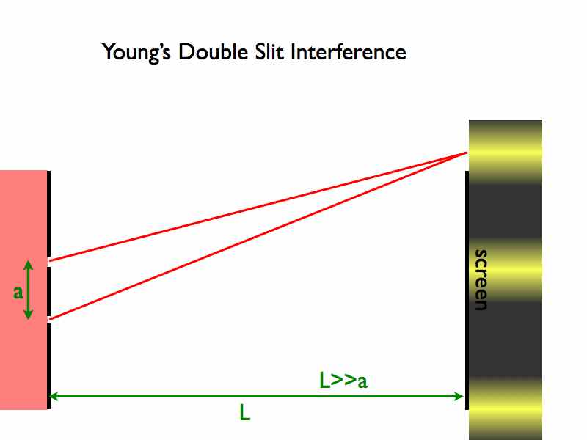

Slide 19
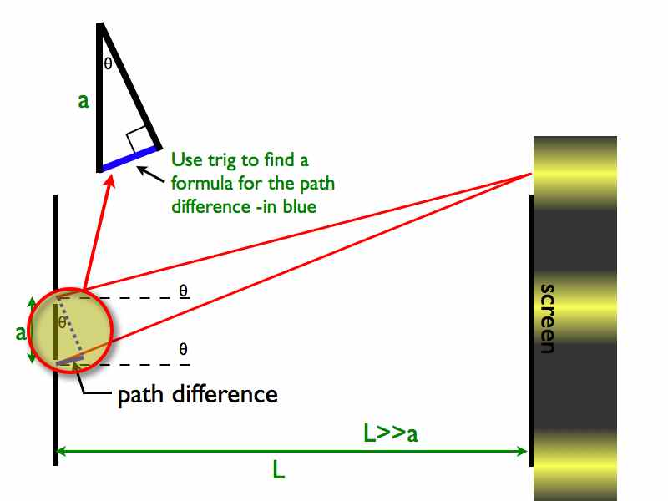
Notes:
Question: what is the path difference between the two rays of light?

Slide 20
Notes:
Generate an equation for when waves are at a maxima
Generate an equation for when waves are at a minima.

Slide 22
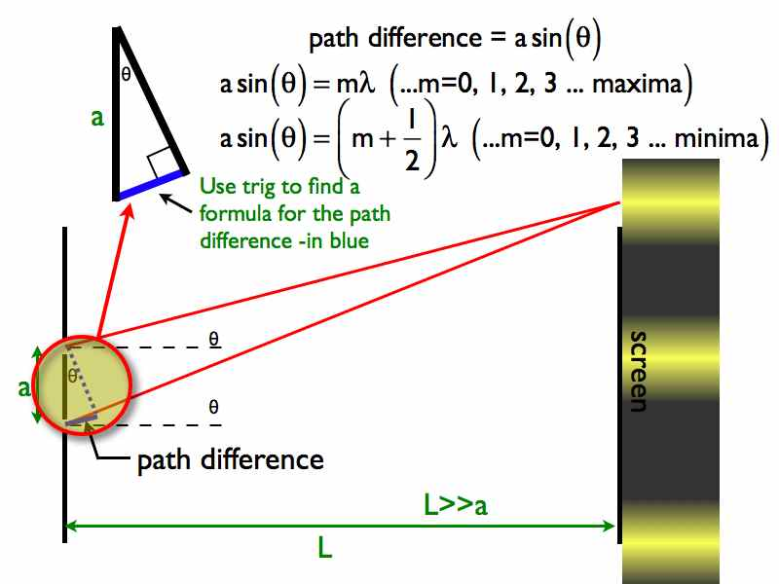
Notes:
Maximum = Constructive Interference
Minima = Destructive Interference
Drawn in y and tan = sin , Question, how can you find y’s?

Slide 24
Example
http://vsg.quasihome.com/interfer.htm

Slide 25
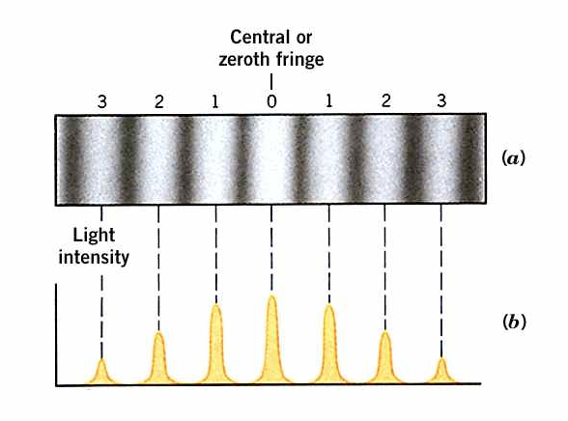
Notes:
Question why is it more intense for the central image and progressively lighter for outer images?

Slide 26
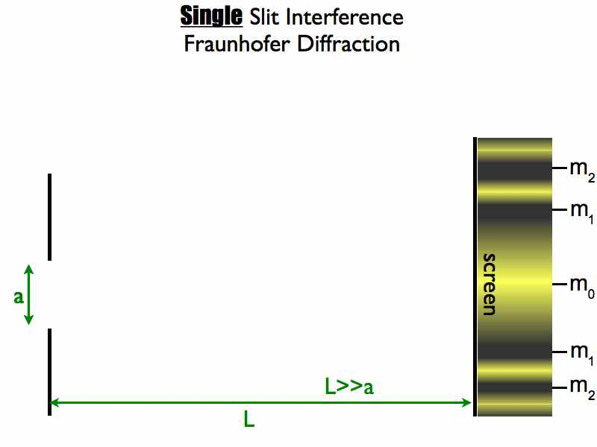

Slide 29
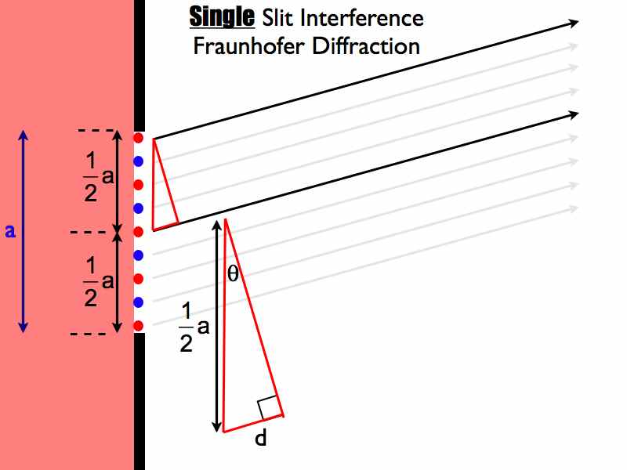
Notes:
Question: Find the different in wavelengths between the two waves

Slide 30
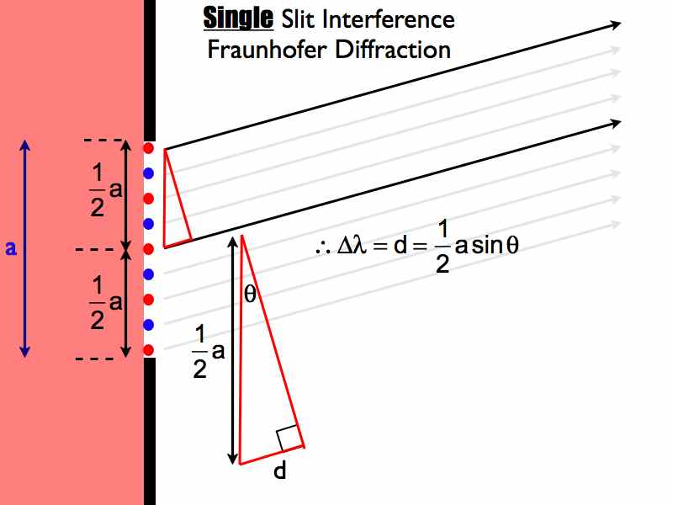

Slide 31
Notes:
What value of m leads to destructive interference?

Slide 34
Notes:
\

Slide 35
Example
http://www.phys.hawaii.edu/~teb/optics/java/slitdiffr/index.html

Slide 37
Notes:
Maximum = Constructive Interference
Minima = Destructive Interference

Slide 38
Notes:
Maximum = Constructive Interference
Minima = Destructive Interference

Slide 39
For next class….
Watch: Dispersion and EM Spectrum
Begin: Waves and Optics MC practice problems - Section B Physical Optics

