Slide 1
3D Molecular Geometry
Notes:
Describes shape

Slide 2
Shades and Behaviours of 3D Molecules
In order to understand the shapes the molecules form we must adhere to rules that are based on the repulsion of valence shell electrons!
VSEPR = Valence Shell Electron Pair Repulsion

Slide 3
Reasons for Geometry boils down to 5 things
Electrons all have the same negative charge
Like charges repel therefore Electrons repel
Bonded pairs surrounding the nucleus repel other bonded pairs and other electrons
Lone pairs surrounding the nucleus repel other bonded pairs and other electrons
Valence electrons are oriented in such a way as to be as far apart from one another as possible
For each of the following models, A will represent the central element, X the outer element and E the Electron Long Pairs
Notes:
Much start by drawing Lewis Structures

Slide 4
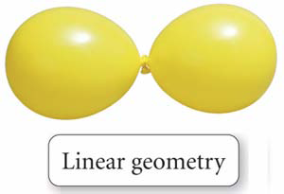
Shapes of 3D Molecules
Molecule | Shape | Molecular Geometry | Reason for Shape
BeCl₂ (AX₂) |  | Linear | The 2 pairs of bonding electrons maximize their distance from each other – 180º apart
Notes:
What is the bond angle between Cl-Be-Cl

Slide 5
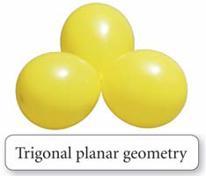
Shapes of 3D Molecules
Molecule | Shape | Molecular Geometry | Reason for Shape
BF₃ (AX₃) (AX₃E₂) |  | Trigonal Planar | The bonding pairs must be equally far from each other The 3 bonding pairs maximize distance from each other – 120º
Notes:
Bond Angle 120^{O}

Slide 6
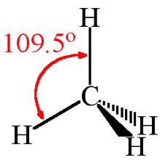
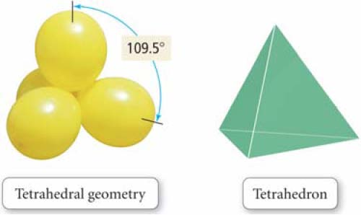
Shapes of 3D Molecules
Molecule | Shape | Molecular Geometry | Reason for Shape
CH₄ (AX₄) |  | Tetrahedral | The bonding pairs must be equally far from each other Maximize distance from each other
Notes:
Discuss bonds in and out of the page
Bond Angles

Slide 7
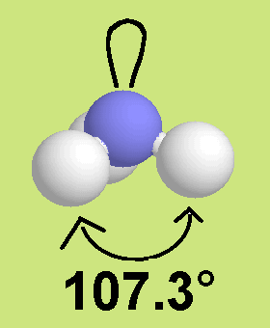
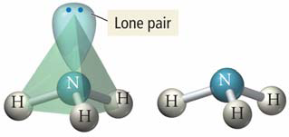
Shapes of 3D Molecules
Molecule | Shape | Molecular Geometry | Reason for Shape
NH₃ (AX₃E) |  | Bent | Because the lone pairs are closer to the nucleus they have great repulsion, push the H’s down
Notes:
Why are the bond angles less that 109^{O}

Slide 8
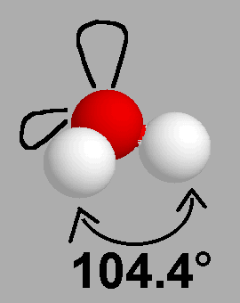
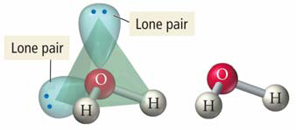
Shapes of 3D Molecules
Molecule | Shape | Molecular Geometry | Reason for Shape
H₂O (AX₂E₂) |  | Bent | The two sets of lone pairs further push the H’s down and together

Slide 9
Shapes of 3D Molecules
Molecule | Shape | Molecular Geometry | Reason for Shape
PCl₅ (AX₅) |  | Trigonal Bipyramidal | To maximize distance 3 equatorial Cl’s are 120º Top and bottom Cl’s are 90º apart
Notes:
Equatorial vs. axial –
Axial to equatorial – 90%
Equatorial to axial - 120⁰

Slide 10
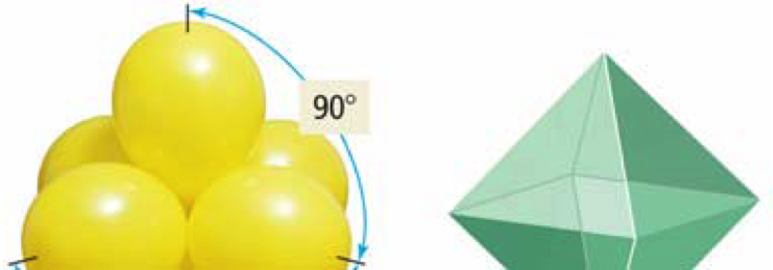
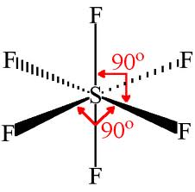
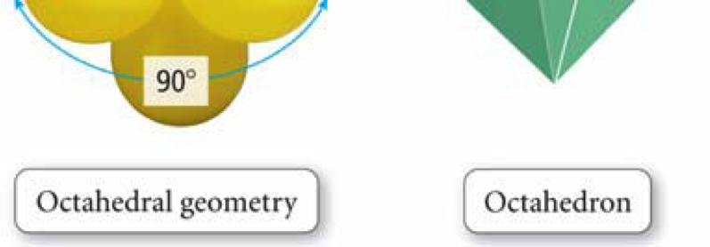
Shapes of 3D Molecules
Molecule | Shape | Molecular Geometry | Reason for Shape
SF₆ (AX₆) |  | Octahedradron | As more bonding pairs fill up locations around the nucleus the space between the pairs becomes smaller and smaller The molecule becomes less stable due to increased repulsion
Notes:
All bonds 90º apart

Slide 11
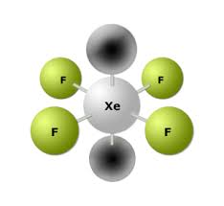
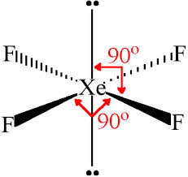
Shapes of 3D Molecules
Molecule | Shape | Molecular Geometry | Reason for Shape
XeF₄ (AX₄E₂) |  | Square Planar | Similar to Octahedradron except two lone pairs occupy the axial positions.
Notes:
All bonds 90º apart

Slide 12
Whiteboarding!
Grab a whiteboard and pens…
Form a group of 3 to 4 with people you have never worked with!

Slide 13
Notes:
Draw Methane and Ammonia molecular structure on the board

Slide 15
Steps to Make VSEPR Diagrams

Slide 21
Combining two Concepts
Electronegativity + Shape of the Molecule
We will know combine two concepts to introduce a new one Polarity

Slide 22
Remember… Electronegativity Values

Slide 23
Polarity
Molecules are said to be polar is the electron density is NOT evenly spread around the molecule
This causes part of the molecule to be partially positive and part of the molecule to be partially negative
Two Factors
Electronegativity
Symmetry of the Molecule (based on shape)

Slide 24
Determining the Dipole + Dipole
In the bonding unit we determined if a bond was polar based on the electronegativity difference of the two elements
To determine if the entire molecule is polar we must also check the symmetry (or lack there of) of the molecule

Slide 25
Symmetry vs. Asymmetry

Slide 26
Case 1: Non-Polar

Slide 27
Case 2: Polar and Asymmetric

Slide 28
Case 3: Polar and Symmetric
Polar or not polar?

Slide 29
Case 3: Polar and Symmetric
Not Polar

Slide 30
Case 4: Polar and Asymmetric
Polar or not polar?

Slide 31
Case 4: Polar and Asymmetric
Polar

Slide 32
Same Shape, Different Polarity

Slide 33
Question to ask yourself
Polar or not Polar?
Does the molecule contain polar bonds, and if so, do the bond dipoles cancel each other or not?

Slide 34
Whiteboarding!
Please collect a whiteboard and pens!
Work in groups of 3

Slide 38
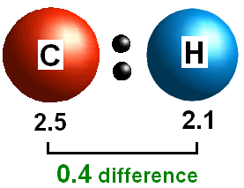
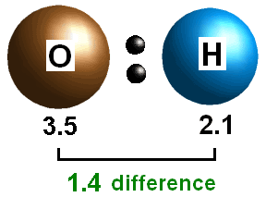
Polarity
The extent of polarity depends on the size of the dipole
The size of the dipole depends on the difference in electronegativities and the symmetry (or lack there of) of the molecule

Slide 39
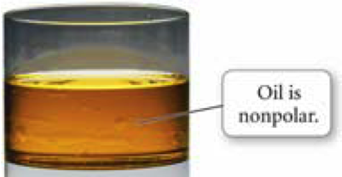
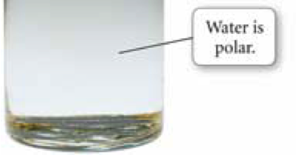
Polarity
When two substances have opposite polarities, they do not mix.
“Like” mixes with “Like”

Slide 40
In-Class Work
Collect the Worksheet – Shapes of Molecules from the front of the class
Work your way through the questions, the answers will be posted online

