Slide 1
Atomic and Nuclear Physics Physics
Day 1: Photon’s + Photoelectric Effect + Compton Scattering
Day 2: Atomic Energy Levels (absorption/emission spectrum)
Day 3: Wave Particle Duality

Slide 2
Reminders
AP exam are on May 9th
At some point soon there will be an AP Exam orientation in the library!
Now would be a good time to pick up a study guide for the exam.

Slide 3
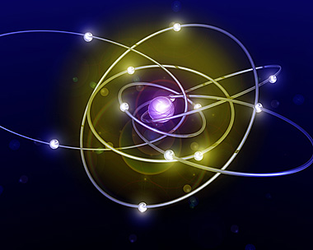
Quantum?... Quantized!?
Quantum mechanics is the study of processes which occur at the atomic scale.
The word "quantum" is derived
From Latin to mean BUNDLE.
Therefore, we are studying the motion of objects that come in small bundles called quanta. These tiny bundles that we are referring to are electrons traveling around the nucleus.

Slide 4
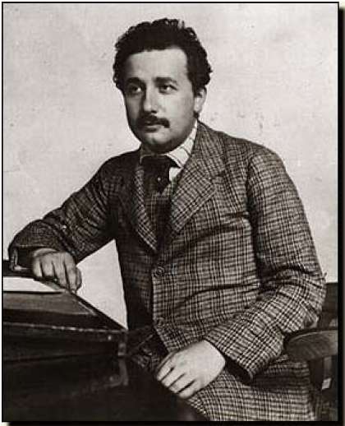
“Newton, forgive me…”, ~ Albert Einstein
One of the most popular concepts concerning Quantum Mechanics is called,“The Photoelectric Effect”. In 1905, Albert Einstein published this theory for which he won the Nobel Prize in 1921.

Slide 5
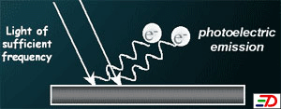
The Photoelectric Effect
"When light strikes a material, electrons are emitted. The radiant energy supplies the work necessary to free the electrons from the surface."

Slide 6
Group Think! – Whiteboards – 10 minutes!
In a group of 2 or 3 come up with answers to the following:
What properties of the incoming light would effect it’s ability to eject electrons?
Would all metals react the same to similar photon’s of light? Explain your reasoning.
What effect would increasing the intensity of light (# of photon’s) have?
Are all emitted electrons equivalent? If not how are they different, and what led to this difference?

Slide 7
Video!
Photoelectric Effect Wave Particle Duality

Slide 8
An Aside…
Before we begin to discuss the photoelectric effect, we must introduce a new type of unit.
This is a very useful unit as it shortens our calculations and allows us to stray away from using exponents.

Slide 9
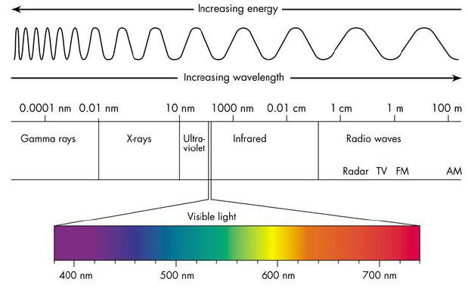
Light Review

Slide 10
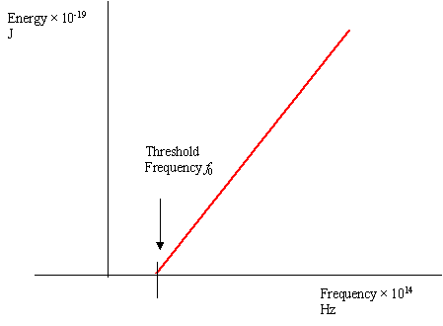
Photoelectric Fact #1
The frequency of radiation must be above a certain value. This minimum frequency required by the source of electromagnetic radiation to just liberate electrons from the metal is known as threshold frequency, f₀.
The threshold frequency is the X-intercept of the Energy vs. Frequency graph!

Slide 11
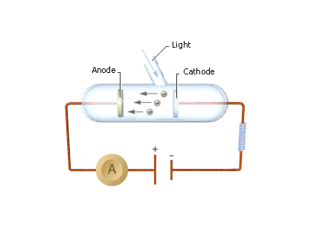
Photoelectric Fact #2
Work function, Φ, is defined as the least energy that must be supplied to remove a free electron from the surface of the metal
Not ALL of the energy goes into work! As you can see the electron then MOVES across the GAP to the anode with a certain speed and kinetic energy.

Slide 12
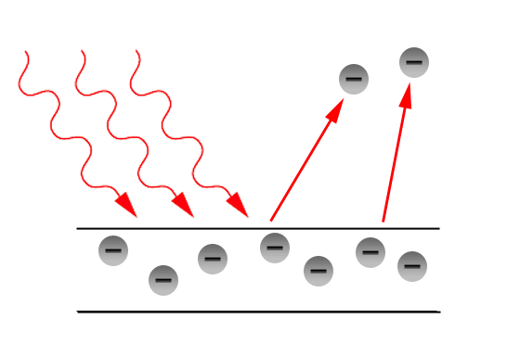
Photoelectric Fact #3
THE BOTTOM LINE: Energy Conservation must still hold true!
The energy NOT used to do work goes into KINETIC ENERGY as the electron LEAVES the surface.
Light Energy, E
WORK done to remove the electron
Notes:
The MAXIMUM KINETIC ENERGY is the energy difference between the MINIMUM AMOUNT of energy needed (ie. the work function) and the LIGHT ENERGY of the incident photon.

Slide 13
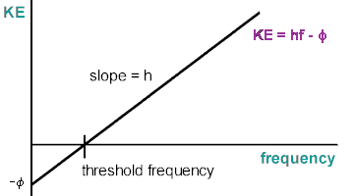
Putting it all together
Notes:
KINETIC ENERGY can be plotted on the y axis and FREQUENCY on the x-axis. The WORK FUNCTION is the y – intercept as the THRESHOLD FREQUNECY is the x intercept. PLANCK’S CONSTANT is the slope of the graph.

Slide 14
When Data doesn’t match theory…
Classical physics predicts that any frequency of light can eject electrons as long as the intensity is high enough.
Experimental data shows there is a minimum (cutoff frequency) that the light must have.
Classical physics predicts that the kinetic energy of the ejected electrons should increase with the intensity of the light.
Again, experimental data shows this is not the case; increasing the intensity of the light only increases the number of electrons emitted, not their kinetic energy.
THUS the photoelectric effect is strong evidence for the photon model of light.

Slide 15
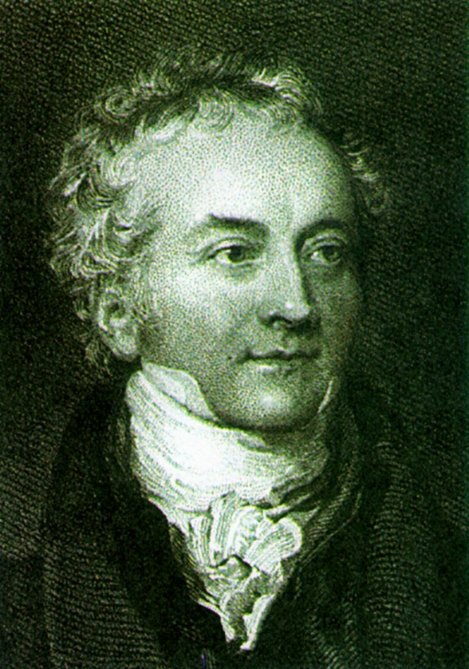
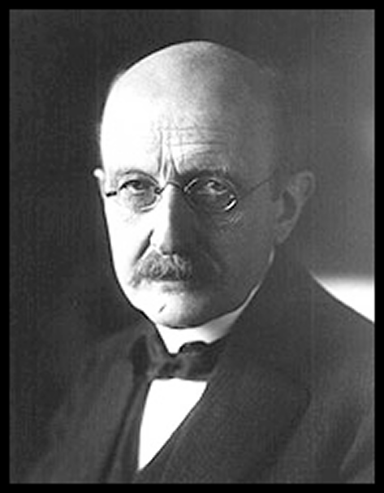
Wave-Particle Duality
The results of the photoelectric effect allowed us to look at light completely different. (more on this later!)
First we have Thomas Young’s Diffraction experiment proving that light behaved as a WAVE due to constructive and destructive interference.
Then we have Max Planck who allowed Einstein to build his photoelectric effect idea around the concept that light is composed of PARTICLES called quanta.

Slide 16
What does this diagram imply…?
Notes:
Another Example of the Conservation of Energy!

Slide 17
How Smart is a Physics AP Student…
An X-ray photon (with frequency f₁) strikes an electron in a piece of graphite, the X-ray scatters in one direction, and the electron recoils in another direction
Derive an equation to show the conservation of energy

Slide 18
How Smart is a Physics AP Student…
Energy of incident photon = energy of scattered photon + KE of e⁻
hf₁ = hf₂ + E_{k} (of e⁻)
The scattered photon has a frequency f₂ that is smaller than the frequency f₁ of

Slide 19
What about momentum?
Same deal… except angles… ewwwww
For an initially stationary electron, conservation of total linear momentum requires that:
Momentum of incident photon = momentum of scattered photon + momentum of electron

Slide 20
So now what?
Finish the Photoelectric Effect worksheet
Read the notes
Section A: Review Package Section A: MC: 1, 2, 4, 7, 8, 10, 15, 16, 20, 21, 25-27, 34, 36-41
Watch the next video: Atomic Energy Levels and complete readings

