Slide 1
AP Phys 12 – Class Starter
Let’s start by reviewing a 2003 AP Question
Work in groups of 2-3 to answer the following question…
Grab a Whiteboard and Pens

Slide 2
In your physics lab, you have a concave mirror with radius of curvature r = 60 cm. You must determine experimentally the location of a lit candle (in relation to the mirrow) such that the mirror will produce a virtual image that is two times the height of the candle.
You have an optical bench, which is a long straight track as shown below. You place a concave mirror in the holder. Both the mirror and the candle can be adjusted. You also have a ruler!

Slide 3
Draw a ray diagram of your setup and include the candle, the mirror and the image
Is your image upright/inverted?
Is your image larger/smaller than the object?

Slide 4
Draw a ray diagram of your setup and include the candle, the mirror and the image
Is your image upright/inverted?
Is your image larger/smaller than the object?

Slide 5
Lenses
Technically… we have already looked at reflection, and since mirrors are just lenses that don’t reflect we know most of what we need to know!
Lenses = Law of Refraction + Ray Diagrams for Mirrors

Slide 6
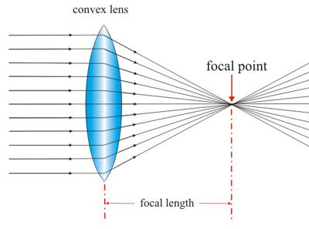
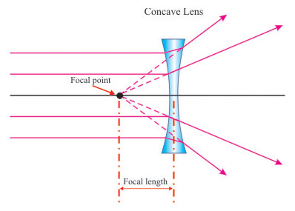
Lenses – An application of refraction
There are 2 basic types of lenses
A converging lens (Convex) takes light rays and bring them to a point. This is what we will focus on!
A diverging lens (concave) takes light rays and spreads them outward. Guess what…? Your generally NOT going to be asked this because only virtual/non-existent images are formed.

Slide 7
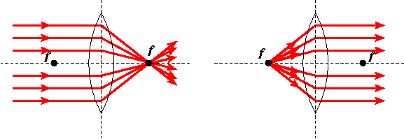
Converging (Convex) Lens
Much like a mirror, lenses also take light rays from infinity and converge them to a specific point also called the FOCAL POINT, f.
The difference, however, is that a lens does not have a center of curvature, C, but rather has a focal point on EACH side of the lens.
Note: technically mirrors also have focal points on each side of the mirror.

Slide 8
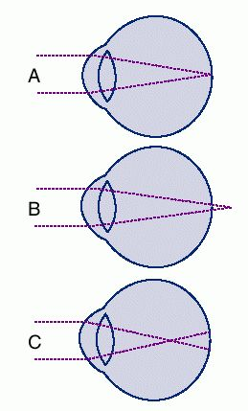
Applications of Converging Lenses
Often times we need additional corrective lenses (glasses and contacts) to fix our vision.
In figure A, we see an eye which converges what we see on the retina.
In figure B, we see an eye which converges too LATE. The eye itself is often too short and results in the person being far sighted.
In figure C, we see an eye which converges too SOON. The eye itself is often too long and results in the person being near sighted
In the later 2 cases, a convex or concave lens is necessary to ensure the image is on the retina.

Slide 9
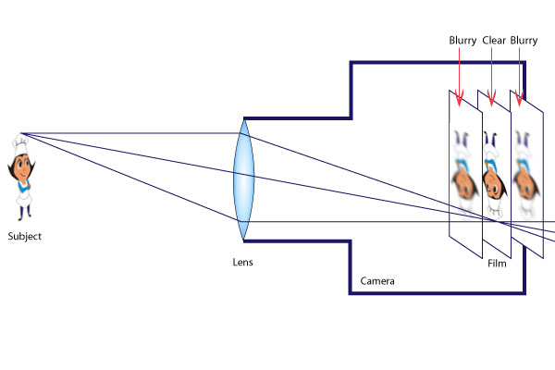
Applications of Converging Lenses
A camera uses a lens to focus an image on photographic film.
Notice how cameras (and humans) have trouble focusing on objects that are close and far away at the same time
Changing shutter speeds can allow more or less light onto the “film”

Slide 10
Ray Diagrams
The rules for ray diagrams are the SAME for lenses as they were for mirrors except you go THROUGH the lens after refraction and instead of going through, C (center of curvature) you go through the actual center of the lens.
f
f
Rule #1: Draw a ray, starting from the top of the object, parallel to the principal axis, then through “f” after refraction.
Rule #2: Draw a ray, starting from the top of the object, through “f”, then parallel to the principal axis, after refraction.
Rule #3: Draw a ray through the center of the lens.
Rule #4: Why is there no rule 4? (Hint: think of an m-ray)

Slide 11
Ray Diagrams
As before, you draw the image down to the intersection as shown.
f
f
Since this image could be projected on to a screen it is a REAL IMAGE and real images ALWAYS are found on the OPPOSITE side of the lens from the object.
Likewise, virtual images would appear on the SAME SIDE as the object.
The characteristics in this case are still inverted and reduced.

Slide 12
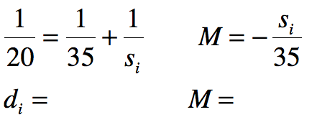
Lenses – The Mirror/Lens Equation
To CALCULATE the image’s position and characteristics you use the same equations you used for mirrors.
An object is placed 35 cm in front of a converging lens with focal length of 20 cm. Calculate the image’s position relative to the lens as well as the image’s characteristics.
This image is REAL (since the object distance is positive) and on the OTHER side of the lens. The image is INVERTED and ENLARGED.

Slide 13
Question:
A 3-cm tall object is placed 20 cm from a converging lens. The focal distance of the lens is 10 cm. How tall will the image be? What will be the magnification?
d_{i} = 20 cm

Slide 14
Next Class:
Waves Unit Quiz + Start SHM

Slide 15
Question:
A 3-cm tall object is placed 20 cm from a converging lens. The focal distance of the lens is 10 cm. How tall will the image be? What will be the magnification?
d_{i} = 20 cm
m = -1 (upside down)

