Slide 1
Community Interactions
Section 3.3

Slide 2
Niche
The role an organism plays in a community/ecosystem
Examples: Worm as a composter, Wolves in Alaska control Caribou population

Slide 3
Wolves in Alaska

Slide 4
BBC Nature Predation - Wolves Hunting Caribou

Slide 5
Competition
When two organisms fight over the same resource, or niche within an ecosystem
Roles/Niches overlap
Competition can Interspecfic (between two different species) or Intraspecific (within the same species)

Slide 6
Example: Polar Bears Competing
Intraspecific or Interspecific?

Slide 7
Foreign/Invasive Species
They out compete the existing native species – ultimately taking over
Humans are responsible for the most of the non-native introductions
Foreign species lack local predators, causing their populations to grow exponentially
Can ruin the fragile balance that exists within an ecosystem
Examples: Asian Carp, American Bullfrog, Purple Loosestrife

Slide 8
American Bullfrog
Asian Carp
Purple Loosestrife

Slide 9
Invasive Species: Asian Carp

Slide 10
Invasive Species: American Bullfrog

Slide 11
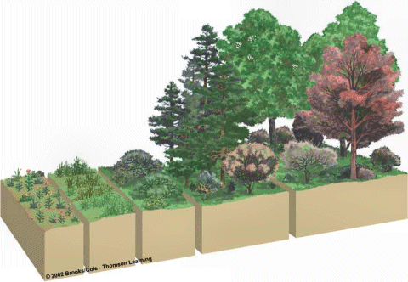
Succession
Gradual change in the types of plants in an area over time

Slide 12
BBC Nature Succession - Tropical Rainforest

Slide 13
Local Example: Stanley Park Windstorm 2006

Slide 14
Pioneer Species vs. New Species
Pioneer Species: 1st plants to inhabit an area
They change the environment (by making dirt)so new species can come
Examples: Lichen and Moss
New Species: Out compete the pioneer species
Climax Community: The ultimate community that inhabits that area – usually a forest

Slide 15
Succession

Slide 16
Primary vs. Secondary Succession
Primary Succession: Begins in an area that is lifeless = bare rock or a new pond
Secondary Succession: An area where flood, landslides, forest fire or another natural disaster has occurred
The dominant species have been removed
Pioneer species come in and the cycle begins again

Slide 18
In-Class/Homework
Read 3.3 CYU 3.3 p. 73 1,3,5,6-8,11,15
Chapter 3 Review: p. 80 2,3,5,8-10,13,14,16-18,20
Things you need to know for Chapter 3

