Slide 1
Adaptation and Natural Selection
Section 3.2

Slide 2
Adaptations
Modifications of an organism so that it is more specialized and successful in a certain ecosystem
Adaptations evolve over time through the process of natural selection

Slide 3
Natural Selection
The process that favours the survival of organisms with traits that are better adapted to the environment
Tends to eliminate individuals of a population that are poorly adapted
“Multiply, vary, let the strongest live and the weakest die.” Charles Darwin, The Origin of Species

Slide 4
Adaptive Radiation
Certain species are specialized to exploit a specific part of an ecosystem
A species takes on a different niche – (role or job within the ecosystem)
Those that are able to support that need thrive, those that cannot…. flounder
This process leads to Natural Selection!

Slide 5
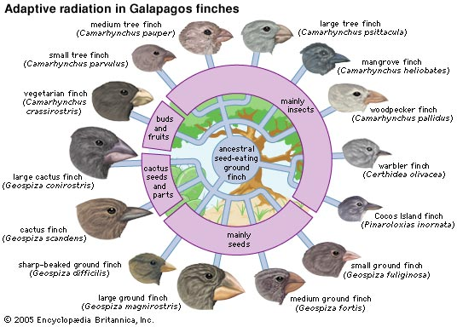
Example: Finches of Galapagos

Slide 6
Thought Problem
Question: What would happen if tomorrow, our environment made it such that it was unfavorable to have a short nose?
ANSWER: Only people with long noses would survive and reproduce to create long-nosed offspring. The people with short noses didn't adapt (i.e. their nose didn't grow to match the environment). The species adapted in the sense that the long-nosers became the next generation.
NOTE: Adaptations happens slowly over MANY generations and is a result of Natural Selection

Slide 7
Natural Selection leading to Generational Adaptions
Question: How does an adaptation occur within a species?
ANSWER: Survival of the fittest (or more correctly fittest to survive in that environment!)
It's not about changing; it's about not dying. Those who survive, procreate and pass forward their beneficial trait(s) to the next generation.

Slide 8
Proliferation
Once a new trait is produced – the organisms will reproduce and the population size will increase dramatically
Question: What’s the opposite of Proliferation?

Slide 9
Extinction
Species are removed due to changes in the ecosystem, foreign species and human influence.
Examples: Sabre Tooth Tiger, Woolly Mammoth
OR in some cases…

Slide 10
Extirpation
Local extinction, a population of a species in a specific area ceases to exist.

Slide 11
2 Types of Adaptations
Structural – Physical design changes
Examples: Mimicry, Turtles hard shell, Lion manes provide neck protection
Behavioral – How an individual or group acts
Examples: Migration, Hibernation, Estivation (Summer hibernation to avoid the heat)

Slide 12
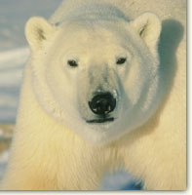
Polar Bears Special Adaptations
Why do polar bears have such big feet?
Answer: Helps distribute massive weight on the ice
How does the polar bear stay warm?
Answer: Their skin is black, insulating it from the cold combines with a thick soft undercoat, and a covering of long, stiff guard hairs to help repel water help keep the polar bear warm!
Why are their coats white?
Answer: It provides camouflage in the ice and slow, making them invisible to their prey

Slide 13
Pebble Toad
What is the Pebble Toad’s adaptation?

Slide 14
Jesus Christ Lizard
What is the Jesus Christ Lizard’s adaptation?

Slide 15
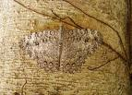
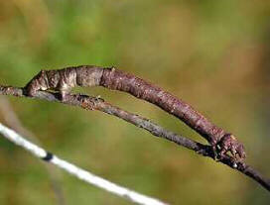
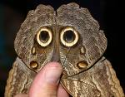
Mimicry

Slide 16
Mimic Octopus

Slide 17
Keystone Species
A species that plays an important role in keeping balance in their ecosystem
When eliminated, the effects on the ecosystem are dramatic
Named after the last stone placed in an arch

Slide 18
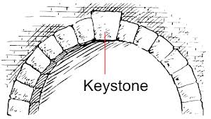
Keystone Arch

Slide 19
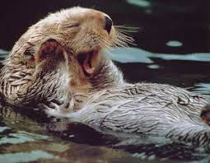
Example: Sea Otters

Slide 20
Otters Holding Hands
Rafting: Behavioral Adaptation
Question: Why is rafting beneficial?
Answer: The otters can link up to each other and kelp to prevent drifting when sleeping

Slide 21
Indicator Species
Can be used as a warning system for the health and well being of an ecosystem
Analogy: The Canary in a Coal Mine
Examples: Mussels, Oysters, Lichens

Slide 22
Learn Biology: Keystone Species vs Indicator Species

Slide 23
In-Class/Homework
Homework: Read 3.2 CYU 3.2 p. 66 Q’s 4-6,8,10
Project: Up to Adaptations, only one more to go!
Note: These projects are due next Wednesday!

