Slide 1
Climate
With your neighbour come up with a definition for the word climate
Collect the notes from the front of the room!

Slide 2
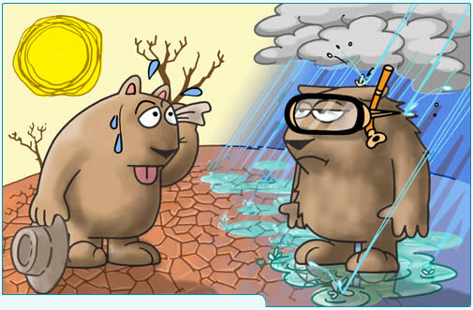
Chapter 3: Climate

Slide 3
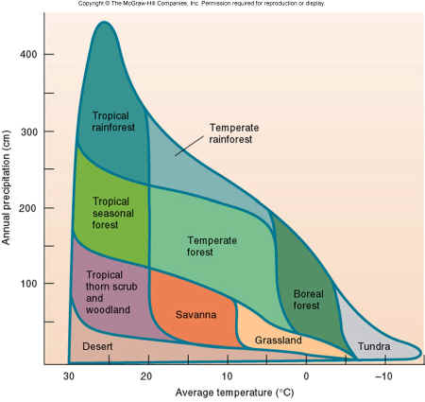
Climate: a long term pattern of temperature and precipitation
There are 3 Factors that Affect Climate…….

Slide 4
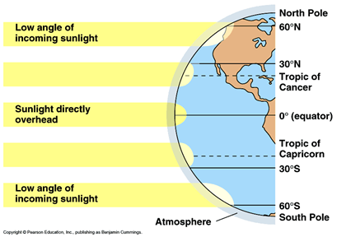
Latitude
Latitude means the distance from the equator
The suns rays are direct at the equator so it is hotter
rays more indirect closer to the poles so it is colder
tilt of the earth causes seasons for Northern and Southern hemisphere.
*There are no seasons at the equator

Slide 5
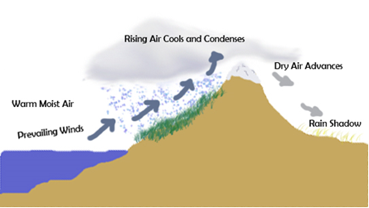
2. Distance from water
The ocean has greater heat capacity than land so it helps to moderate the temperature – less extremes
Warm moist ocean air moves over coastal mountains and cools releasing precipitation
The other side of the mountains = rain shadow (low precipitation)
Heat Capacity = the amount of energy (J) needed to raise the temperature of 1 kg of substance by 1 º C.

Slide 6
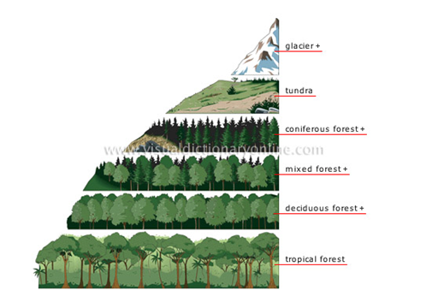
Elevation
Higher elevation = cooler temperatures and increased precipitation

Slide 7
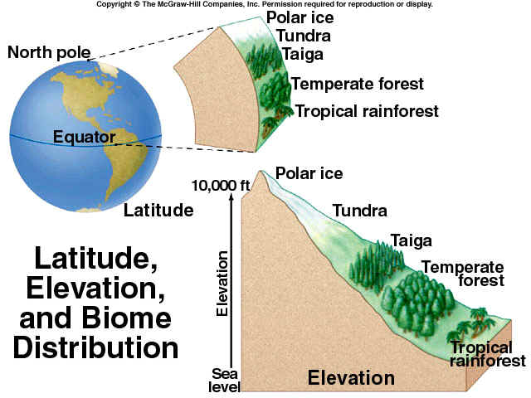

Slide 8
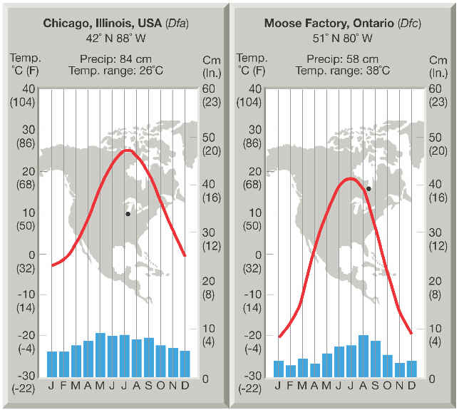
Climatographs
.
What does the line represent?
What do the bars represent?
Describe the difference in climate between Chicago, Illinois and Moose Factory, Ontario

Slide 9
Sci 10 – class Starter
Please hand in your Climatographs at the front of the class
Please collect a Know Your Biosphere handout from the front of the class
Use your textbooks to look up the definition of Biome and write it out the top of the handout

Slide 10
Know your Biosphere
Stations Activity
Working in groups of 4-5 you will travel the globe and to explore each Biome!
The 8 Biomes we will explore today are…
Tundra, Boreal Forest, Temperate Deciduous Forest, Temperate Rainforest, Grassland, Tropical Rainforest, Desert, and Permanent Ice
Note: Maybe this info will help you with your own Biome Project!

Slide 11
Groups
1
Ikumi
Nathan
Allistair
Eric K
2
Alex
Hanieh
Mikayla
Griffin
Ciaran
3
Clementine
Josh
Avery
Phaelan
Brendan
4
Makaela
Malcolm
Jake
Lauren
Derek L
5
Hope
Karis
Liam W.
Roy
Zack
6
Emmett
Liam R
Ian W.
Kazuki
Dane

Slide 12
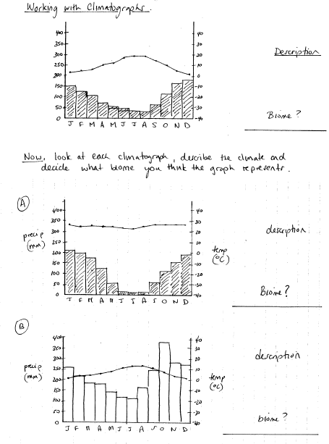
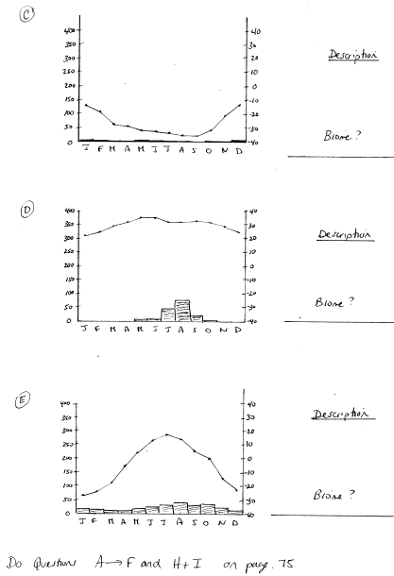
Find the Biome!

Slide 13
Homework:
Worksheet: Analysing Climatographs
Create a Climatograph for your biome

