Slide 1
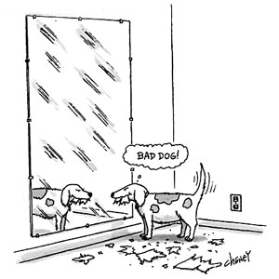
The Law of Reflection
The angle of reflection equals the angle of incidence

Slide 2
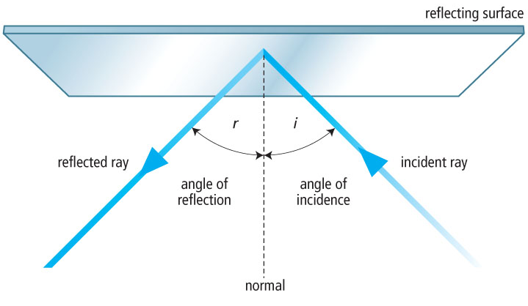

Slide 3
Incident Ray
The light ray that strikes the reflecting material
Reflected ray
The light ray that is bounced back (reflected) from a reflecting surface
Normal
An imaginary line drawn perpendicular to a reflecting surface at the point where an incident ray strikes the surface

Slide 4
Angle of Incidence
Labeled i
The angle formed by the incident ray and the normal
Angle of Reflection
Labeled r
The angle formed by the reflected ray and the normal

Slide 6
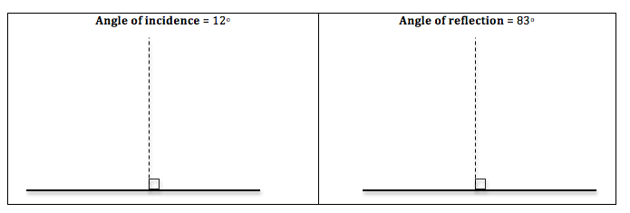
For the following diagrams: Draw the given angle. Label the (1) normal (2) mirror (3) ray of incidence (4) ray of reflection (5) angle of incidence (6) angle of reflection.

