Slide 1
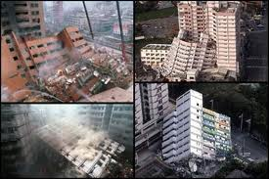
Describing Earthquakes
Earthquakes are very difficult to predict.
Scientists understand why they happen, but it is very difficult to predict their timing, exact location, and strength
Notes:
Pressure build-up happens underground, over very long periods of time

Slide 2
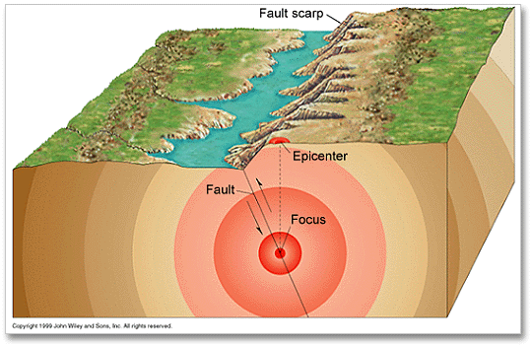
Describing Earthquakes
The focus of the earthquake is where the pressure is finally released
The epicenter is the point on the surface directly above the focus
Notes:
Subduction zone faults vs. Slip Strike Faults

Slide 3
Describing Earthquakes
Earthquakes occur at different depths, depending on the plates involved.
Earthquakes at the surface usually cause more damage
Notes:
Why would earthquakes near the surface cause more damage?

Slide 4
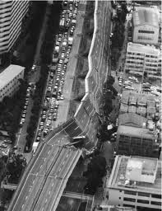
Describing Earthquakes
Earthquakes produce seismic waves
Seismology is the study of these waves.
These waves show the source and strength of an earthquake.

Slide 5
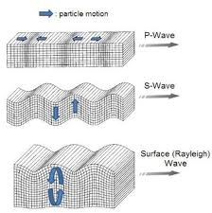
Types of Earthquake Waves
There are three types of seismic waves;
Primary wave (P-wave)
Secondary wave (S-wave)
Surface wave (L-wave)
P and S waves are always
made during earthquakes
Each wave has a different
motion and characteristics

Slide 6
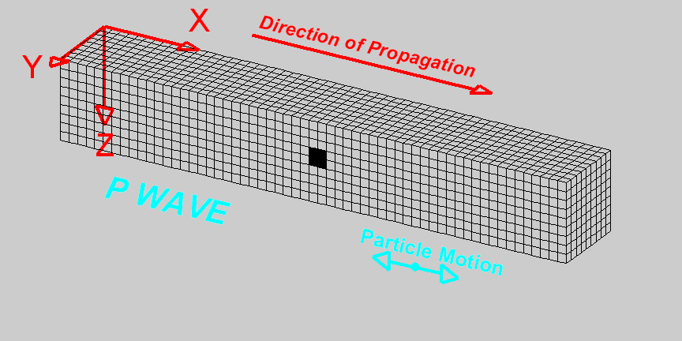
P-waves
The fastest seismic wave
The ground compresses and expands in the direction the wave is travelling
Can travel through solid, liquid, and gas

Slide 7
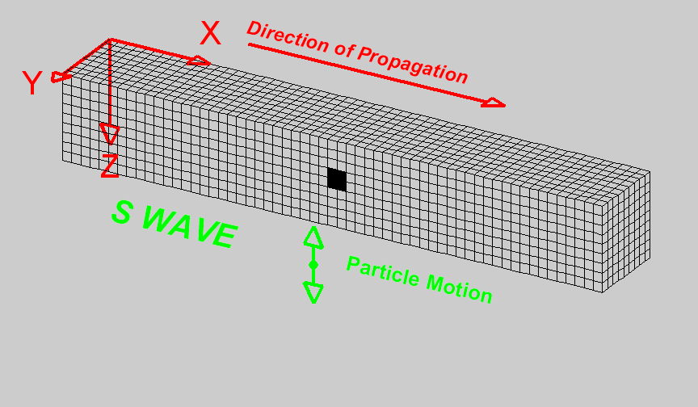
S - waves
2nd fastest wave
Ground moves perpendicular to the direction of the wave
Travels through solids only

Slide 8
L-Waves Surface waves
Slowest wave
Travels on the surface of the Earth
Ground moves in rolling action

Slide 9
Seismic Waves
Seismic waves behave differently in different Earth layers.
Scientists can learn from earthquakes about Earth’s interior.
What could scientists learn about the Earth by looking at the 3 types of waves during an earthquake?
See pages 530 - 531

Slide 10
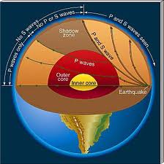
Inside the Earth
Comparing how
P and S waves
travel through the
Earth can tell us
if the Earth is solid,
or liquid
How???
Nye Time!

Slide 11
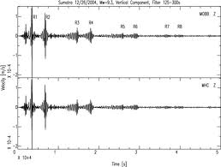
Seismometers
Seismometers are used to measure seismic wave energy
Seismometers measure how strong the waves are and when they are detected
Seismometers produce seismograms

Slide 12
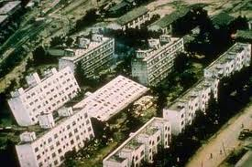
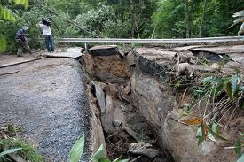
Describing Earthquakes
Seismograms show when an earthquake started, how long it lasted, and the magnitude (strength)
The Richter Scale:
1 increase in magnitude = 10X stronger
A magnitude 6 earthquake is 100X more powerful than a 4

Slide 13
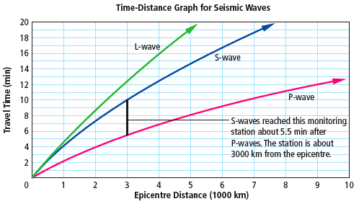
Calculating Epicentre
Since seismic waves travel at different speeds, a distance-time graph can show where the focus was.

