Slide 1
Please collect a Whiteboard and Pens!

Slide 2
The diagram below shows some of the equipotentials in a plane perpendicular to two parallel charged metal cylinders. The potential of each line is labeled.
A. The left cylinder is charged positively. What is the sign of the charge on the other cylinder?
B. Draw a diagram like the one to the right, sketch lines to describe the electric field produced by the charged cylinders.
C. Determine the potential difference, V_{A} – V_{B}, between points A and B.
D. How much work is done by the field if a charge of 0.50 coulomb is moved along a path from point A to point E and then to point D?

Slide 3
The diagram below shows some of the equipotentials in a plane perpendicular to two parallel charged metal cylinders. The potential of each line is labeled.
A. The left cylinder is charged positively. What is the sign of the charge on the other cylinder?
Positive!
B. Draw a diagram like the one to the right, sketch lines to describe the electric field produced by the charged cylinders. →
C. Determine the potential difference, V_{A} – V_{B}, between points A and B.
V_{A} – V_{B} = (–20 V) – (–10 V) = –10 V
D. How much work is done by the field if a charge of 0.50 coulomb is moved along a path from point A to point E and then to point D?
W_{AED}= W_{AD}= ΔE_{p} =qΔV = (0.5 C)(30 V) = +15 J

Slide 4
Three point charges produce the electric equipotential lines shown on the diagram below.
a. Draw arrows at points L, N. and U on the diagram to indicate the direction of the electric field at these points.
b. At which of the lettered points is the electric field E greatest in magnitude? Explain your reasoning.
c. Compute an approximate value for the potential difference, V_{M} – V_{S}, between points M and S.
d. Determine the work done by the field if a charge of +5.0 × 10^{–12} coulomb is moved from point M to point R.
e. If the charge of +5.0×10^{–12} coulomb were moved from point M first to point S, and then to point R, would the answer to e. be different, and if so, how?

Slide 5
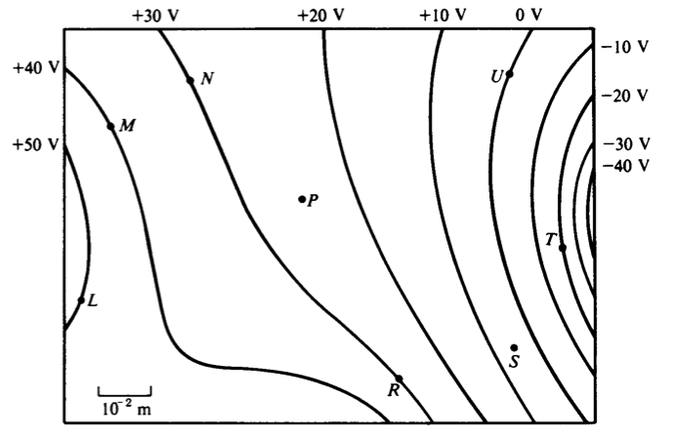
Three point charges produce the electric equipotential lines shown on the diagram below.
a. Draw arrows at points L, N. and U on the diagram to indicate the direction of the electric field at these points. →
b. At which of the lettered points is the electric field E greatest in magnitude? Explain your reasoning.
The magnitude of the field is greatest at point T because the equipotential lines are closest together.
c. Compute an approximate value for the potential difference, V_{M} – V_{S}, between points M and S.
V_{M} – V_{S} = 40 V – 5 V = 35 V
d. Determine the work done by the field if a charge of +5.0×10^{–12} coulomb is moved from point M to point R.
W = qΔV and ΔV = 10 V which gives W = 5.0 ×10^{–11} J
e. If the charge of +5.0×10^{–12} coulomb were moved from point M first to point S, and then to point R, would the answer to d. be different, and if so, how?
The work done is independent of the path so the answer would be the same.

Slide 6
AP Physics 2 – Class Starter
Quiz 6: Electric Fields between charged plates
Clear everything off your desk except a pencil and calculator
Set up dividers where necessary
Collect Data Sheets from the front of the room
Finished…? Hand the quiz in at the front of the room

Slide 7
A Chart to Remember!
Please collect the Review Chart from the front of the room
Fill it out to help you keep track of all the new formula’s and equations!

Slide 9
Cathode Ray Tube

Slide 10
Video’s:
CRT's - Brian Green – JJ Thompson
Millikan Oil Drop Experiment

Slide 11
Group Activity (Due at the end of class)

Slide 12
Please complete the Capacitor Reading before next class!

