Slide 1
Lesson 5: The Human Eye
YOUR TASKS:
Take out your writing utensils, binder, agenda, and device
Put your bag at the side of the room
SCIENCE 8 UNIT 2: Optics

Slide 2
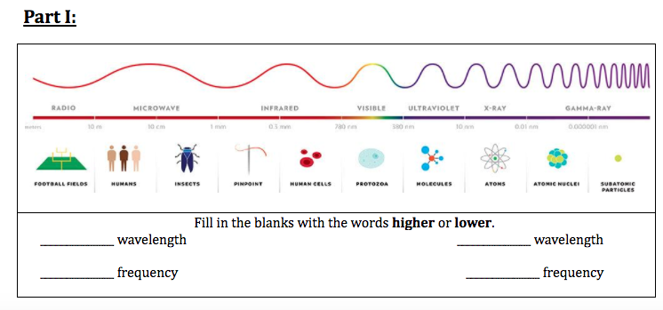
Homework:
Have you submitted Part A of the Electromagnetic Spectrum Assignments?
If not please do so now!

Slide 3
VOD - How Your Eyes Make Sense of the World
Notes:
https://www.youtube.com/watch?v=hsh2kPdgazo

Slide 4
Learning Targets
Explore the connection between Visible Light and he The Human Eye.

Slide 5
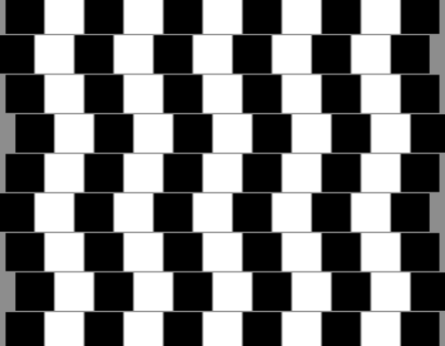
Human Vision

Slide 6
Parts of the EYE (notes)
CORNEA: Transparent material that covers the iris and pupil and holds the eye together.
PUPIL: An opening where light enters the eye
IRIS: Muscle that surrounds the pupil
SCLERA: A white region around the the iris.
LENS: A flexible convex structure behind the pupil and iris
RETINA: A screen at the back of the eye where the image is formed.
OPTIC NERVE: The nerve through which the retina communicates with the brain.

Slide 7
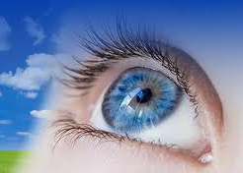
FOCUSING SYSTEM
The focusing system consists of:
Cornea
Lens
Spaces in the eye filled with watery fluid.
Light rays focus as soon as they pass into the cornea.
The cornea refracts (bends) and focuses the light.
The lens fine-tunes the focus.

Slide 8
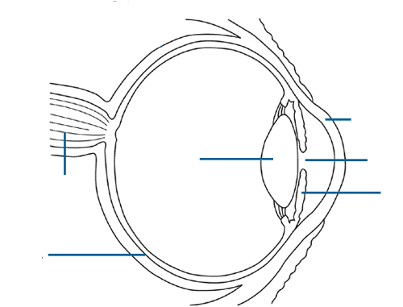
Parts of the EYE – label your diagram

Slide 9
FOCUSING SYSTEM

Slide 10
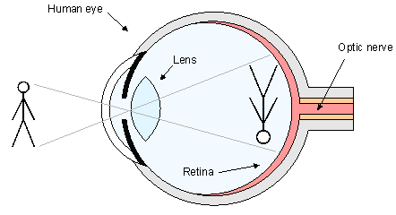
FORMING AN IMAGE
All light rays travel in straight lines.
The image formed by the lens is inverted
Your brain interprets the image as being upright

Slide 11
BW & Colour Vision
There are specialized cells in your retina that absorb and detect light.
Rod Cells
Rod cells absorb green light particularly well.
Even though rod cells absorb colour, our brains use rod cells to detect light and dark.
This is called our black and white vision system

Slide 12
BW & Colour Vision
Cone Cells
Cone cells are used to detect colour
There are three types of cone cells that detect the colours red, green and blue.
These three colours are important because they are the primary colours of light

Slide 13
Correcting Focus Problems
Normal Vision
Most of the fine-focusing takes place in the lens
The lens is able to fine-tune the image by changing it shape
The lens is convex in shape and the light rays converge at the retina

Slide 14
Correcting Focus Problems
Near-Sighted Vision
People who are near-sighted can see nearby objects but cannot see far
The eye has a longer shape than the normal eye
The lens converges the light rays to form an image in front of of the retina causing a fuzzy image
Vision is corrected with a concave lens (glasses or contacts)

Slide 15
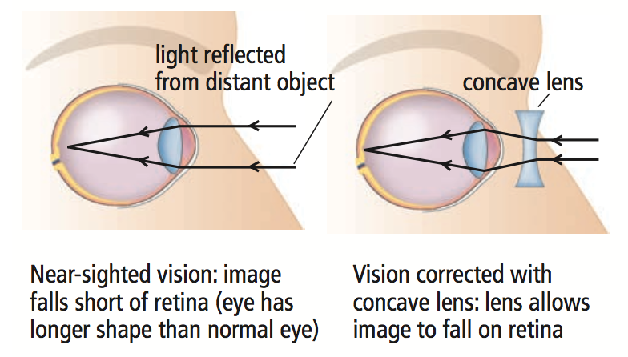

Slide 16
Correcting Focus Problems
Far-Sighted Vision
People who are far-sighted can see distant objects but cannot see near
The eye has a shorter shape than the normal eye
The lens converges the light rays to form an image behind the retina causing a fuzzy image
Vision is corrected with a convex lens (glasses or contacts)

Slide 17
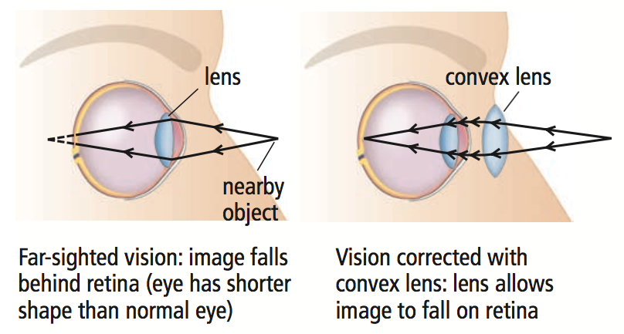

Slide 18
Blindness
It can range from not being able to detect any light to being able to perceive some light.
Blindness can often be a result of disease or malnutrition.

Slide 19
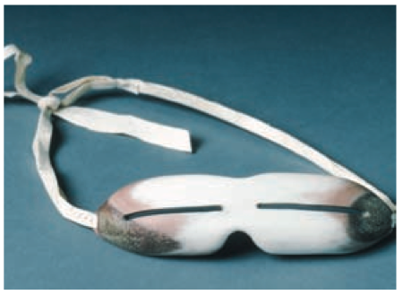
Other Types of Blindness
Snow Blindness:
Painful condition of temporary partial or complete blindness caused by overexposure to the glare of sunlight
Treatment for snow blindness: resting the eyes in the dark

Slide 20
Other Types of Blindness
Night Blindness:
A condition in which it is difficult or impossible to see in dim light
The most common cause is the rod cells losing their ability to respond to light

Slide 21
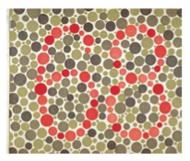
Other Types of Blindness
Colour Blindness:
The ability to see only in shades of grey
It occurs in about one person in every 40 000
An advantage of a person who is colour-blind is: to not be distracted by colourful distractions
The most common kind of colour vision deficiency is the inability to tell red and green apart

Slide 22
Colour Vision Tests
Please bring your chair to the front!

Slide 23
Plate 1
Both normal and those with all colour vision deficiencies should read the number 12.

Slide 24
Plate 2
Those with normal colour vision should read the number 8.
Those with red-green colour vision deficiencies should read the number 3.
Total colour blindness should not be able to read any numeral.

Slide 25
Plate 3
Normal colour vision should read the number 74.
Red-Green colour deficiencies should read the number 21.
Total colour blindness should not be able to read any numeral.

Slide 26
Plate 4
Normal colour vision should read the number 6.
The majority of those with colour vision deficiencies cannot read this number or will read it incorrectly.

Slide 27
Plate 5
Normal colour vision should read the number 7.
Those with colour vision deficiencies will not read this number or read it incorrectly.

Slide 28
Plate 6
Normal colour vision and those with total colour blindness should not be able to read any number.
The majority of those with red-green deficiencies should read the number 5.

Slide 29
Chemistry BINGO!

Slide 30
Please pick element only from the following list!
Na, O, Cl, Al, Au, Cu, Fe, H, He, C, Ca, Ar, Ne, F, Hg, N, Cf, Os, At, Ga, W, Pb, Ag, Po, Tc, Si, `
The Rules!
Use an element only once.
Make sure you write both the Element Symbol and it’s name on your sheet.
First person to get two rows (horizontal, diagonal and/or vertical wins!)

