Slide 1
Plate Tectonics and Boundaries

Slide 2
The story so far…
Name the four layers of Earth, in order from the inside out.
Inner core, outer core, mantle, crust
What was the name of the last super continent?
Pangaea
What evidence do we have that a super continent formed?
Shape of Continents, Matching Mountains, Coal Deposits, Glaciers, Plant/Animal Fossils

Slide 3
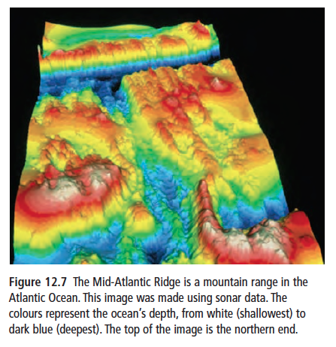
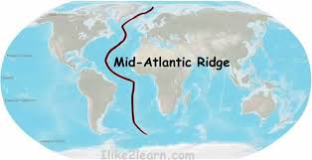
Mid-Atlantic Ridge
In 1872, a British vessel HMS Challenger set out to map the ocean floor
The oceanographers discovered a long mountain range running north to south down the length of the Atlantic Ocean.
They called this the Mid-Atlantic Ridge

Slide 4
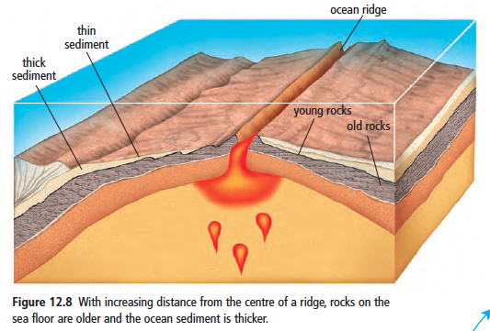
Mid-Atlantic Ridge
Oceanographers found that the youngest rocks were found closest to the ridge… Why?

Slide 5
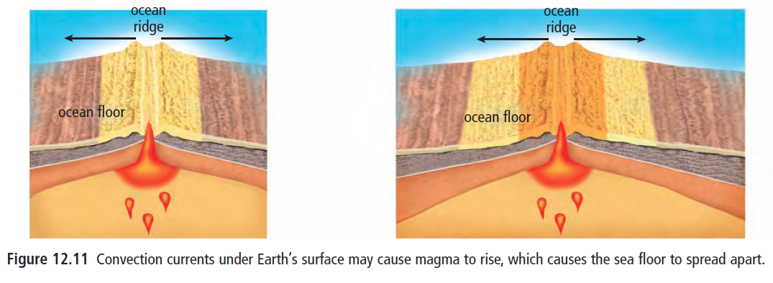
Sea-floor spreading
In 1960, Harry Hess proposed an explanation:
Magma rises from beneath the Earth’s surface
When it breaks through the Earth’s surface, it hardens and forms new sea floor
New magma forces apart the hardened material and continuously pushes older rock aside

Slide 6
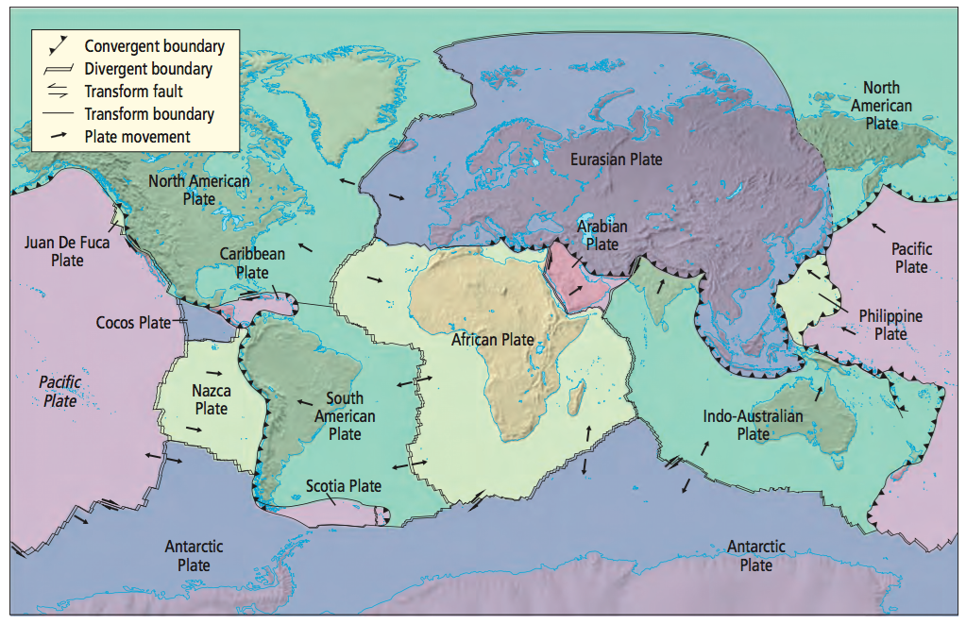
Plate Boundaries
A region where two tectonic plates are in contact
The way in which tectonic plates interact depends on…
The type of plate
The direction the plates are moving relative to one another

Slide 7
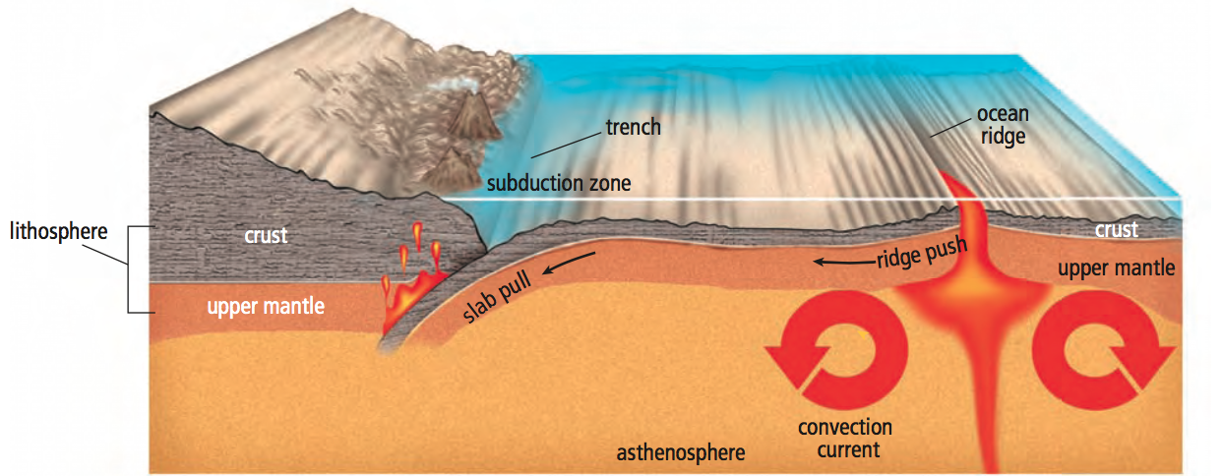
Push and Pull
Ridge Push
As magma reach Earth’s surface, a spreading centre occurs
Magma cools as it reaches the surface and becomes “new rock” and pushes older material aside
Slab Pull
One plate is pushed below another = subduction
Areas of large earthquakes and volcanic eruptions

Slide 8
Types of Plate Interaction
Divergence (spreading apart)
Convergence (moving together)
Transform (sliding by)

Slide 9
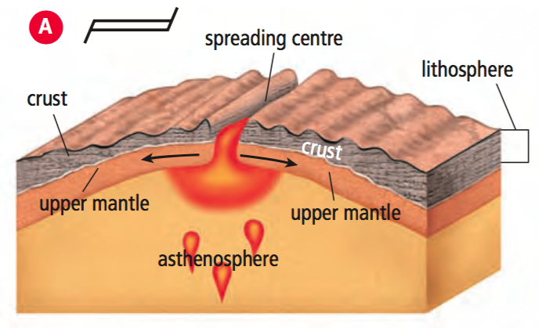
Divergence
Divergent plate boundaries mark where the areas where tectonic plates are spreading apart
In the ocean, sea floor spreading causes plates to separate
Ex. Mid-Atlantic Ridge

Slide 10
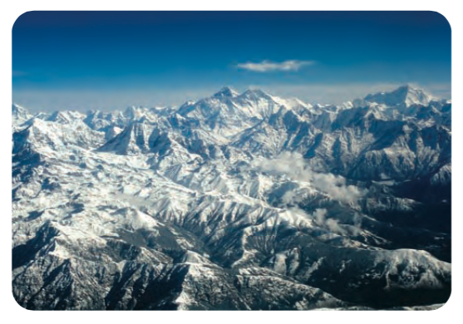
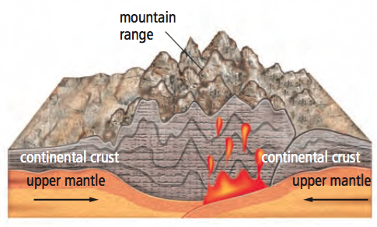
Convergence
Convergent plate boundaries occur where tectonic plates collide.
Three types:
Continent plate + continent plate
Plates have similar density
As the plates collide, their edges fold and crumple, forming great mountain ranges
Ex. Himalayas

Slide 11
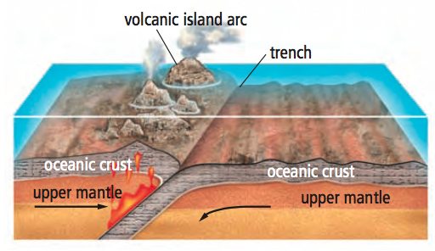
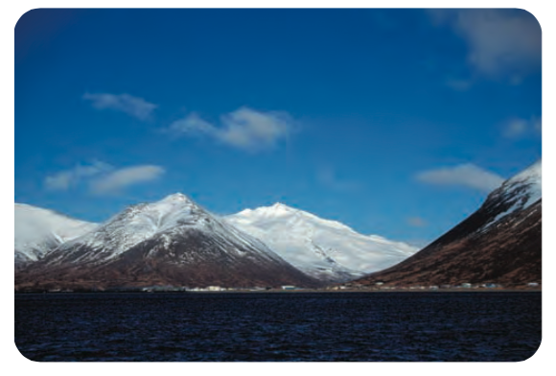
Convergence
Ocean plate + ocean plate
Subduction occurs where the more dense plate will slide under the less dense plate and deep into the mantle
A deep underwater valley called a trench is formed
Can produce a volcanic island arc
Ex. Islands of Japan and Indonesia

Slide 12
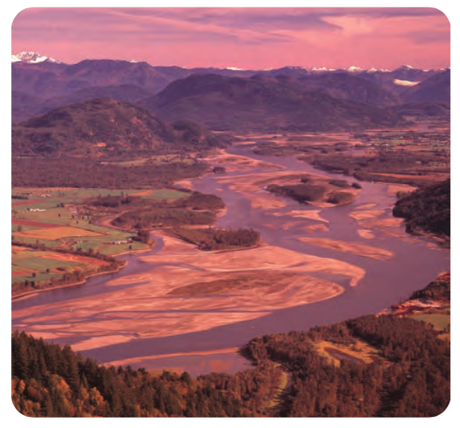
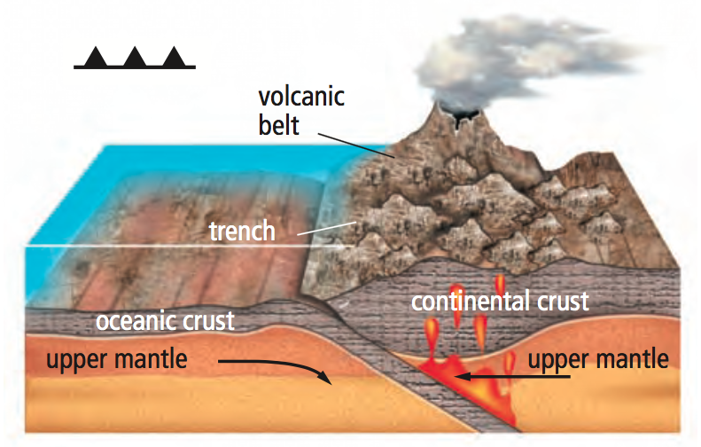
Convergence
Ocean plate + continental plate
Oceanic plate is more dense and is forced to slide beneath the continental plate
Also produces an underwater trench
Ex. The Coast Mountains of B.C.

Slide 13
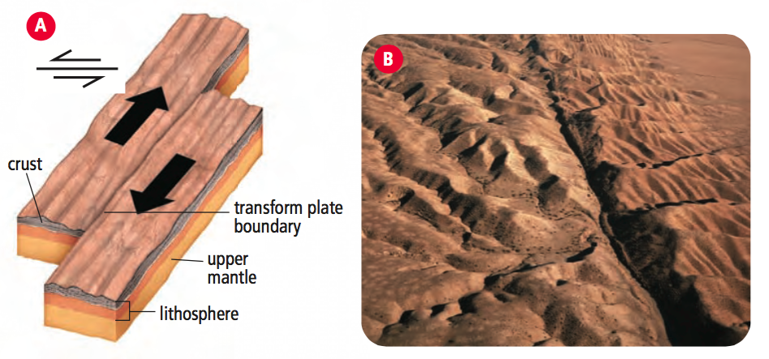
Transform
Transform plate boundary occurs when tectonic plates slide past one another.
At these boundaries, no mountains or volcanoes form
Ex. San Andreas Fault of California

Slide 15
Video - BBC Power of the Planet - Continental Drift

