Slide 1
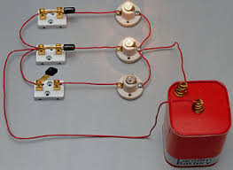
Whiteboarding!
Before the quiz let’s try some tricky circuit questions
Grab a whiteboard, pens and some colleagues (max 3)

Slide 2
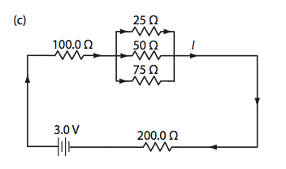
Question 1:
For the circuit to the right:
Find the equivalent resistance of the entire circuit
The current at the point marked I

Slide 3
Question 1: ANSWERS
For the circuit to the right:
Find the equivalent resistance of the entire circuit – 314 Ω
The current at the point marked I –

Slide 4
Question 1: ANSWERS
For the circuit to the right:
Find the equivalent resistance of the entire circuit – 314 Ω
The current at the point marked I – 9.5 mA

Slide 5
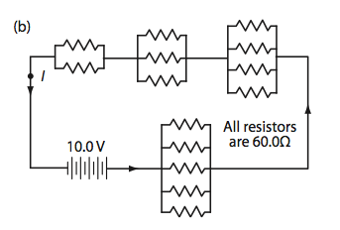
Question 2:
For the circuit to the right:
Find the equivalent resistance of the entire circuit
The current at the point marked I

Slide 6
Question 2: ANSWERS
For the circuit to the right:
Find the equivalent resistance of the entire circuit - 77 Ω
The current at the point marked I

Slide 7
Question 2: ANSWERS
For the circuit to the right:
Find the equivalent resistance of the entire circuit - 77 Ω
The current at the point marked I – 0.13 A

Slide 8
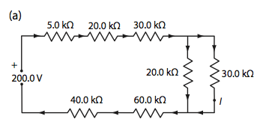
Question 3:
For the circuit to the right:
Find the equivalent resistance of the entire circuit
The current at the point marked I

Slide 9
Question 3: ANSWERS
For the circuit to the right:
Find the equivalent resistance of the entire circuit - 167 kΩ
The current at the point marked I

Slide 10
Question 3: ANSWERS
For the circuit to the right:
Find the equivalent resistance of the entire circuit - 167 kΩ
The current at the point marked I - 0.48 mA

Slide 11
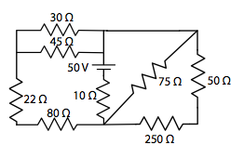
Question 4:
What is the equivalent resistance of the entire circuit?
What current is drawn from the battery?
What is the current in the 50 Ω resistor?
What is the voltage across the 22 Ω resistor?

Slide 12
Question 4: ANSWERS
50 Ω

Slide 13
Question 4: ANSWERS
50 Ω
1.0 A

Slide 14
Question 4: ANSWERS
50 Ω
1.0 A
0.13 A

Slide 15
Question 4: ANSWERS
50 Ω
1.0 A
0.13 A
7.3 V

Slide 16
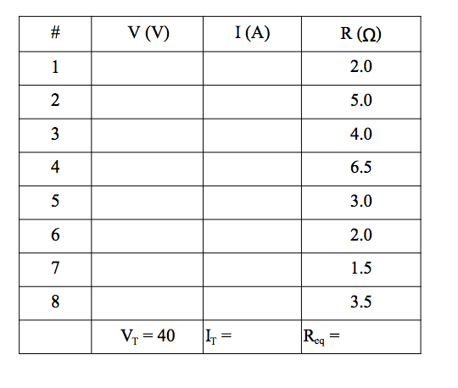
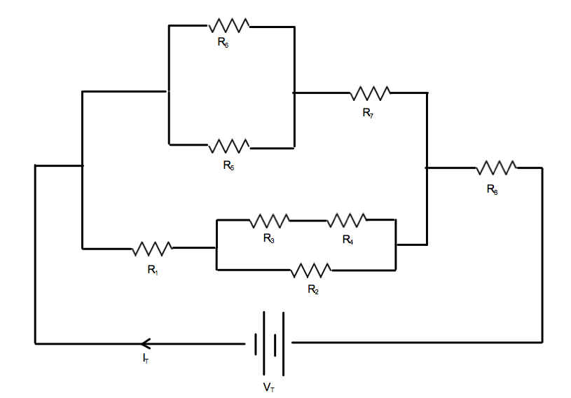
Question 5

Slide 17
Question 5
 | V(V) | I(A) | R(Ω)
1 | 5.0 | 2.52 | 2.0
2 | 8.6 | 1.71 | 5.0
3 | 3.2 | 0.81 | 4.0
4 | 5.3 | 0.81 | 6.5
5 | 6.1 | 2.03 | 3.0
6 | 6.1 | 3.05 | 2.0
7 | 7.6 | 5.04 | 1.5
8 | 26.4 | 7.55 | 3.5
 | V_{t}= 40 | I_{t}= 7.55 | R_{t} = 5.3

Slide 18
Quiz: Kirchhoff’s Laws
Please clear your whiteboards and prepare your group for Quiz 3

Slide 19
Notes: EMF and Terminal Voltage
Please take out your notes!
Last Page… must be a Unit Test coming up…
Next Class: Terminal Voltage Lab + Time to Review
2 Classes: Unit Quiz Electric Circuits
3 Classes: Review Day
4 Classes: Unit Test Electric Circuits

