Slide 1
Chem 11 – Class Starter
Please take out your phones/computers and open the app Socrative
If you are using a computer, navigate to m.socrative.com
Enter the Room Number: Slawson
If you do not have a phone or computer work with someone who does
Take the quiz on the Mole, have a piece of paper in front of you to make calculations where needed

Slide 2
Quiz!
Quiz: 1-Step Molar Conversions
Clear everything from your desks
Collect scrap paper and a Periodic Table from the front
Set up dividers to separate yourself from your neighbours!

Slide 3
challenging Mole Conversions.
Let’s work on some Work in groups of 2-3
Collect a whiteboard(s) and pens
Reflect on your contribution. Ask yourself, do I know how to do this?

Slide 4
Question 1
A student in Chem 11 wanted to determine how many molecules of water fit inside her water bottle. She weighed her empty water bottle (8.76 g) then proceeded to the water fountain and filled her bottle with water and then reweighed the bottle (248.42 g).
Determine how many molecules of water fit inside the students water bottle.
When the student wasn’t looking, Mr. Lawson secretly switched EACH Molecule of the water with a molecule of ethanol (C₂H₅OH). Will the full bottle weigh more or less after the switch?
How much more or less did it weigh in grams?

Slide 5
Question 1
A student in Chem 11 wanted to determine how many molecules of water fit inside her water bottle. She weighed her empty water bottle (8.76 g) then proceeded to the water fountain and filled her bottle with water and then reweighed the bottle (248.42 g).
Determine how many molecules of water fit inside the students water bottle. Ans: 8.01 x 10²⁴ molecules of H₂O
When the student wasn’t looking, Mr. Lawson secretly switched EACH Molecule of the water with a molecule of ethanol (C₂H₅OH). Will the full bottle weigh more or less after the switch?
How much more or less did it weigh in grams?

Slide 6
Question 1
A student in Chem 11 wanted to determine how many molecules of water fit inside her water bottle. She weighed her empty water bottle (8.76 g) then proceeded to the water fountain and filled her bottle with water and then reweighed the bottle (248.42 g).
Determine how many molecules of water fit inside the students water bottle. Ans: 8.01 x 10²⁴ molecules of H₂O
When the student wasn’t looking, Mr. Lawson secretly switched EACH Molecule of the water with a molecule of ethanol (C₂H₅OH). Will the full bottle weigh more or less after the switch? Ans: MORE (C₂H₅OH has a greater molar Mass)
How much more or less did it weigh in grams?

Slide 7
Question 1
A student in Chem 11 wanted to determine how many molecules of water fit inside her water bottle. She weighed her empty water bottle (8.76 g) then proceeded to the water fountain and filled her bottle with water and then reweighed the bottle (248.42 g).
Determine how many molecules of water fit inside the students water bottle. Ans: 8.01 x 10²⁴ molecules of H₂O
When the student wasn’t looking, Mr. Lawson secretly switched EACH Molecule of the water with a molecule of ethanol (C₂H₅OH). Will the full bottle weigh more or less after the switch? Ans: MORE (C₂H₅OH has a greater molar Mass)
How much more or less did it weigh in grams? Ans: 373 g more!

Slide 8
Question 2
Determine how many molecules there are in exactly 1.00 gallons of gasoline. Assume that the molecular formula for gasoline is C₆H₁₄ and that the density of gasoline is approximately 0.85 grams/mL.
3.78541 L = 1Gallons

Slide 9
Question 2
Determine how many molecules there are in exactly 1.00 gallons of gasoline. Assume that the molecular formula for gasoline is C₆H₁₄ and that the density of gasoline is approximately 0.85 grams/mL.
1 L = 3.78541 Gallons

Slide 10

Question 3
If Mr. Lawson weighs 75 kg’s and is 72% water, how many molecules of water does he have in his body?

Slide 11
Question 3
If Mr. Lawson weighs 75 kg’s and is 72% water, how many molecules of water does he have in his body?
Ans:1.8 x 10²⁷ molecules H₂O

Slide 12
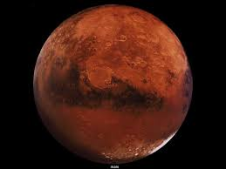
Question 4
Someone once told me that Mars is red because of rust, so like any great scientist I took their word on it. If Mars weighs 7.34767309 × 10²² kilograms, and is all rust (Iron (III) Hydroxide). How many individual atoms make up Mars?

Slide 13
Question 4
Someone once told me that Mars is red because of rust, so like any great scientist I took their word on it. If Mars weighs 7.34767309 × 10²² kilograms, and is all rust (Iron (III) Hydroxide). How many individual atoms make up Mars?
Atoms: 2.90 x 10⁴⁸ atoms

Slide 14
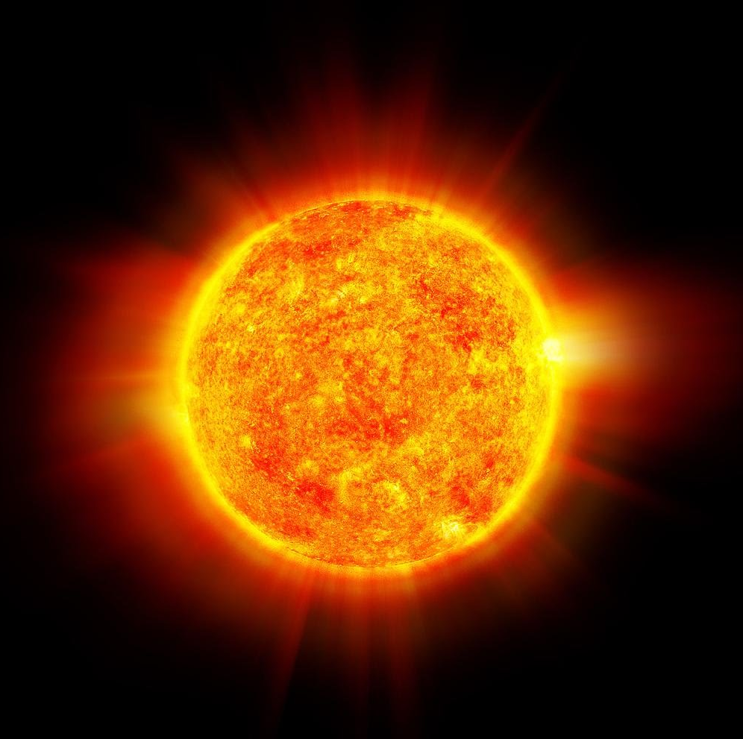
Question 5
The Volume of the Sun is 1.409 x 10¹⁸ km³. If we make the assumption the sun is at STP (it most DEFINITELY is not), and is made entirely of H atoms, how much does the sun weigh?
(1 cubic kilometer = 1 000 000 000 000 litres)

Slide 15
Question 5
The Volume of the Sun is 1.409 x 10¹⁸ km³. If we make the assumption the sun is at STP (it most DEFINITELY is not), and is made entirely of H atoms, how much does the sun weigh?
Ans: 6.35 x 10²⁸ g
Note: the actually mass is much more then this because of the density of the core.

Slide 16
Worksheet – Multi-Step Mole Conversion
Please download the worksheet from the front of the room
Note: These are CHALLENGING problems that test your understanding, not your ability to regurgitate!
Please see me if you need extra help!
Find the KEY online!

