Slide 1
Chem 11 – Class Starter
Please grab a whiteboard and work in groups of 3 to answer the following 4 Questions.
Remember, we are looking for active engaged participation
If you do not know the answer, visit another group, ask a friend or ask specific questions!

Slide 2
Whiteboarding Question #1
Using a diagram show, why water would have a higher boiling point then a similar molecule that is non-polar?

Slide 3
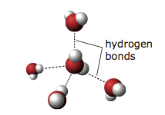
Q1: Answer

Slide 4
Whiteboarding Question #2
Why does NaCl dissolve in water? Think of a similarity between the 2 particles. Explain your answer with a diagram.

Slide 5
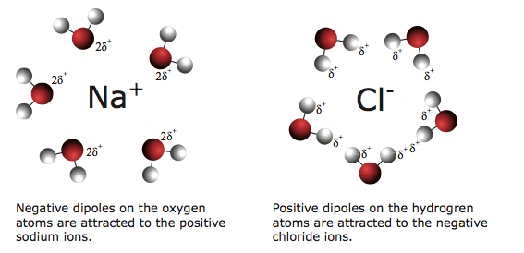
Q2: Answer

Slide 6
Whiteboarding Question #3
Would you expect NaCl to dissolve in hexane (C₆H₁₄), which is a non-polar solvent? Explain your answer with a diagram.

Slide 7
Q3: Answer
NaCl is ionic Hexane is non-polar covalent. They are not “like”.
General Rule: Like Solvents dissolve Like Solutes

Slide 8
Whiteboarding Question #4
Predict whether NaCl would dissolve in NH₃. Draw a diagram to show the forces acting within the solute, the solvent and the resulting mixture.

Slide 9

Q4: Answer

Slide 10
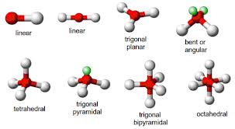
Molecular Shapes Time!

