Slide 1
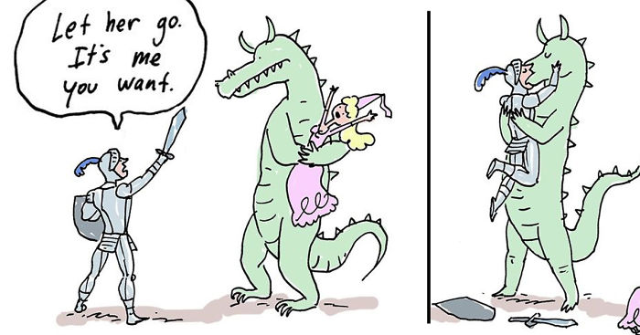
AP Questions!
Please work in groups of 2 or 3.
Grab a whiteboard ad pens!

Slide 2
Two equal and opposite charges are fixed to a grid at the locations shown. Four points in the vicinity of these charges are labeled A - D. Rank the electric potential at the labeled points. Explain your reasoning.

Slide 3
Two equal and opposite charges are fixed to a grid at the locations shown. Four points in the vicinity of these charges are labeled A - D. Rank the electric potential at the labeled points. Explain your reasoning.
B > A = C > D. The potential is zero at A and C because the two charges are the same distance from each of these points and one charge contributes a positive potential and the other a negative. B is the point with the largest potential since it is closest to the positive charge and D is the lowest potential since it is negative.

Slide 4
AP Physics 2 – Class Starter
Please submit your simulations by next class
Quiz 4: Electric Potential Energy + Electric Potential
Clear everything off your desk except a pencil and calculator
Set up dividers where necessary
I will hand out the formula sheets!
Finished…? Hand the quiz in at the front of the room

Slide 5
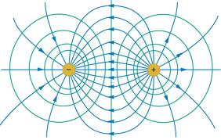
Notes – Equipotential Lines
Please take out your notes!

Slide 6
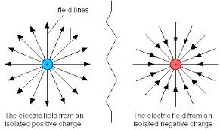
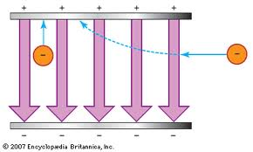
Notes: Uniform Electric Fields
Non - Uniform
Uniform

Slide 7
Please Complete Quiz 5 at home!
Next Class: Applications of Electrostatics

