Slide 1
Cycloalkanes & Aromatic Rings

Slide 2
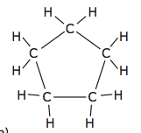
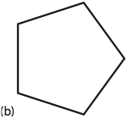
Cycloalkanes
Carbon atoms may bond to each other and form a cyclic structure
becomes

Slide 3
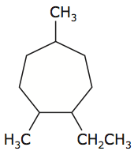
Naming Cycloalkanes
The ring that contains the greater number of carbon atoms is the parent chain.
The prefix “cyclo” is placed before the parent chain name.
Parent Chain = Cycloheptane

Slide 4
Naming Cycloalkanes
The carbon atoms are numbered either clockwise or counterclockwise.
The lowest numbers are used to identify the placement of the branches.
1-ethyl
2,5-dimethyl

Slide 5
Naming Cycloalkanes
Name the branches.
1-ethyl
2,5-dimethyl

Slide 6
Naming Cycloalkanes
Name the compound.
1-ethyl-2,5-dimethyl cycloheptane

Slide 7
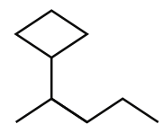
Naming Cycloalkanes
If the ring structure is not the longest continuous carbon chain, then it is named as a branch with prefix “cyclo” and ends in “yl.”
Parent: pentane
Branch: 2-cyclobutyl
Compound:
2-cyclobutylpentane

Slide 8
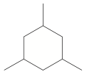
Naming Cycloalkanes
Parent Chain.
Number the parent chain.
Name the branches.
Name the compound
1,3,5-trimethylcyclohexane

Slide 9
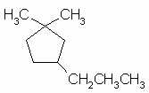
Naming Cycloalkanes
Parent Chain.
Number the parent chain.
Name the branches.
Name the compound
1,1-dimethyl-3-propylcyclopentane

Slide 10
Naming Cycloalkanes
Parent Chain.
Number the parent chain.
Name the branches.
Name the compound
2-cyclopropylpentane

Slide 11
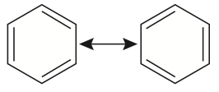
Aromatic Hydrocarbons
Benzene is a hydrocarbon with six carbon atoms in a ring.
It has the molecular formula C₆H₆

Slide 12
Aromatic Hydrocarbons
There is more than one way of drawing its Lewis structure.
Equivalent Lewis structures are called resonance structures.

Slide 13
Aromatic Hydrocarbons
Can also be drawn as:

Slide 14
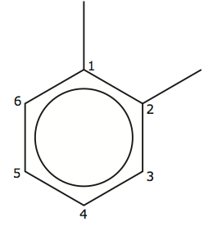
1,2-dimethylbenzene

Slide 15
Naming Aromatic Hydrocarbons
Some organic compounds have benzene as a branch.
In this case, the branch name is “phenyl”

Slide 16
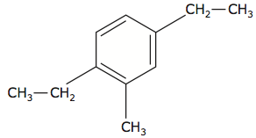
Naming Aromatic Hydrocarbons
Parent Chain.
Number parent chain.
Name the branches.
Name the compound
1,4-diethyl-2-methylbenzene

Slide 17
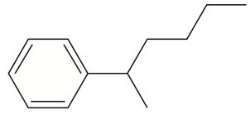
Naming Aromatic Hydrocarbons
Parent Chain.
Number parent chain.
Name the branches.
Name the compound
2-phenylhexane

Slide 18
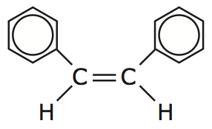
Naming Aromatic Hydrocarbons
Parent Chain.
Number parent chain.
Name the branches.
Name the compound
1,2-diphenyl-1-ethene

