Slide 1
Chem 11 – Class Starter
Collect and work through the Mole-to-Mole class starter from the front of the room
For question 3 change replace with produce!

Slide 2
Mass to Mass Conversions
In a moment I will put you in a group of 3-4
Collect a whiteboard and pens and take out both a periodic table and your mole conversion handout

Slide 3
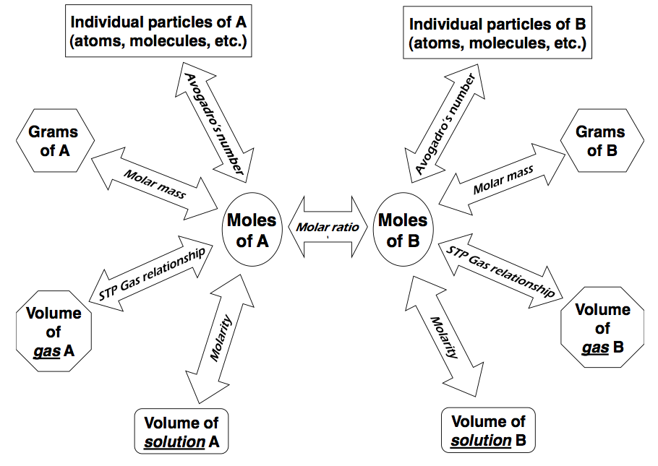
Gram A to Gram B
STOICHIOMETRY: The MATH behind CHEMISTRY
The mole bridge is the ONLY place you can cross
Last class we learned to move over the “mole bridge”

Slide 4
Let’s try something a little more difficult…
Note: if you are struggling please read p. 123-128 of Hebden and come in for extra help!
Please do so before we get too deep!

Slide 5
Predict the products and balance the following equation:
V₂O₅ →

Slide 6
Predict the products and balance the following equation:
2V₂O₅ → 4V + 5O₂

Slide 7
2V₂O₅ → 4V + 5O₂
If 5.78g of V₂O₅ decomposes, how many grams of Vanadium are produced?
How many grams of Oxygen are produced?
Notes:
V₂O₅ = 181.88 g/mol
V = 50.94 g/mol
O₂ = 32.00 g/mol
3.24 g
2.54 g

Slide 8
Gram A to Gram B
STOICHIOMETRY: The MATH behind CHEMISTRY

Slide 9
Predict the products and balance the following equation:
Lead (II) metal reacts with Iron(III) Sulphate.

Slide 10
Predict the products and balance the following equation:
Lead (II) metal reacts with Iron(III) Sulphate.
3Pb + Fe₂(SO₄)₃ → 3PbSO₄ + 2Fe

Slide 11
3Pb + Fe₂(SO₄)₃ → 3PbSO₄ + 2Fe
If 6.91g of Fe is produced, how many grams of Pb reacted?
If 1.12g of Fe₂(SO₄)₃ reacts, how many moles of PbSO₄ are produced?
Notes:
Pb = 207.21 g/mol
Fe = 55.85 g/mol
PbSO₄ = 303.27 g/mol
Fe₂(SO₄)₃ = 399.88 g/mol

Slide 12
Predict the products and balance the following thermonuclear equation:
Propane (C₃H₈) is used in BBQ’s to cook-yo-steak! For every mole of propane combusted, 2202 kJ of energy are released to the surroundings.

Slide 13
C₃H₈ +5 O₂ → 3CO₂ + 4H₂O + 2202 kJ
If 13.3 g of propane react, how many grams of carbon dioxide are produced?
If the BBQ is left on and the lid is closed (sealing the chamber) leaving only 123.2 g of oxygen. By the time the oxygen runs out how much water (by mass) is produced?
If 255.3 g of propane react, how much energy was released to cook-yo-steak!?
Notes:
C₃H₈ = 44.11 g/mol
O₂ = 32.00 g/mol
CO₂ = 44.01 g/mol
H₂O = 18.02 g/mol

