Slide 1
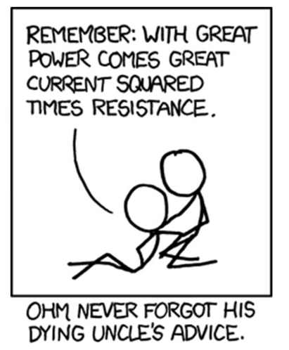
AP Phys 2 – Class Starter
Please collect a Whiteboard and Answer the following Conceptual Q’s!

Slide 2
Class Starter Questions
If there is an electric (conventional) current from Object A to Object B what can we say about the relative magnitudes of the potentials of the two objects?
A current-carrying wire is electrically charged. (True/False)
If a current of 0.1 or 0.2 Amps flows into one of your hands and out the other, you will probably be electrocuted. But if the same current flows into your hand and out the elbow above the same hand you can survive (despite the burning of flesh). Explain why.
Are automobile headlights wired in parallel or in series?
If electrons flow very slowly through a circuit, why does it not take noticeably longer for a lamp to flow when turned on by a distant switch?

Slide 3
Class Starter Questions
If there is an electric (conventional) current from Object A to Object B what can we say about the relative magnitudes of the potentials of the two objects? Object A has a higher potential
A current-carrying wire is electrically charged. (True/False)
If a current of 0.1 or 0.2 Amps flows into one of your hands and out the other, you will probably be electrocuted. But if the same current flows into your hand and out the elbow above the same hand you can survive (despite the burning of flesh). Explain why.
Are automobile headlights wired in parallel or in series?
If electrons flow very slowly through a circuit, why does it not take noticeably longer for a lamp to flow when turned on by a distant switch?

Slide 4
Class Starter Questions
If there is an electric (conventional) current from Object A to Object B what can we say about the relative magnitudes of the potentials of the two objects? Object A has a higher potential (voltage)
A current-carrying wire is electrically charged. (True/False) False! Protons are present
If a current of 0.1 or 0.2 Amps flows into one of your hands and out the other, you will probably be electrocuted. But if the same current flows into your hand and out the elbow above the same hand you can survive (despite the burning of flesh). Explain why.
Are automobile headlights wired in parallel or in series?
If electrons flow very slowly through a circuit, why does it not take noticeably longer for a lamp to flow when turned on by a distant switch?

Slide 5
Class Starter Questions
If there is an electric (conventional) current from Object A to Object B what can we say about the relative magnitudes of the potentials of the two objects? Object A has a higher potential (voltage)
A current-carrying wire is electrically charged. (True/False) False! Protons are present
If a current of 0.1 or 0.2 Amps flows into one of your hands and out the other, you will probably be electrocuted. But if the same current flows into your hand and out the elbow above the same hand you can survive (despite the burning of flesh). Explain why. Does not enter your heart.
Are automobile headlights wired in parallel or in series?
If electrons flow very slowly through a circuit, why does it not take noticeably longer for a lamp to flow when turned on by a distant switch?

Slide 6
Class Starter Questions
If there is an electric (conventional) current from Object A to Object B what can we say about the relative magnitudes of the potentials of the two objects? Object A has a higher potential (voltage)
A current-carrying wire is electrically charged. (True/False) False! Protons are present
If a current of 0.1 or 0.2 Amps flows into one of your hands and out the other, you will probably be electrocuted. But if the same current flows into your hand and out the elbow above the same hand you can survive (despite the burning of flesh). Explain why. Does not enter your heart.
Are automobile headlights wired in parallel or in series? Parallel! One head light…
If electrons flow very slowly through a circuit, why does it not take noticeably longer for a lamp to flow when turned on by a distant switch?

Slide 7
Class Starter Questions
If there is an electric (conventional) current from Object A to Object B what can we say about the relative magnitudes of the potentials of the two objects? Object A has a higher potential(voltage)
A current-carrying wire is electrically charged. (True/False) False! Protons are present
If a current of 0.1 or 0.2 Amps flows into one of your hands and out the other, you will probably be electrocuted. But if the same current flows into your hand and out the elbow above the same hand you can survive (despite the burning of flesh). Explain why. Does not enter your heart.
Are automobile headlights wired in parallel or in series? Parallel! One head light…
If electrons flow very slowly through a circuit, why does it not take noticeably longer for a lamp to flow when turned on by a distant switch? The energy is transferred along the electrons like a wave

Slide 8
Question
Because the temperature is always above absolute zero (-273.15 ºC) electrons are always moving. They are roughly 1800 times less massive than a hydrogen atom, and hydrogen atoms are moving randomly at about 1800 m/s, so electrons are moving randomly at 75,000 m/s. In a typical household current in a typical wire, how fast are electrons drifting through a wire?
At the speed of light.
As fast as a supersonic jet.
As fast as a racecar.
As fast as a person walks.
As fast as a snail crawls.

Slide 9
Answer
Because the temperature is always above absolute zero (-273.15 ºC) electrons are always moving. They are roughly 1800 times less massive than a hydrogen atom, and hydrogen atoms are moving randomly at about 1800 m/s, so electrons are moving randomly at 75,000 m/s. In a typical household current in a typical wire, how fast are electrons drifting through a wire?
At the speed of light.
As fast as a supersonic jet.
As fast as a racecar.
As fast as a person walks.
As fast as a snail crawls.

Slide 10
Answer
We are interested only in the drift velocity, or the net motion in one direction. Electrons oscillate back and forth much like air molecules. Using this analogy the drift velocity is like wind speed.
At the speed of light.
As fast as a supersonic jet.
As fast as a racecar.
As fast as a person walks.
As fast as a snail crawl.

Slide 11
Notes!
Let’s finish off the notes we started last class!

Slide 12
Circuit Q’s!
Grab another Whiteboard!

Slide 13
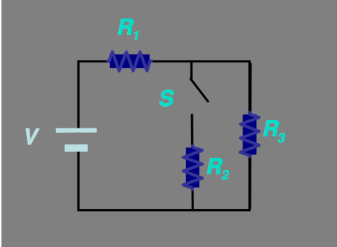
Question
What happens to the voltage across resistor R1 when the switch is closed?
A) It decreases
B) It increases
C) It stays the same
What happens to the current flowing through R3?
A) It decreases
B) It increases
C) It stays the same

Slide 14
Answer
What happens to the voltage across resistor R1 when the switch is closed?
A) It decreases
B) It increases
C) It stays the same
What happens to the current flowing through R3?
A) It decreases
B) It increases
C) It stays the same

Slide 15
Answer
What happens to the voltage across resistor R1 when the switch is closed?
A) It decreases
B) It increases
C) It stays the same
What happens to the current flowing through R3?
A) It decreases
B) It increases
C) It stays the same

Slide 16
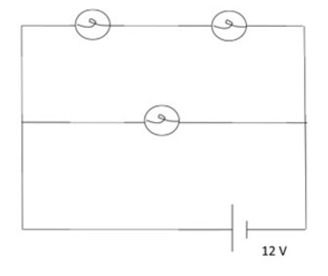
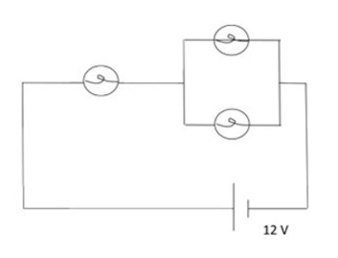
Question: What will be the relative order of brightness of the bulbs in each of these circuits?

Slide 17
Question: What will be the relative order of brightness of the bulbs in each of these circuits?
2.
2.
1.

Slide 18
Question: What will be the relative order of brightness of the bulbs in each of these circuits?
2.
2.
2.
1.
1.
2.

Slide 19
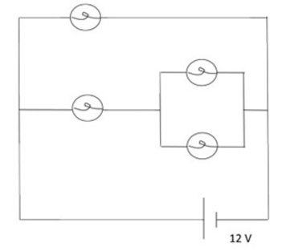
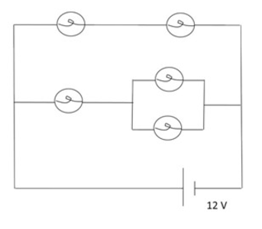
Question: What will be the relative order of brightness of the bulbs in each of these circuits?

Slide 20
Question: What will be the relative order of brightness of the bulbs in each of these circuits?
1.
3.
2.
3.

Slide 21
Question: What will be the relative order of brightness of the bulbs in each of these circuits?
1.
2.
2.
3.
4.
2.
1.
3.
4.

Slide 22
Next Class: Electricity Lab
Groups of 2
Google Classroom Code: ycl5vf

