Slide 1
Science 10 – Class Starter
Please hand in your Review Quiz’s we marked last class at the front of class
Pick up your notebook from the front of the class (if you never brought one in come see me)
On the first page, record the date and title: Atomic Structure

Slide 2
Science 10 – Class Starter
Please also have out on your desk your completed Bohr Diagram Worksheets an your Covered Textbooks for me to check
Answer the questions of the following slides…

Slide 3
Sci 10 – Class Starter
1.
 | Element | Atomic Number | Number of Protons | Number of Neutrons | Number of Electrons
a. | Pb | 82
b. |  |  | 8
c. |  |  |  |  | 30
d. | Fe
e. |  | 47
f. |  |  |  |  | 17

Slide 4
Sci 10 – Class Starter
Explain how an atom is composed of charged particles yet can have an overall charge of zero.
A bucket full of water has both mass and volume. Referring to the subatomic particles, explain which of the subatomic particles accounts for most of the:
mass of the water
volume of the water

Slide 5
Sci 10 – Class Starter
1.
 | Element | Atomic Number | Number of Protons | Number of Neutrons | Number of Electrons
a. | Pb | 82 | 82 | 125 | 82
b. | O | 8 | 8 | 8 | 8
c. | Zn | 30 | 30 | 35 | 30
d. | Fe | 26 | 26 | 30 | 26
e. | Ag | 47 | 47 | 61 | 47
f. | Cl | 17 | 17 | 18/19 | 17
Notes:
Notice Colum 3/4/6 are all the same!
Highlight Chlorine!

Slide 6
Sci 10 – Class Starter
Explain how an atom is composed of charged particles yet can have an overall charge of zero.
Positive charges (Protons) = Negative Charges (Electrons)
A bucket full of water has both mass and volume. Referring to the subatomic particles, explain which of the subatomic particles accounts for most of the:
mass of the water – Protons + Neutons
volume of the water – Electrons

Slide 7
Bohr Diagrams and the Periodic Table
Take out your completed Bohr Diagram Assignments
With your neighbour, discuss the connection between the Valence Electron Configuration of an atom and the layout of the Periodic Table

Slide 8
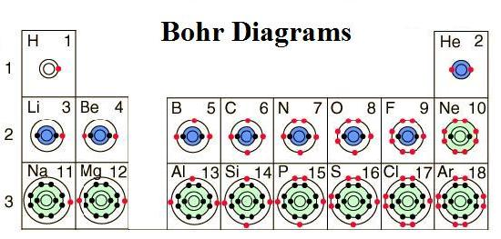
Each Family has the SAME # of Valence Electrons

Slide 9
SHONE
The History of the Periodic Table

Slide 10
Organization of the Periodic Table
Many levels of organization! (Reads like a WESTERN Book)
Increasing Atomic Number (increasing Protons)
Increasing (mostly) Atomic Mass
Metals vs. Non-Metals
Rows/Periods – Left to Right (Same Shell)
Groups/Periods – Up to Down (Same number of electrons in outer shell)

Slide 11
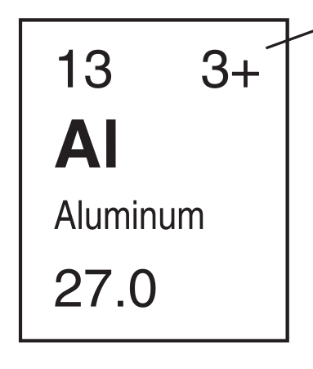
Each Element

Slide 12
Homework
Online Form: this year you will be handing in homework online on my website (similar to the survey you completed)
http://mrlawsonscience.weebly.com/unit-1-chemistry.html
Review Questions (Optional): Chapter 6 Review p. 166 #’s – 3,6-10,12,13,14

Slide 13
Next Class:
Checkpoint for Chapter 6
Intro to Ionic and Covalent Bonds

