Slide 1
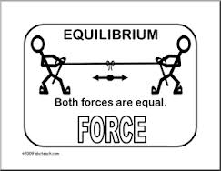
Physics 12
Before the quiz, let’s practice what we know in groups!
Working in groups no bigger than 4, collect a whiteboard and pens
Answer the following questions showing ALL work

Slide 2
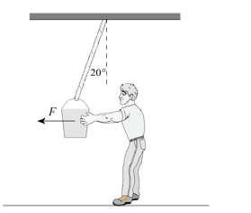
Question 1
Mr. Dickinson exerts a horizontal force F on a 12 kg bucket of concrete so that the supporting rope makes an angle of 20⁰ with the vertical. Find the tension force in the supporting rope.

Slide 3
Question 1
Mr. Dickinson exerts a horizontal force F on a 12 kg bucket of concrete so that the supporting rope makes an angle of 20⁰ with the vertical. Find the tension force in the supporting rope.
Ans: 1.3 x 10² N

Slide 4
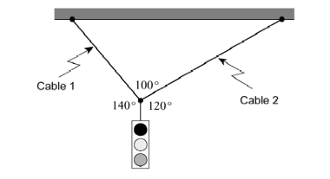
Question 2
A 35 kg traffic light is suspended from two cables as shown in the diagram. What is the tension in each of the cables?

Slide 5
Question 2
A 35 kg traffic light is suspended from two cables as shown in the diagram. What is the tension in each of the cables?
Ans: T₁ = 302 N T₂ = 224 N

Slide 6
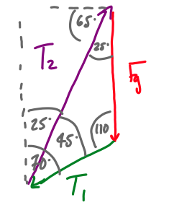
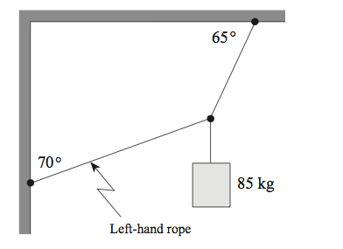
Question 3
A 85 kg mass is connected to two ropes. The system is at equilibrium.
Create a closed vector diagram for the system
Find the tension in both ropes.

Slide 7
Question 3
A 85 kg mass is connected to two ropes. The system is at equilibrium.
Create a closed vector diagram for the system
Find the tension in both ropes.
T₁ = 5.00 x 10³ N ; T₂ = 1.1 x 10³ N

Slide 8
Quiz 1
Please put away the whiteboards and pens
Set up dividers
Take out a piece of paper, a ruler and calculator
Wait quietly for the quiz

Slide 9
Finished?
Hand in your Quizzes/Formula Quizzes at the front of the room
Collect the Student Log for Unit 3
Take out your notes and review Part 2 of the Equilibrium Unit

