Slide 1
Bonding & Naming

Slide 2
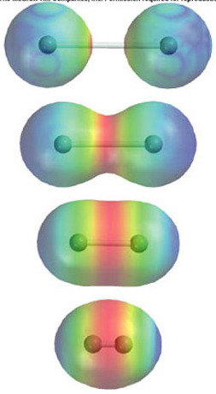
Bonding
Relationship between electrons
Only valence electrons interact

Slide 3
Ionic Bonding
Electron giving and taking
Between metals and non-metals
(ie. Between atoms on the extreme left side and extreme right side of the periodic table)
Na → (to achieve noble gas stability) becomes Na⁺
Cl → (to achieve noble gas stability) becomes Cl⁻

Slide 4
Covalent Bonding
Electron sharing
Between non-metals
Electrons are shared so that each atom reaches noble gas stability
Example 1: H₂O
Example 2: NH₃

Slide 5
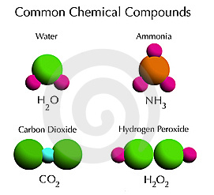
What is a COMPOUND?
A substance composed of two or more elements that have been chemically united.

Slide 6
What is a CHEMICAL FORMULA?
A way of expressing the atoms that make up a chemical compound
Always neutral

Slide 7
What is a CHEMICAL FORMULA?
Example 1: H₂O
The subscript “2” means that there are 2 hydrogen atoms
Oxygen does not have a subscript – there is 1 oxygen atom
Example 2: CH₄
How many carbon atoms are there?
How many hydrogen atoms are there?

Slide 8
What is a CHEMICAL FORMULA?
Example 3: NH₄Cl
List the atoms that are in the compound.
How many of each atom are there?
Example 4: (NH₄)₃PO₄
List the atoms that are in the compound.
The “3” means that there are 3 x NH₄
How many of each atom are there?

Slide 9
Naming Simple Ionic Compounds
Example 1: NaCl
Identify the positive ion and the negative ion
Na⁺ – positive ion
Cl⁻ – negative ion
What is the name of the positive ion?
Na⁺ - sodium
What is the name of the negative ion? – change the ending to “ide”
Cl⁻ - chlorine → chloride

Slide 10
Naming Simple Ionic Compounds
Example 2: MgBr₂ (when naming, ignore the subscript “2”)
Identify the positive ion and the negative ion
Mg²⁺ – positive ion
Br⁻ – negative ion
What is the name of the positive ion?
Mg²⁺ – magnesium
What is the name of the negative ion? – change the ending to “ide”
Br⁻ - bromine → bromide

Slide 11
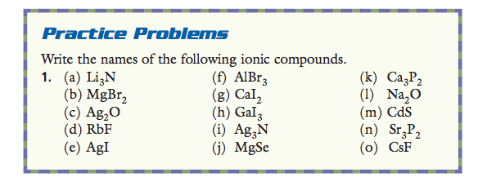
Practice Problems

Slide 12
Formulas of Simple Ionic Compounds
Example 1: Barium chloride
This is where we have to take note of the charges of each ion
When we write our formula, we do not include the charges
What is the charge of barium?
2+
What is the charge of chlorine?
1-
To write the formula, we must balance the charges.

Slide 13
Formulas of Simple Ionic Compounds
To write the formula, we must balance the charges.
Positive | Negative
Ba²⁺ | Cl⁻

Slide 14
Formulas of Simple Ionic Compounds
To write the formula, we must balance the charges.
Positive | Negative
Ba²⁺ | Cl⁻ Cl⁻

Slide 15
Formulas of Simple Ionic Compounds
To write the formula, we must balance the charges.
Positive | Negative
Ba²⁺ | Cl⁻ Cl⁻
Overall: 2+ | Overall: 2-

Slide 16
Formulas of Simple Ionic Compounds
To write the formula, we must balance the charges.
Positive | Negative
Ba²⁺ | Cl⁻ Cl⁻
Overall: 2+ | Overall: 2-
BaCl₂

Slide 17
Formulas of Simple Ionic Compounds
Example 2: Magnesium oxide
What is the charge of magnesium?
2+
What is the charge of oxygen?
2-
To write the formula, we must balance the charges.
Positive | Negative
Mg²⁺ | O²⁻

Slide 18
Formulas of Simple Ionic Compounds
Example 2: Magnesium oxide
What is the charge of magnesium?
2+
What is the charge of oxygen?
2-
To write the formula, we must balance the charges.
Positive | Negative
Mg²⁺ | O²⁻
Overall: 2+ | Overall: 2-

Slide 19
Formulas of Simple Ionic Compounds
Example 2: Magnesium oxide
What is the charge of magnesium?
2+
What is the charge of oxygen?
2-
To write the formula, we must balance the charges.
Positive | Negative
Mg²⁺ | O²⁻
Overall: 2+ | Overall: 2-
MgO

Slide 20
Formulas of Simple Ionic Compounds
Example 3: Strontium phosphide
What is the charge of strontium?
2+
What is the charge of phosphorus?
3-
To write the formula, we must balance the charges.
Positive | Negative
Sr²⁺ | P³⁻
Overall: | Overall:

Slide 21
Formulas of Simple Ionic Compounds
Example 3: Strontium phosphide
What is the charge of strontium?
2+
What is the charge of phosphorus?
3-
To write the formula, we must balance the charges.
Positive | Negative
Sr²⁺ Sr²⁺ Sr²⁺ | P³⁻ P³⁻
Overall: 6+ | Overall: 6-

Slide 22
Formulas of Simple Ionic Compounds
Example 3: Strontium phosphide
What is the charge of strontium?
2+
What is the charge of phosphorus?
3-
To write the formula, we must balance the charges.
Positive | Negative
Sr²⁺ Sr²⁺ Sr²⁺ | P³⁻ P³⁻
Overall: 6+ | Overall: 6-
Sr₃P₂

Slide 23
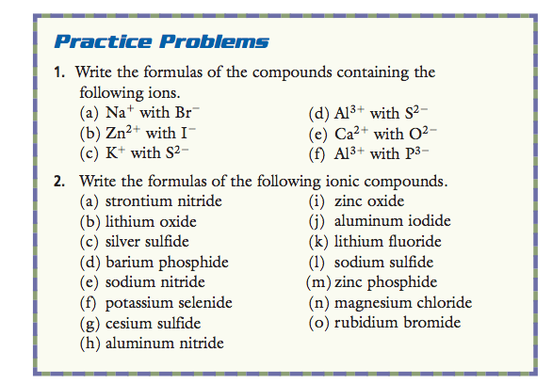
Practice Problems

