Slide 1
Class Starter – Science 10
Please hand in your Biome Projects Part B at the front of the room
Socratice Review:
Take out your computers/phones/iPads and either open the socrative app or go to the website m.socrative.com
Room Number: slawson
If you do NOT have an electronic device work with a neighbour who does
Complete the review quiz

Slide 2
Review Assignment
Textbook Review: Unit A p. 142 #’s 1-9, 11-18, 22, 23, 25, 26, 27, 29, 30, 36, 39, 40
With about 20 minutes left in class we will review as a class
Please work quietly and individually
If you have any questions please come to the front and ask

Slide 3
Class Questions:
Grab a whiteboard, brainstorm how you would answer the following questions with 1 or 2 other classmates (max groups of 4!)

Slide 4
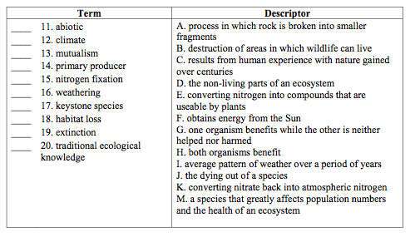
Question 1: Match these terms with their description!

Slide 5
Question 1: Match these terms with their description! Answers
^{11. D}
^{12. I}
^{13. H}
^{14. F}
^{15. E}
^{16. A}
^{17. M}
^{18. B}
^{19. J}
^{20. C}

Slide 6
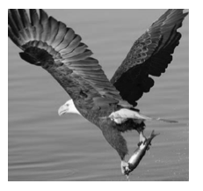
Question 2
Many eagles contain chemicals called PCBs in their fatty tissues. PCBs are poisonous substances that were used in North America until they were banned in 1977. Today, many years later, small amounts of PCBs are still present in the waters off of the west coast of British Columbia.
Explain how the process of biomagnification results in dangerous amounts of PCBs in eagles today.

Slide 7
Question 2 - Answer
Dilute concentrations of PCBs in the ocean are stored in plants, which are eaten by fish, which are preyed upon by salmon, which are eaten by eagles. At each trophic level the PCBs become more concentrated.

Slide 8
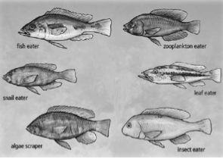
Question 3
The different species evolved to their present form through a process called adaptive radiation. Use names of the different types of fish in the diagram to explain the meaning of adaptive radiation.

Slide 9
Question 3
The common ancestor of these fish may have eaten several kinds of foods. Through natural selection, certain fish became more successful at eating different kinds of food, such as snails or leaves. Each began to fill a different niche. This leads to the eventual evolution of distinct species.

Slide 10
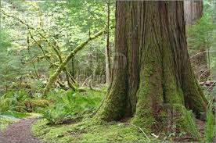
Question 4
In the deciduous rainforests of British Columbia, cedar trees become covered by moss. The moss is protected by the tree it grows on. The moss is able to collect rainwater running down the tree’s trunk. The cedar tree is not affected by the moss.
What term describes the relationship between the tree and the moss?
Explain the relationship between the cedar trees and the moss.

Slide 11
Question 4 Answer
In the deciduous rainforests of British Columbia, cedar trees become covered by moss. The moss is protected by the tree it grows on. The moss is able to collect rainwater running down the tree’s trunk. The cedar tree is not affected by the moss.
Commensalism
The moss benefits from the cedar trees and the cedar trees are neither harmed, nor do they benefit from the moss.

