Slide 1
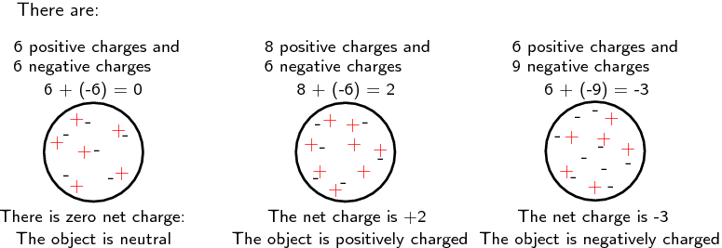
AP Physics 2 – Class Starter
What is the Charge on the following Spheres?

Slide 2
What is the Charge on the following Spheres?

Slide 3
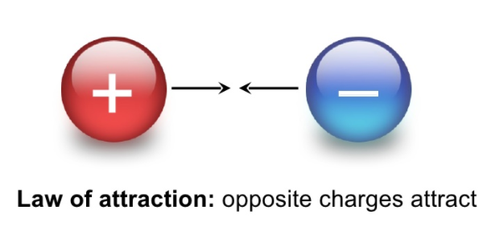
Attraction

Slide 4
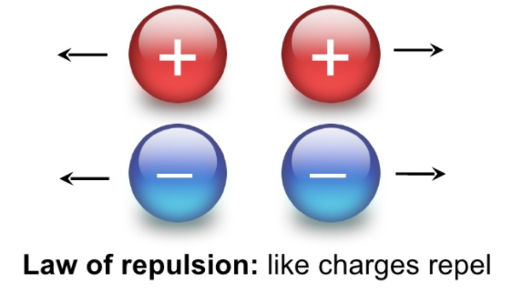
Repulsion

Slide 5
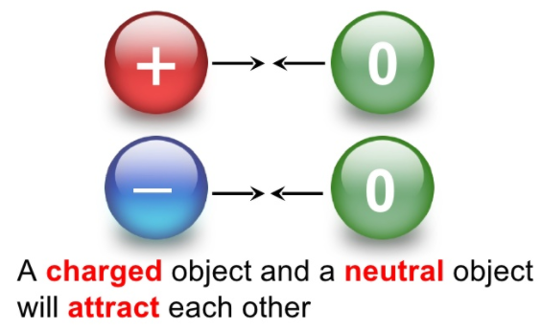
???? WHY ????

Slide 6
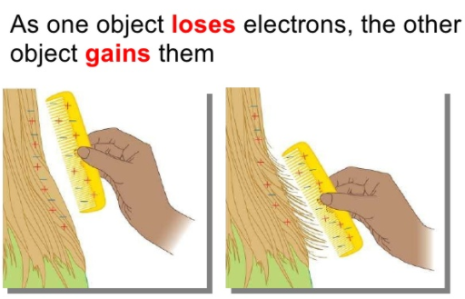
So… How does an Object become charged?

Slide 7
It’s important to note… new electrons are not being created… just rearranged

Slide 8

Two identical conducting spheres are shown with an initial given number of units of charge. The two spheres are brought into contact with each other. After several moments the spheres are separated.
Rank the charge on the left sphere from the highest positive charge to the lowest negative charge after they have been separated. (Note that -6 is lower than -2).
Explain your reasoning.

Slide 9
Two identical conducting spheres are shown with an initial given number of units of charge. The two spheres are brought into contact with each other. After several moments the spheres are separated.
Rank the charge on the left sphere from the highest positive charge to the lowest negative charge after they have been separated. (Note that -6 is lower than -2).
Explain your reasoning.
Answer: A > D > B > C. When the two spheres are brought together the charges will redistribute equally between the two spheres since the spheres are conductors and they are the same size. When each pair of spheres is separated each of the two spheres will have half of the total charge, so the ranking goes from highest positive charge total to most negative charge total.

Slide 10
Two pairs of charged, isolated, conducting spheres are connected with wires and switches. The spheres are very far apart. The larger spheres (A and B) are identical and the smaller spheres (C and D) are identical. Before the switches are closed, both spheres on the left have a charge of +20 nC and both spheres on the right have a charge of +70 nC.
Rank the electric charge of the spheres after the switches are closed.
Explain your reasoning.

Slide 11
Two pairs of charged, isolated, conducting spheres are connected with wires and switches. The spheres are very far apart. The larger spheres (A and B) are identical and the smaller spheres (C and D) are identical. Before the switches are closed, both spheres on the left have a charge of +20 nC and both spheres on the right have a charge of +70 nC.
Rank the electric charge of the spheres after the switches are closed.
Explain your reasoning.
Answer: A = B = C = D. The charges will move until the potential of each sphere is the same. Since the spheres that are connected have the same size, they share the charge equally. Each sphere will have a final charge of +45 nC.

Slide 12
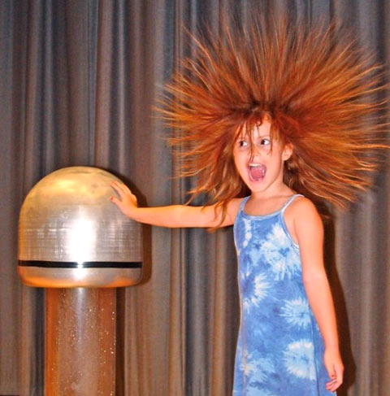
AP Physics 2
Who’s charged up for the
Electrostatic/RC Circuits Unit?
Collect the handout from the front of the room. Read through the handout and answer the questions on the back. Note: This is technically a repeat lesson from last year!

Slide 13
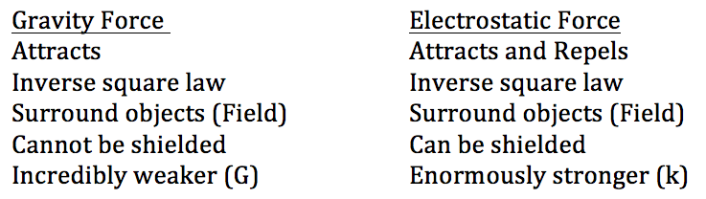
Gravity vs. Electromagnetic Force: Gravity fields and electric fields are both similar and different at the same time. Here is a handy little table to organize things:

Slide 14
Finishing up Physics 12
Unit 1: Electrostatics – relating to stationary electric charges or fields as opposed to electric currents (static) + RC (Resistor Capacitor Circuits
Unit 2: Electromagnetism - the interaction of electric currents (moving electric charges) or fields and magnetic fields

Slide 15
Finished…?
I will post the answers in a few minutes
While at the front, collect the note package and complete Section 1: Charges and Coulomb’s Law
Let’s go over the first page of the notes together!
Note: If you didn’t get a chance you should take the time to review the intro to static electricity handout you received at the end of the unit test

Slide 16
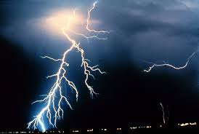
Worksheet – Coulomb’s Law + Electric Fields on a Single Charge
Download and complete worksheet 1.1/1.2 from the course website
Note you need to complete Quiz 1 at home. Collect a student log before you leave today!

