Slide 1
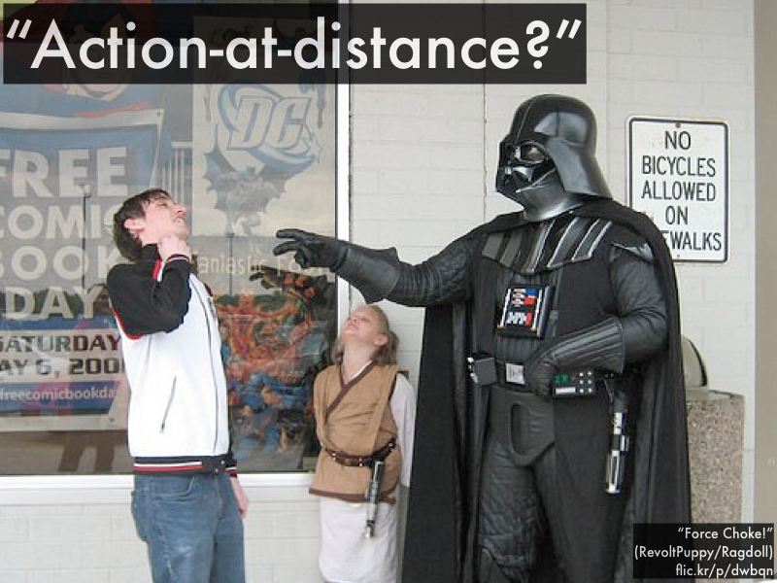
AP Phys 2 – Class Starter (Force Fields)
Collect a whiteboard and answer the following questions!

Slide 2
Q1
A positive point charge is placed a distance d away from a neutral solid metal sphere.
A student makes the following statement about the electric force between the neutral metal sphere and the point charge:
“There is an attraction between the point charge and the sphere. Since the sphere is a conductor, the external positive point charge pulls electrons in the sphere toward it. This leaves positive charges evenly distributed throughout the sphere, since the sphere is still neutral. The force between the point charge and the sphere is just the attraction between the negative charges on the left end of the sphere and the point charge.”
There is at least one problem with this student’s contention. Identify any problem(s) and explain how to correct it/them.

Slide 3
Q1 - ANSWER
“There is an attraction between the point charge and the sphere. Since the sphere is a conductor, the external positive point charge pulls electrons in the sphere toward it. This leaves positive charges evenly distributed throughout the sphere, since the sphere is still neutral. The force between the point charge and the sphere is just the attraction between the negative charges on the left end of the sphere and the point charge.”
There is at least one problem with this student’s contention. Identify any problem(s) and explain how to correct it/them.
The induced positive charge on the sphere cannot be ignored since it repels the positive point charge, but has less effect than the negative charge because it is at, on average, a greater distance.

Slide 4
Q2
Two negatively charged particles labeled A and B are separated by a distance x. The particles have different charges and masses as shown.
Three students are discussing what will happen just after the particles are released.
Antonio: “The magnitude of the force that A exerts on B will be the same as the magnitude of the force that B exerts on A. Since A has less mass, it will have a larger acceleration.”
Brenda: “The magnitude of the force on A by B is greater than the magnitude of the force on B by A since B has more mass. So A will have the largest acceleration.”
Cho: “A has more charge but it has less mass. The larger mass of B is exactly compensated for by the larger charge of A. The acceleration of both will be the same.”
With which of these students do you agree?
Antonio_____ Brenda_____ Cho_____ None of them_____
Explain your reasoning.

Slide 5
Q2
Two negatively charged particles labeled A and B are separated by a distance x. The particles have different charges and masses as shown.
Three students are discussing what will happen just after the particles are released.
Antonio: “The magnitude of the force that A exerts on B will be the same as the magnitude of the force that B exerts on A. Since A has less mass, it will have a larger acceleration.”
Brenda: “The magnitude of the force on A by B is greater than the magnitude of the force on B by A since B has more mass. So A will have the largest acceleration.”
Cho: “A has more charge but it has less mass. The larger mass of B is exactly compensated for by the larger charge of A. The acceleration of both will be the same.”
Answer: Antonio is correct. We know the forces have the same magnitude either through Coulomb’s Law or Newton’s Third Law and then Newton’s Second law tells us that the particles have different accelerations because of the different masses.

Slide 6
Notes – Electric Field on a Single Charge

