Slide 1
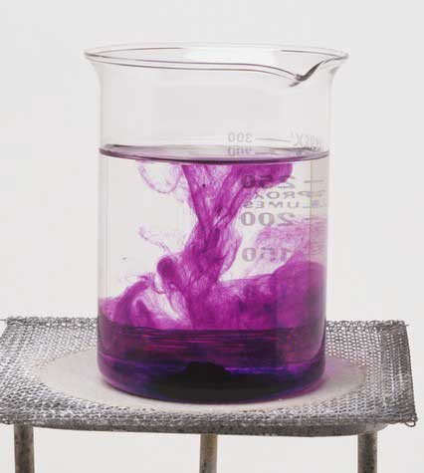
UNIT 6
Solution Chemistry

Slide 2
SOLUTIONS AND SOLUBILITY
Definitions:
Solution:
Solvent:
Solute:
Notes:
Ask students for the definitions

Slide 3
SOLUTIONS AND SOLUBILITY
Saturated:
Unsaturated:
Solubility:
Notes:
Ask students for the definitions

Slide 4
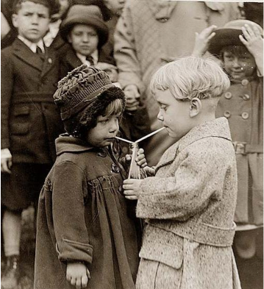
Bonding Reminder – Two Extremes
Covalent - “Sharing”
Ionic – “Not-Sharing”
Most Bonds fall somewhere in-between…

Slide 5
MOLECULAR POLARITY
Van der Waals Forces:
THREE main types:
DIPOLE-DIPOLE FORCES
LONDON FORCES
HYDROGEN BONDING

Slide 6
MOLECULAR POLARITY
A. DIPOLE-DIPOLE FORCES
Dipole:
δ⁺ Cl—F δ⁻
*a permanent dipole results from atoms with different ELECTRONEGATIVITY!
Dipole-Dipole Forces:

Slide 7
MOLECULAR POLARITY
Dipole-Dipole Force
Melting/Boiling Point
Dipole-dipole forces will result in higher melting and boiling points because more energy will be required to overcome the attractions between the molecules.

Slide 8
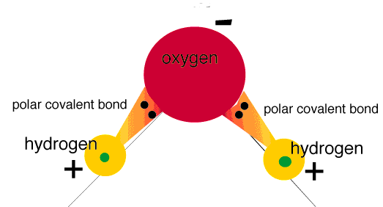
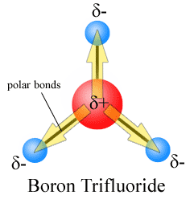
MOLECULAR POLARITY
Polar: Difference in Charge Distribution
Polarity difference with molecule
Asymmetrical
Nonpolar: Either no difference, or difference cancels our
One of the following does NOT hold
Polarity difference with molecule
Asymmetrical

Slide 9
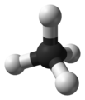
MOLECULAR POLARITY
Ex: Which of the following are expected to be polar and which are expected to be nonpolar??
nonpolar = symmetrical polar = asymmetrical
(if one end of the molecule differs from the other)
Methane Hydrogen fluoride

Slide 10
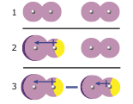
MOLECULAR POLARITY
B. LONDON FORCES
London Forces: Temporary dipoles (polarization) formed based on interaction with other molecules
Only for Non-Polar molecules!
*if a permanent dipole is ABSENT….LONDON FORCES!

Slide 11
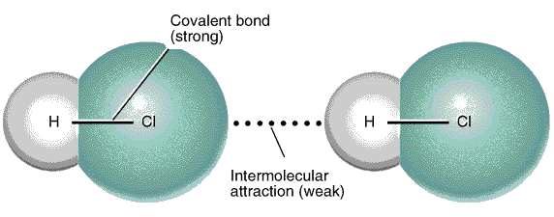
MOLECULAR POLARITY
IONIC BOND DIPOLE – DIPOLE ==LONDON FORCE
Intramolecular Intermolecular
*the attraction between polar molecules is much less than the attraction between ions
*polar molecules have a higher boiling temp then nonpolar

Slide 12
MOLECULAR POLARITY
C. HYDROGEN BONDING
Hydrogen Bond: strong dipole – dipole attraction between molecules containing a H – N, H – O, or H – F
Really the same thing as dipole-dipole interactions… just given a special name
*intermolecular bond – inter = between molecules
*intramolecular bond – intra = within a molecule
*strongest van der Waals bonds – but still weaker than covalent and ionic

Slide 13
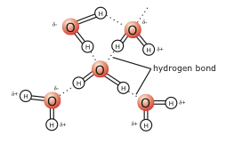
MOLECULAR POLARITY
Hydrogen Bonding in H₂O
Hydrogen Bonding in DNA
Hebden p. 199 #9, p. 202 # 11-12, p. 203 # 13-16
Notes:
Without Hydrogen Bonding there would be no life… Life as we know it would be very unlikely if water became a gas at –90°C!

Slide 14
POLAR AND NONPOLAR SOLVENTS
BOND TYPE | WHAT TO LOOK FOR...
INTRAMOLECULAR BONDS: Bonds within a molecule
IONIC BOND | Made up of metal and nonmetal (or recognizable ions)
COVALENT BOND | Made up of nonmetal and nonmetal
INTERMOLECULAR BONDS: Bonds between molecules/ions
HYDROGEN BOND | Look for HF or any molecule having OH or NH in its formula
DIPOLE-DIPOLE FORCE | Look for polarity within the molecule and asymmetry
LONDON FORCE | Always present

Slide 15
POLAR AND NONPOLAR SOLVENTS
Common solvents: p.204
water
methanol
ethanol
benzene
ethoxyethane
acetone
acetic acid
chloroform
carbon tetrachloride
heptane
liquid ammonia

Slide 16
POLAR AND NONPOLAR SOLVENTS
Dissolving Process – 3 ATTRACTIONS:
attraction of solvent molecule to surrounding solvent molecules
attraction of solvent molecule to particles of solute
attraction of one solute particle to other solute particles

Slide 17
The Solution Process
“Rule”: LIKE DISSOLVES LIKE
polar solvents dissolve polar solutes.
Non-polar solvents dissolve non-polar solutes.
Water is polar (because it’s bent)
It will therefore tend to dissolve other polar molecules or ions.
For example, most salts, alcohols and sugars dissolve in water.
Alcohols and sugars all contain the O-H part of a molecule which makes them polar:
. .
X
O
. .
H

Slide 18
The Solution Process
Most organic substances (compounds of carbon) are non-polar.
That is why they in general do not dissolve in water (which is polar).
H
H
H
H
C
C
C
C
H
H
H
H
Generally, carbon chains are non-polar (no dipole moment)
Since the electronegativities of hydrogen and carbon are virtually
the same, hydrocarbons are non-polar. Gasoline is non-polar,
because it is a hydrocarbon.

Slide 19
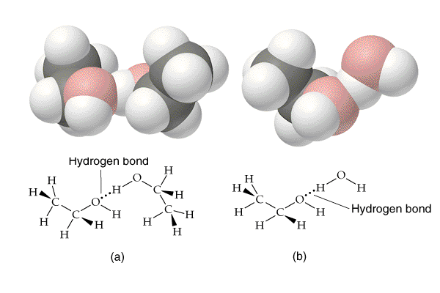
Factors Affecting Solubility
Solute-Solvent Interactions
ethanol ---- ethanol
ethanol ---- water

Slide 20
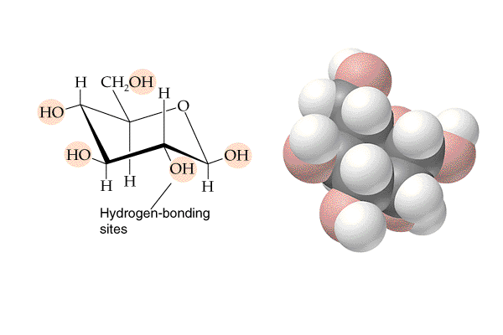
Factors Affecting Solubility
Solute-Solvent Interactions
The number of -OH groups within a molecule increases solubility in water.
Glucose – (a sugar)

Slide 21
POLAR AND NONPOLAR SOLVENTS

Slide 22
POLAR AND NONPOLAR SOLVENTS
**WATER is one of the most polar solvents known and tends to dissolve both polar and ionic solutes.
Remember “Like dissolves Like”
Hebden p. 207 # 18-22, p. 208 # 23-27

Slide 23
THE NATURE OF SOLUTIONS OF IONS
The formation of a solution depends on the ability of the solute to dissolve in the solvent.
SOLVATION:
The process by which the solvent molecules surround and interact with solute molecules
IONIC SOLID:
A solid molecule that dissolves into ions when placed in a solvent
MOLECULAR SOLID:
A solid molecule that does not dissolve into ions when placed in a solvent

Slide 24
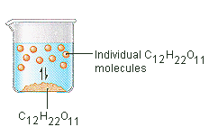
THE NATURE OF SOLUTIONS OF IONS

Slide 25
SOLUTIONS AND SOLUBILITY

Slide 26
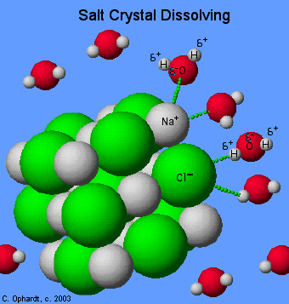
THE NATURE OF SOLUTIONS OF IONS
DISSOCIATION:
The breaking up of a compound into simpler components Dissociation Equation
ex: NaCl ----> Na⁺ + Cl⁻

Slide 27
THE NATURE OF SOLUTIONS OF IONS
Ex: NaCl dissolving in water
https://www.youtube.com/watch?v=EBfGcTAJF4o

Slide 28
THE NATURE OF SOLUTIONS OF IONS
IONIZATION:
The breaking up of a compound into simpler components, but in this case the simpler components are ions
ex: CH₃COOH + H₂O ------> CH₃COO⁻ + H₃O ⁺
Hebden p. 210 # 28 & 29

Slide 29
Writing Dissociation Equations
Writing dissociation equations is similar to balancing equations…
The difference is it’s always one molecule breaking into the ions that make it up
Use these rules to help you balance Dissociation Equations
The state is VERY important (aq)
Same rules for balancing Elements as before
PLUS we must now balance the charge (same amount of charge on the Left Side as Right Side
The [ions] released is proportional to the ratio of elements in the original molecule

Slide 30
Try These

Slide 31
Try These

Slide 32
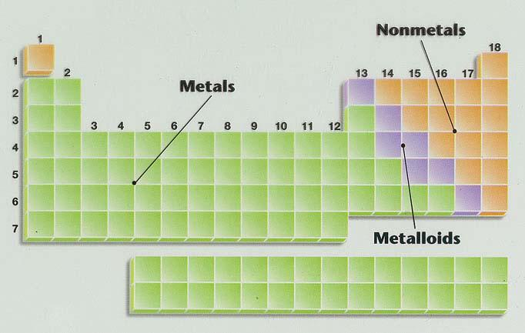
SOLUTIONS AND SOLUBILITY

Slide 33
THE CONDUCTIVITY OF AQUEOUS SOLUTIONS
A conducting solution contains ions; the greater the concentration of ions, the greater the conductivity.
A compound made up of a METAL and NONMETAL is IONIC, and forms a conducting solution in water.
A substance made up of a NONMETAL and a NONMETAL is COVALENT, and will NOT form a conducting solution in water.

Slide 34
THE CONDUCTIVITY OF AQUEOUS SOLUTIONS
The "+" and "-" ions are now free to move around. The "+" ions would be attracted to a negative electrode and the "-" ions would be attracted to a positive electrode. In this way, the ionic solution conducts a current.

Slide 35
THE CONDUCTIVITY OF AQUEOUS SOLUTIONS
Compounds whose formulae start with a CARBON ATOM are usually ORGANIC and normally DO NOT form a conducting solution in water.
ACIDS and BASES form conducting solutions in water.
Notes:
Foreshadowing

Slide 36
THE CONDUCTIVITY OF AQUEOUS SOLUTIONS
**TO CONDUCT or NOT CONDUCT??? that is the question.....
CONDUCT DOESN’T CONDUCT
ionic - solid
acidic - covalent
basic - starts with C
CH₃COOH (exception)
Hebden p. 198 # 6-8

