Slide 1
Class Starter – Whiteboarding!
What term do we give an atom’s outer electrons that take part in chemical bonding?
Valence Electrons
Define electronegativity.
The ability of an atom to attract electrons to itself within a bond
In which region of the periodic table are elements located that tend to….
Lose outer electrons most easily during chemical changes?
The lower left side of the table
Gain outer electrons most easily during chemical change?
The upper right side of the table

Slide 2
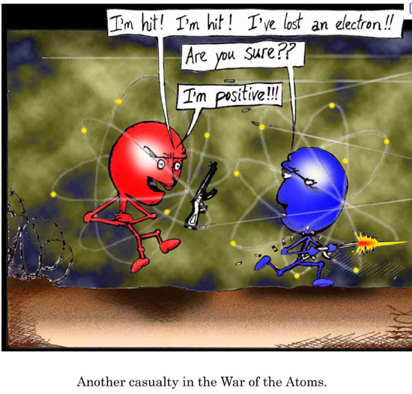

Slide 3
Chemical Bonding To bond or not to bond?

Slide 4
The big question… why do atoms bond?
Hint: While many young basketball players “Wanna be like Mike”, atoms “Wanna be like Neon… or Argon… or Xenon”
Ans: atoms bond in such a way to complete (by either emptying or filling) their outer shells!

Slide 5
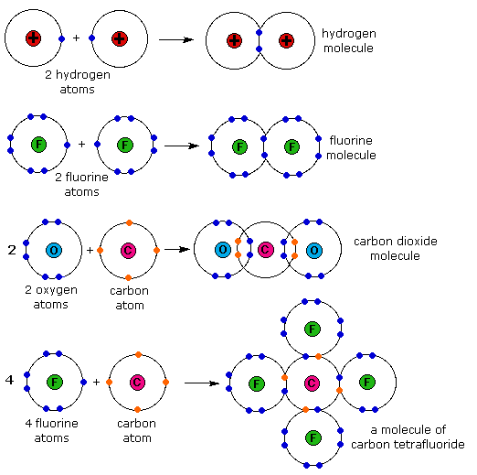
Chemical Bonding

Slide 6
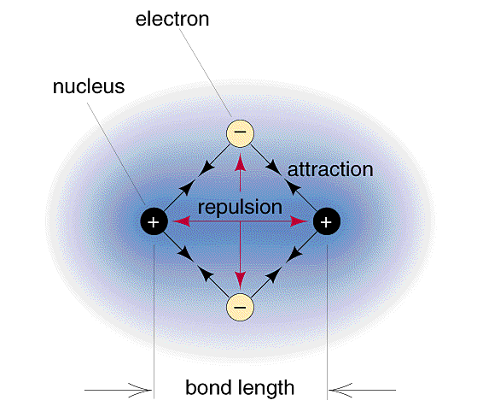
What causes a chemical bond?
The negative electron cloud of the atoms exert repulsive forces on each other
Each nucleus begins to attract the approaching atom’s outer electron cloud
If the attractive forces between the atoms are stronger than the repulsive forces, a chemical bond forms between them

Slide 7
Atoms are like children when it comes to electrons…
Sharing….
Not Sharing...

Slide 8
Ionic Bonding
Formed between two atoms with large differences in their ionization energies and electronegativity's
An electronegativity difference of greater than 1.6 can be classified as an ionic bond
In this case we can essentially say electrons are transferred from one atom to another

Slide 9
Ionic Bonding
What compound is formed when the following elements combine?
Ca and Br
Al and O
Be and O

Slide 10
Ionic Bonding
What compound is formed when the following elements combine?
Ca and Br CaBr₂
Al and O Al₂O₃
Be and O BeO
Determine the ΔEN in each case.
Absolute value of the EN difference of the two elements. Do not take subscripts or charges into consideration.

Slide 11
Ionic Bonding
What compound is formed when the following elements combine?
Ca and Br CaBr₂ ΔEN = 1.8
Al and O Al₂O₃ ΔEN = 2.0
Be and O BeO ΔEN = 2.0
Determine the ΔEN in each case.
Absolute value of the EN difference of the two elements. Do not take subscripts or charges into consideration.

Slide 12
Summary

Slide 13
Covalent Bonding
Formed between two atoms with almost no difference in their ionization energies and electronegativity's
An electronegativity difference of less than 0.5 can be classified as a covalent bond

Slide 14
Summary

Slide 15
Warning!!!!

Slide 16
Not everything is black and white
Ionic and covalent are the extreme cases of bonding.
While we often hear about the political extremist most people fall somewhere in the middle
Between these extremes are covalent bonds involving unequal electron sharing

Slide 17
Polar Covalent Bonding
Electrons are still shared between two atoms but unequally
Electrons are drawn closer to the atom with higher electronegativity
One side of the bond has a partially negative “pole” and the other a partially positive “pole” → creates a bond “dipole”

Slide 18
Polar Covalent Bonding
Example:
HCl
ΔEN = 3.0 (Cl) – 2.1 (H) = 0.9
Chlorine has higher EN
Electrons will be drawn more towards chlorine than hydrogen

Slide 19
Polar Covalent Bonding
Essentially Chlorine “owns” more of the negative charge associated with the bonding pair

Slide 20
Summary

Slide 21
Not quite…
iPad

Slide 22
In Summary…
ΔEN | Bond Type
0 | Non-Polar
< 0.5 | Covalent (Mostly Non-Polar)
0.5 – 1.6 | Polar Covalent
> 1.6 | Ionic

Slide 23
Try This!
The questions on your notes handout!

