Slide 1
Rates of Chemical Reactions

Slide 2
Objectives:
To review Kinetic Molecular Theory (Grade 9)
To understand that a chemical reaction involves collisions between particles (Collision Theory)
To be able to describe the four factors which will affect the rate of a chemical reaction.

Slide 3
Before we begin…
What is a rate of reaction?
A measure of the speed at which a reaction occurs.

Slide 4
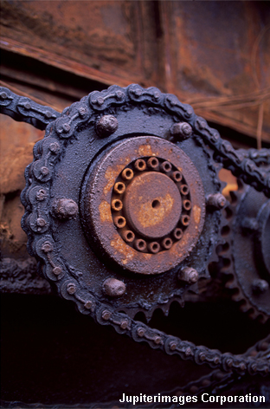
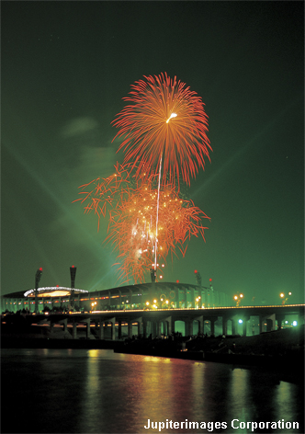
The speed of different chemical reactions varies hugely. Some reactions are very fast and others are very slow.
The speed of a reaction is called the rate of the reaction.
What is the rate of these reactions?
rusting
baking
explosion
slow
fast
very fast

Slide 5
Rates of Reaction
A chemical reaction involves a collision between particles.
The particles collide and make new substances
The particles which react are called the reactants
The substances which are made are called the products

Slide 6
KMT - Whiteboarding
In a momemt I will give you a number between 1-7
Collect a whiteboard, cloth, and several coloured pens
Use your previous knowledge (Grade 9!) plus textbooks and phones to create a diagram that demonstrates your understanding of Kinetic Molecular Theory!
You have 10 minutes, at which point you present your diagram to the rest of the class

Slide 7
Kinetic Molecular Theory suggests that matter is made up of tiny particles in constant, random motion

Slide 8
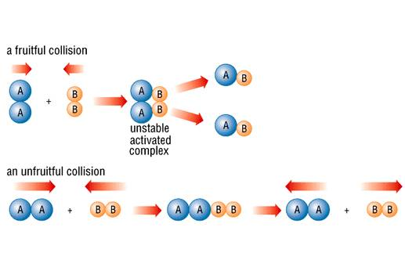
But when the collide do the always react?
Collision theory states that for a successful collision to take place the particles must have a minimum energy, and the correct orientation (alignment)

Slide 9
Reactions, particles and collisions
The rate of a reaction depends on two things:
the frequency of collisions between particles
the energy with which particles collide.
If particles collide with less energy than the activation energy, they will not react.

Slide 10
Changing the rate of reactions
Anything that increases the number of successful collisions between reactant particles will speed up a reaction!
What factors that lead to an increased rate of reactions?
increased temperature
increased concentration of dissolved reactants, and increased pressure of gaseous reactants
increased surface area of solid reactants
use of a catalyst

Slide 11
1. Temperature – for all Phases!
When the temperature is increased, the particles have increased energy.
Will result in more frequent and more forceful collisions.
More frequent and more forceful collisions result in more successful collisions.
If the temperature increases the reaction rate will increase.

Slide 12
Cold vs. Hot

Slide 13
Concentration – Only for a Liquid or Gas
Concentration is the amount of “stuff” in a given space or volume
As the reactant concentration increases, there are more particles to collide with each other.
Creates more opportunity for successful collisions
If the concentrations increase the reaction rate will increase.

Slide 14
Concentration

Slide 15
3. Surface Area – Only for a Solid
Surface is the amount of “stuff” exposed. Solids with low surface area have stuff hidden beneath the surface.
The greater the surface area exposed, the greater the locations where the reaction can take place
Allows for increase in reaction rate.

Slide 16
4. Catalyst – For all reactions
A catalyst is a substance that increases the rates of chemical reactions without being used us.
(An inhibitor is a species that reduces the rate of a chemical reaction by combining with a reactant to stop it from reacting in its usual way.)
A biological catalyst is known as an enzyme

Slide 17
Catalytic Convertors:
All automobiles built in North America since the 1980s have pollution control devices built into their exhaust systems A catalytic converter is a stainless steel device, shaped like a muffler, located underneath the frame of the vehicle. Inside it is a ceramic or wire honeycomb-like structure that provides a large surface area for reactions to take place. The surface of the honeycomb is coated with a thin layer of metallic catalysts, involving platinum, rhodium, and palladium.
As exhaust passes through the catalytic converter, several reactions occur. Much of the poisonous carbon monoxide, which is produced from the combustion of gasoline, reacts with oxygen and is changed into carbon dioxide. Hydrocarbons react with oxygen to produce carbon dioxide and water. Finally, most of the poisonous nitrogen oxides are converted into nitrogen gas and oxygen gas in the following reaction.
Most catalytic converters work best when the catalysts are warmed up. Studies show that 70 percent of all pollutants released from a car happen during the first 90 s while the car warms up. Very little pollution is produced after the first 90 s.

Slide 18
Form Groups of 2 or 3

Slide 19
What to do…
Please read about catalytic convertors on the next page
In-Class Work: Complete the questions on the back and when finished come to the front to collect the worksheet package
Homework: Finish the Reaction Rates Worksheet Package + Homework Survey
Note: Chapter 9 Checkpoint Friday
Unit Test: Next Tuesday Chapter’s 6,7,9

