Slide 1
Electron Configuration Orbital Diagrams

Slide 2
Bohr Video

Slide 3
Bohr Video

Slide 4
Hydrogen Spectrum Series
The transitions from higher to lower energy levels were defined by the energy level the excited electron returned too
Notes:
Notice there are MANY different transitions possible.
This would become EXTREMELY complicated with multi-electron systems (have to look at electron electron repulsion)

Slide 5
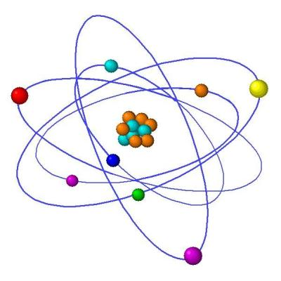
A Teachers Confession…
What can I say, we lied to you…
Electrons do NOT orbital around the nucleus like planets, and while they do exist at certain quantized energy orbitals/shells we can never know exactly where they are

Slide 6
Please collect the handout from the front
Before we begin, ask yourself the following questions:
How many electrons can reside in each of the first four shells of an atom?
How do you know?
Are all the electrons in a shell equal in terms of energy?

Slide 7
Please collect the handout from the front
Before we begin, ask yourself the following questions:
How many electrons can reside in each of the first four shells of an atom? 2, 8, 18, 32
How do you know?
Are all the electrons in a shell equal in terms of energy?

Slide 8
Please collect the handout from the front
Before we begin, ask yourself the following questions:
How many electrons can reside in each of the first four shells of an atom? 2, 8, 18, 32
How do you know? The # of elements in a row of the Periodic Table!
Are all the electrons in a shell equal in terms of energy?

Slide 9
Please collect the handout from the front
Before we begin, ask yourself the following questions:
How many electrons can reside in each of the first four shells of an atom? 2, 8, 18, 32
How do you know? The # of elements in a row of the Periodic Table!
Are all the electrons in a shell equal in terms of energy? NOOOO!! This is new, in each “shell” there are several subshells; s,p,d, and f, all with SLIGHTLY different energies

Slide 11
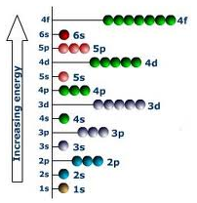

Slide 12
Aufbau Principle
Aufbau = means “building up” in German
When filling orbitals, the lowest energy orbitals available are always filled first.

Slide 13
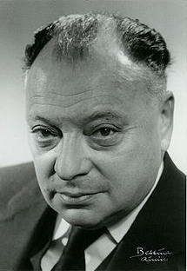
Pauli Exclusion Principle
Each orbital can hold a maximum of 2 electrons

Slide 14
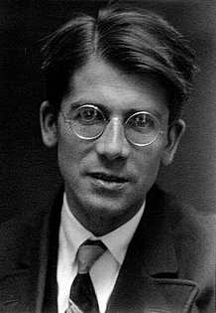
Hund’s Rule
When orbitals of equal energy are being filled, electrons are most stable when each orbital is singly-occupied before any orbitals is doubly-occupied
Each singly occupied orbit must have the same spin! (Up or Down)

Slide 17
These Orbital Diagrams…
Can also be placed in a row! (more on this on the worksheet!)

