Slide 1
Chem 11 - Class Starter
Before we start, let’s introduce a new concept!
Effective Nuclear Charge!!
Please take out a whiteboard…
With 2 partners, draw the Bohr Diagram for both Chlorine and Magnesium
In the nucleus include the total number of protons!
Which element exerts a greater attractive force on it’s valence electrons… Why?

Slide 2
Effective Nuclear Charge

Slide 3
Attraction vs. Repulsion

Slide 4
Periodic Trends
Please collect a blank periodic table from the front of the room
Collect 3 coloured markers to show the trends on the blank table
Please answer all questions on the back of the Periodic Table
At the end of the class I will hand out a handout so please do NOT take notes

Slide 5
Periodic Trends
Periodicity

Slide 6
General Trends

Slide 7
Periodic Trends
As we move across a period or down a chemical family, there are regular changes in elemental properties – Periodic Trends
Atomic Radius
Ionization Energy
Electronegativity

Slide 8
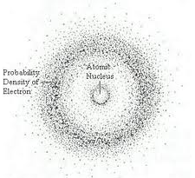
The size of an atom
The outer boundary of an atom depends on the size of a cloud in which electrons spend approximately 90% of their time

Slide 9
The size of an atom
The volume of an atom is the result of a cloud of electrons.
What affects the size of an atom’s electron cloud?
The Number of Energy Level’s Present
The amount of nuclear charge “felt” or “seen” by the outer electrons
Notes:
More electrons stacked on one another the bigger the atom!
Depends on the distance between and potential “barriers”

Slide 11
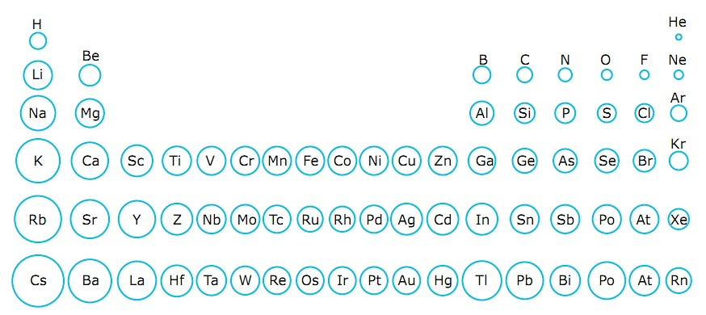
What trends do you see?

Slide 12
As we move down a family…
The number of energy levels (n) increases, the outer electrons will be further from the nucleus and so the atoms become larger

Slide 13
What trends do you see?

Slide 14
As we move across a period…
The atomic number increases and therefore the number of protons increase.
The electrons feel more nuclear charge and are pulled closer to the nucleus and the atom becomes smaller.
Notes:
The charge felt by the electrons is called effective nuclear charge or “Z_{eff}”

Slide 15
Consider this…
Rank the following from largest to smallest:
Al³⁺ F⁻ Mg²⁺ N³⁻ Na⁺ Ne O²⁻
Hints!
How many electrons are in each?
10
How many protons are in each?
Al⁺³ = 13, F⁻ = 9, Mg⁺² = 12, N⁻³ = 7, Na⁺ = 11, Ne = 10, O⁻² = 8
ANS: N³⁻ > O²⁻ > F⁻ > Ne > Na⁺ > Mg²⁺ > Al³⁺

Slide 16
Ionic Radius

Slide 17
Ionization Energy
The energy required to remove an electron from a neutral atom
Atom → Ion⁺ + e⁻
The amount of energy required to move an electron from the outer most orbital to n = ∞

Slide 19
Notes:
What stands out?

Slide 20
Ionization Energy
Ionization energy tells us how strongly an atom holds onto its outermost electrons
Notes:
A large atom has outer electrons that are held less tightly (smaller atom holds onto electrons more strongly)

Slide 21
Ionization Energy Trend

Slide 22
Answer the following Questions

Slide 23
Answers

Slide 24
Electrons are not only REMOVED from atoms but are also ATTRACTED to form bonds between atoms
The ability for atoms to attract electrons in a BOND is called…
Electronegativity

Slide 25
Electronegativity (EN)
Smaller atoms have a nuclei that are closer to the bonded electrons
Have a higher ability to attract electrons, therefore a higher EN value

Slide 26
Electronegativity vs. Atomic Number

Slide 27
Trends in Electronegativity

Slide 28
In Class Work
Please collect the Trends Summary and Period trends worksheet from the front of the room

