Slide 1
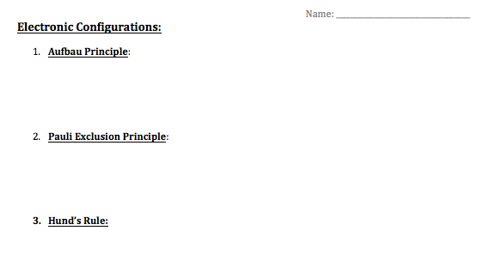
Electron Configuration
Please have your note sheet in from of you!
Let’s review the 3 rules we learned last class!

Slide 2
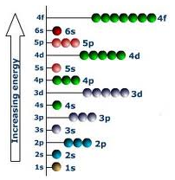
Orbital Diagrams

Slide 3
Aufbau Principle
Aufbau = means “building up” in German
When filling orbitals, the lowest energy orbitals available are always filled first.

Slide 4
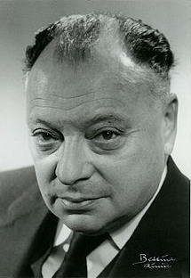
Pauli Exclusion Principle
No two electrons in the same atom can be described by the same set of four quantum numbers
Each orbital can hold a maximum of 2 electrons

Slide 5
Hund’s Rule
When orbitals of equal energy are being filled, electrons are most stable when each orbital is singly-occupied before any orbitals is doubly-occupied

Slide 8
Alternative Method
Electronic Configuration!
A simpler method…
Writing the subshells in order….
Please collect a periodic table from the front of the room!

Slide 9
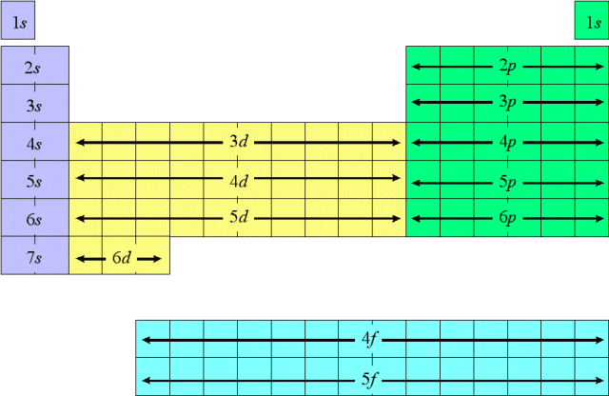
Quantum Periodic Table
1s²
2s²
2p⁵
F
Count the electrons in each different orbital type
until you get to Fluorine. Put in order of lowest to
highest energy level.
Notes:
We can use the Periodic Table to find the electron configuration
Go Slow….. Match up this graph to the one in their notes
Point out how they are reading a book
Match up the orbital type to the area on the periodic table… foreshadow the periodic table section

Slide 10
1. F
1s²2s²2p⁵
The number in front of the sub-orbital is the Principle Quantum Number (n) OR the Energy level
Sub-script = the Number of Electrons in the Orbital
Orbital Type- s, p, d, or f

Slide 11
Quantum Periodic Table
1s²
2s²
2p⁶
3s²
3p⁶
Ca
4s²
Count the electrons in each different orbital type
until you get to calcium.

Slide 12
2. Ca
1s²2s²2p⁶3s²3p⁶4s²
Simplify to a Bohr electron configuration
1s² 2s²2p⁶ 3s²3p⁶ 4s²
2 8 8 2

Slide 13
Quantum Periodic Table
1s²
2s²
2p⁶
3s²
3p⁶
3d⁹
Cu
4s²
Count the electrons in each different orbital type
until you get to copper.

Slide 14
3. Cu
1s²2s²2p⁶3s²3p⁶4s²3d⁹
Whoops!…. There are exceptions, remember we are trying to find the MOST stable and therefore lowest energy electron configuration.
In this case….
1s²2s²2p⁶3s²3p⁶4s¹3d¹⁰ is actually MORE stable
Notes:
Due to the extremely stable full d10 arrangement
Also so them the exception for Cobalt
Write them on the board, they need to know these to….

Slide 15
Quantum Periodic Table
1s²
2s²
2p⁶
3s²
3p⁶
3d¹⁰
4p⁶
Kr
4s²
Count the electrons in each different orbital type
until you get to copper.

Slide 16
4. Kr
1s²2s²2p⁶3s²3p⁶4s²3d¹⁰4p⁶
Simplify to a Bohr electron configuration
1s² 2s²2p⁶ 3s²3p⁶3d¹⁰ 4s²4p⁶
2 8 18 8
Notes:
STOP FOR NOTES

Slide 17
Quantum Periodic Table
1s²
2s²
2p⁶
3s²
3p⁶
3d¹⁰
4p⁶
4s²
5s²
4d⁴
Mo

Slide 18
4. Mo
1s²2s²2p⁶3s²3p⁶4s²3d¹⁰4p⁶5s²4d⁴
WHOOPS!
1s²2s²2p⁶3s²3p⁶4s²3d¹⁰4p⁶5s¹4d⁵

Slide 19
Quantum Periodic Table
1s²
2s²
2p⁶
3s²
3p⁶
4s²
3d¹⁰
4p⁶
5s²
4d¹⁰
5p⁶
Ba²⁺

Slide 20
6. Ba²⁺
1s²2s²2p⁶3s²3p⁶4s²3d¹⁰4p⁶5s²4d¹⁰5p⁶
Xe
1s²2s²2p⁶3s²3p⁶4s²3d¹⁰4p⁶5s²4d¹⁰5p⁶
I⁻
1s²2s²2p⁶3s²3p⁶4s²3d¹⁰4p⁶5s²4d¹⁰5p⁶
The above chemical species are isoelectronic- same
electron configuration

Slide 21
So….
You need to be able to find the electronic configuration of EVERY element on the Periodic Table, even the 4 exceptions!
Exceptions: Chromium (Cr), Molybdenum (Mo), Copper (Cu), and Silver (Ag)

