Slide 1
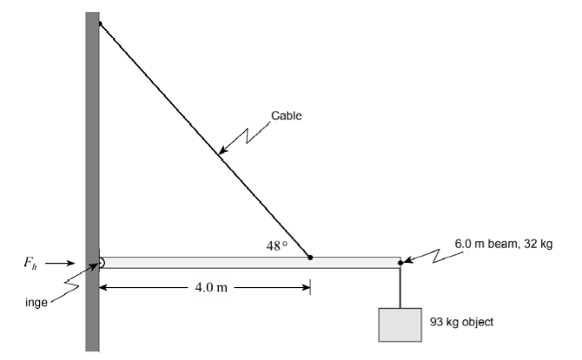
Question 1
A 6.0 m uniform beam of mass 32 kg is suspended horizontally by a hinge and a cable. A 93 kg object is connected to one end of the beam.
What is the magnitude of the horizontal force F_{h} that the hinge exerts on the beam?
Ans: 1.4 x 10³ N

Slide 2
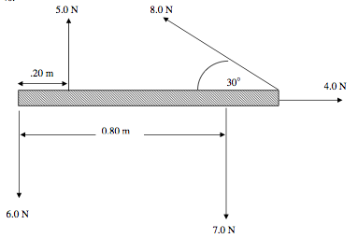
Question 2
Hint: start by balancing forces ΣF = 0
A bar 1.0 m long has five forces acting on it as shown in the diagram. What are the magnitude, direction and location of the single force required to produce static equilibrium.
The weight and thickness of the bar are insignificant.
Use the hinge indicated in orange.
Assume up is north and right is east
3 Sig Figs!
Ans: 4.96 N 54º N of E, 0.15 m from the hinge

