Slide 1
The Periodic Table
Chem 11

Slide 2
Learning Targets
Be able to define Atomic Radius, Electronegativity and Ionization Energy.
Use graphs to demonstrate trends of element properties.
Explore trends in the periodic table based on known properties of the elements.
Trend: a general direction, tendency or inclination.

Slide 3
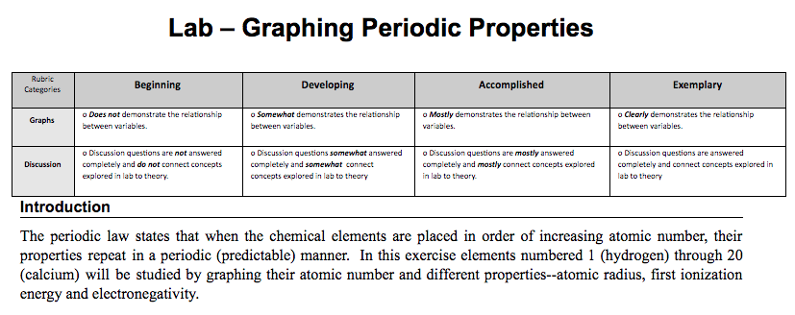
Periodic Trends Graphing Assignment
Access the Periodic Trends assignment on Google Classroom
Find a partner to complete the assignment with
Take out your computers, share one document and begin!
If you are struggling with EXCEL/Google Sheets please ask!
This assignment is due at the START of next class (Hard Deadline)!

Slide 4
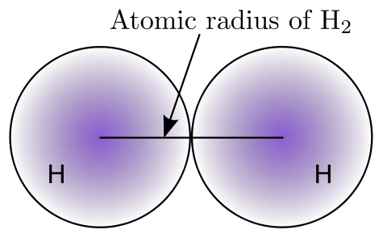
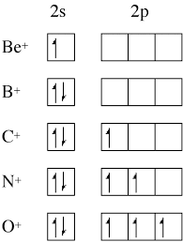
Definitions
Electronegativity is a measure of how strongly atoms attract bonding electrons to themselves.
Ionization Energy is the energy required to remove one electron from a neutral atom.

Slide 5
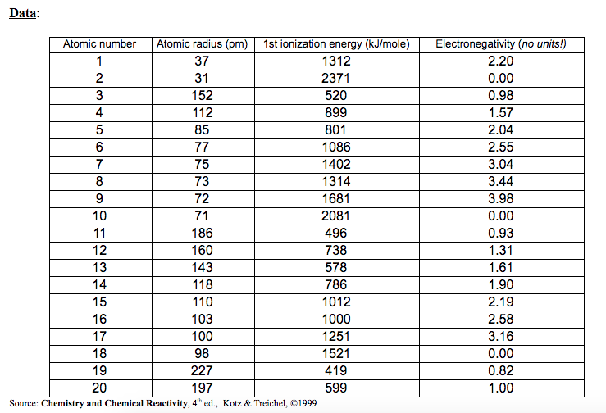

Slide 6
