Slide 1
Chem 11 – Class Starter
Please take out your completed Mind Maps
Collect tape from the front of the room and hang your mind map up in an open space
Make sure your name is visible on the front of the map

Slide 2
Chem 11 – Class Starter
Form groups of 2-3 (no more no less)
Collect a whiteboard and pens from the side of the room
Place the whiteboards side by side
Wait quietly for instructions

Slide 3
Learning Targets
Demonstrate understanding of Unit Conversions by solving test level problems.

Slide 4
Unit Conversions
Work in groups to complete the following Unit Conversion problems
Make sure multiple people have pens and are contributing to the process
If you are not contributing, be reflective as to why. Ask yourself…, “do I know how to do this?”
I will ask groups to hold up their boards to show the class what they have done

Slide 5
Q1
A Pringles chips cylinder has a volume of 500. mL. If Connor buys 12 cylinders of chips, what volume of chips is he eating in liters?

Slide 6
Q2
A barometer measuring atmospheric pressure reads 27.0 inches of mercury. Determine this pressure in units of kPa. (1 inch mercury = 0.033atm, 1atm = 101.3kPa).

Slide 7
Q3
Convert 4.001g/m³ to kg/cm³

Slide 8
Q4
Light travels at 3.0 x 10⁸ m/s. A robot vehicle is travelling on the surface of Mars while Mars and Earth are at their closest approach of 7.83 x 10⁷ km. At this distance, how many minutes will it take a digital signal travelling at the speed of light to go from Earth to Mars to reach the robot?

Slide 9
Q5
On St. Patrick’s day, the Irish Heather pub in gastown sells a total of 6500 bottles of beer from 5 pm to midnight (EXACTLY 7 hrs). If each beer has a volume of 350.0 mL, determine the volume of beer sold in pints/minute. (1L = 2.1134 pints).

Slide 10
Q6
If Mr. Lawson has been alive for 1,159,684,081 Seconds what year and month was he born in?
Consider Leap Years!

Slide 11
How old are you in sec/min/hrs/days?
http://www.brainbashers.com/howold.asp?post=Y

Slide 12
Learning Targets
Demonstrate understanding of Unit Conversions by solving test level problems.

Slide 13
Quiz #3 – Unit Conversions
Please return your whiteboards and pens and clear off your desks
Set up dividers and collect a piece of scrap paper
Wait quietly for the quiz!
Finished…? Hand it in at the front of the room!

Slide 14
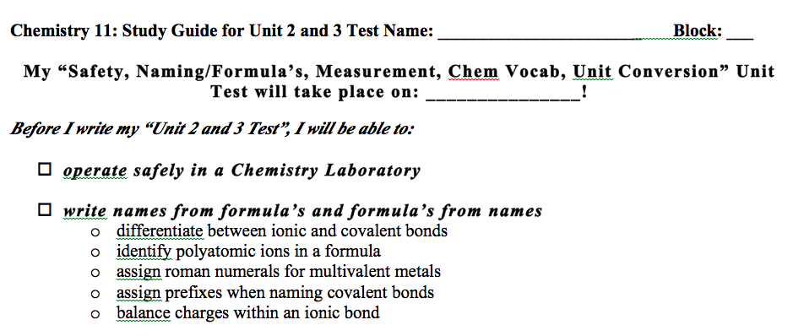
Review Checklist Units 2 and 3

Slide 15
Hebden Review
To review please complete the following from your Hebden Workbooks
Hebden Review:
Safety: p. 8 q's 1-8
Unit Conversions: p. 15-16 Q's 3-10
Sig Figs and Measurement: p. 28-40 Q's 42-59
Nomenclature: p. 75-80 Q's 14-163 (don't do them all...)
I have ALSO updated an addition Review Package on my website!
Unit Quiz Next Class!

