Slide 1
Functional Groups II

Slide 2
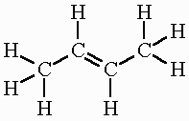
Cis - Trans Isomerism
Draw the structure for 2-butene

Slide 3
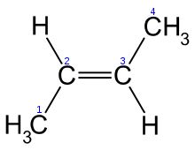
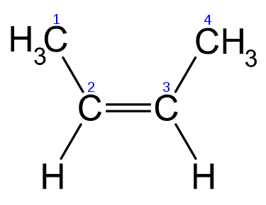
Cis - Trans Isomerism
Is there any other way to draw this structure?
trans-2-butene cis-2-butene

Slide 4
Cis - Trans Isomerism
So what’s the difference?
A lot!
The double bond “locks” the molecule in place and changes the properties of the compound.
One compound may be life saving… another may be deadly…

Slide 5
Cis - Trans Isomerism
Naming Cis-Trans Alkene’s:
The parent chain must contain the double bond.
The name of the parent chain ends with “ene” instead of “ane”.
Determine if the molecule is “cis” (same side) or “trans” (across) AT the double bond and include it at the front of the parent chain
Include the number where the double bond starts before the parent chain

Slide 6
Cis - Trans Isomerism
And as always…
Name and identify positions of the branches.
Name the compound.

Slide 7
Naming Cis-Trans Isomers
Parent Chain.
Number parent chain.
Name the branches.
Name the compound
trans-2-pentene

Slide 8
Naming Cis-Trans Isomers
Parent Chain.
Number parent chain.
Name the branches.
Name the compound
4-methyl-cis-2-heptene

Slide 9
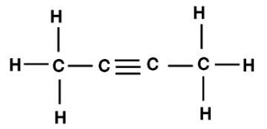
Cis-Trans Isomers
Question: How would you name Cis-Trans Isomers for Alkynes?

Slide 10
Functional Groups
So far….
FG #1: Alkyl Halides R-X
FG #2: Alcohols R-OH
Next….
FG #3: Aldehydes RH=O
FG #4 Ketones R=O
FG #5 Ethers R-O-R
FG #6 Esters R-C=O-O-R (kindof…)

Slide 11
FG#3: Aldehydes
Organic compounds containing an oxygen at the END of a parent chain double bonded to a carbon.
To name aldehydes remove the “-e” from the end of the parent chain and replace it with “-al”

Slide 12
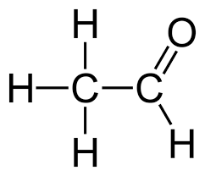
Naming Aldehydes
Parent Chain.
Number parent chain.
Name the branches.
Name the compound
1-ethanal

Slide 13
Naming Aldehydes
Parent Chain.
Number parent chain.
Name the branches.
Name the compound
2-chloro-1-pentanal

Slide 14
FG#4: Ketones
Organic compounds containing an oxygen in the middle of a parent chain double bonded to a carbon.
To name aldehydes remove the “-e” from the end of the parent chain and replace it with “-one”

Slide 15
Naming Ketones
Parent Chain.
Number parent chain.
Name the branches.
Name the compound
2-pentanone

Slide 16
Naming Ketones
Parent Chain.
Number parent chain.
Name the branches.
Name the compound
3-methyl-2-butanone

Slide 17
BONUS!: Naming Ketones
Parent Chain.
Number parent chain.
Name the branches.
Name the compound
2,3-hexandione

Slide 18
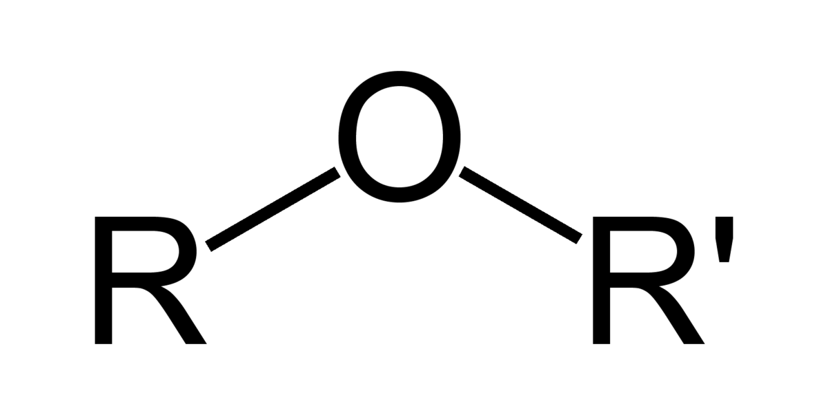
FG#5: Ethers
Recognise that the molecule is an ether because it has the general form:
Identify the parts labelled "R₁" and "R₂". Standard system of labelling carbon chains as used for alkanes.
The shorter of the two chains "R₁" and "R₂" becomes the first part of the name with the “-oxy" suffix, and the name of the longer alkane chain forming the suffix of the name of the ether.

Slide 19
Naming Ethers
Parent Chain.
Number parent chain.
Name the branches.
Name the compound
methoxypropane

Slide 20
Naming Ethers
Parent Chain.
Number parent chain.
Name the branches.
Name the compound
propoxypentane

Slide 21
Naming Ethers
Parent Chain.
Number parent chain.
Name the branches.
Name the compound
Ethoxy-2-methylpropane

Slide 22
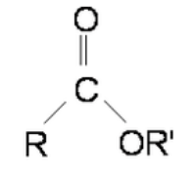
Esters
First, identify the oxygen that is part of the continuous chain and bonded to carbon on both sides. (On one side of this oxygen there will be a carbonyl present but on the other side there won't be.)
Second, begin numbering the carbon chains on either side of the oxygen identified in step 1.

Slide 23
Esters
Next, use this format: [alkyl on side further from the carbonyl] (space) [alkane on the side with the carbonyl] - (In this case: [methyl] [methane])
Finally, change the ending of the alkane on the same side as the carbonyl from -e to -oate. (In this case: methyl methanoate)

Slide 24
Naming Esters
Parent Chain.
Number parent chain.
Name the branches.
Name the compound
propyl ethanoate

Slide 25
Naming Esters
Parent Chain.
Number parent chain.
Name the branches.
Name the compound
ethyl butanoate

Slide 26
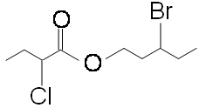
Naming Esters
Parent Chain.
Number parent chain.
Name the branches.
Name the compound
3-bromopentyl-2-chlorobutanoate

