Slide 1
Physics 12 – Class Starter
Quiz: Projectile Basics
Clear your desks and set up binders or divider between yourself and your neighbour
Collect a formula sheet from the front of the room
You should have a calculator, a pencil, and a piece of paper on your desk
Finished… ? Hand it in at the front of the room

Slide 2
Physics 12 – Class Starter
Projectiles
Work in groups of 2 or 3
Collect a whiteboard and pens/eraser
In a moment I will post a challenging Projectile Problem
It’s time for…. PROJECTILE MADNESS!

Slide 3
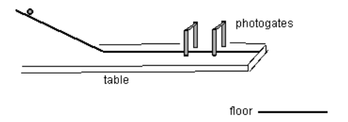
Projectiles #1 (Moderate)
A student finds that it takes 0.20s for a ball to pass through photogates placed 30.0 cm apart on a level ramp. The end of the ramp is 0.92 m above the floor. Where could a coin be placed so that the ball directly strikes the coin on impact with the ground?

Slide 4
Ans: 0.65 m
X-variables
Y-variables

Slide 5
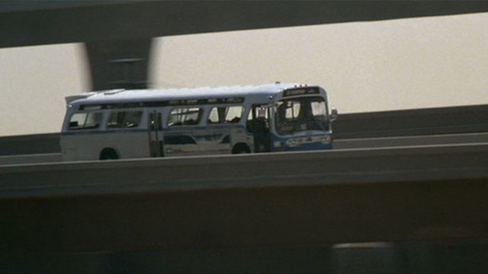
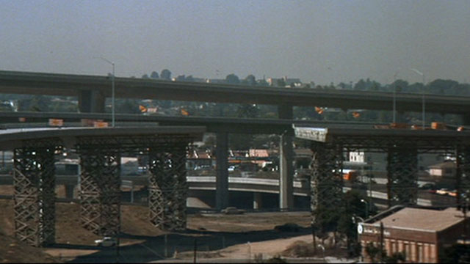
Question 2: Speed (1994)
In the 1994 action-adventure film Speed, an extortionist equipped a Los Angeles bus with a bomb that was set explode if the speed of the bus fell below 50 mph. The police discovered the bomb and routed the bus on to a segment of freeway that was still under construction — their intention being to keep it out of the notoriously heavy Southern California traffic. In a twist of the plot, however, they overlooked a large gap in the construction. Since the bomb would explode killing everyone on board if they slowed down, they decide to jump the gap.

Slide 6
Speed (Clip)

Slide 7
Question 2: Part I
At one point in the film, the camera zooms in on the freeway, revealing that the freeway has no incline.
Determine if the bus will make the jump! EXPLAIN YOUR REASONING
ANS: No. Whatever the initial speed the bus would be acted on by gravity and therefore would have negative (down) vertical displacement!

Slide 8
Question 2: Part II
Now let’s give the moviemakers the benefit of the doubt and assume that the freeway was on a slight incline of 5º degrees above the horizontal.
Determine if the bus will make the jump! Yes/No. Explain your answer with mathematical reasoning!
Ans: YES, travels MORE then 15 m while airborne

Slide 9
Speed (1994)
In the 1994 action-adventure film Speed, an extortionist equipped a Los Angeles bus with a bomb that was set explode if the speed of the bus fell below 50 mph (22 m/s). The police discovered the bomb and routed the bus on to a segment of freeway that was still under construction — their intention being to keep it out of the notoriously heavy Southern California traffic. In a twist of the plot, however, they overlooked a 50 foot (15 m) gap in the construction. Since the bomb would explode killing everyone on board if they slowed down, they decide to jump the gap. Before going airborne the bus was traveling at 67 mi/hr (30 m/s). Record any information you feel important!

Slide 10
Yes! God bless you Keanu!
x-variables
y-variables

Slide 11
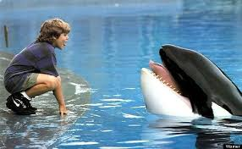
Projectiles #3 (Scary…)
Fishermen separate a young orca whale (Willy) from his parents and he ends up in a fish bowl at a marina. Meanwhile, a street kid runs afoul of the law and gets caught vandalizing the marina, but his social worker gets him off the hook (so to speak) provided he cleans up his mess at the marina. While there, he befriends the whale and teaches him tricks, something the trainer hasn't been able to do….
But when Willy is a dud in front of the audience, the marina owner plans some bad things, and the boy and his friends must try to (*** MAJOR SPOILERS ***) free Willy.

Slide 12
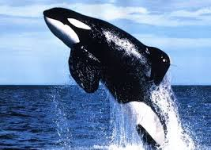
Question
Will our the killer whale make the jump?
What information do you need to determine if they will in fact make the jump?

Slide 13
Variables
Killer Whale max speed: 48 km/hr
Marina Wall Width: 8.12 m
Marina Wall Height: 2.40 m
13 year old boys are approximately ~ 1.56 m

Slide 14
Yes!

Slide 15
OR will it…?
The Killer Whale is a three dimensional object…. how does this change things?

Slide 16
Projectiles #4 (Interesting…)
In 2003 several members of the Fast and Furious cast returned for the equally gripping and well acted sequel 2 Fast 2 Furious!
During the climatic final moments, our two hero’s dramatically attempt to save Brian’s love interest as she is held hostage on luxury yacht.

Slide 17
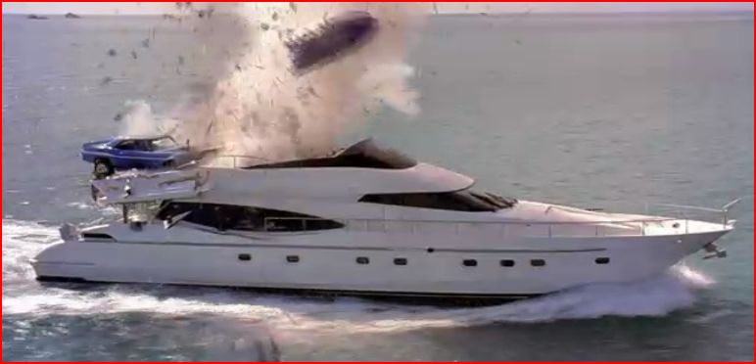
Question
Will our hero’s land on the luxury yacht?
What information do you need to determine if they will in fact make the jump?

Slide 18
Variables
Car speed: 120 mi/hr
Ramp: 10º
Boat Speed: 36 knots
Boat displacement: +30 m from ramp
Boat Length: 20m

Slide 19
Will they make it??
No… Overshoot…

Slide 21
Projectiles #5 (Difficult)
As a consultant for the next monster truck rally downtown, you are in charge of determining the takeoff speed needed for a truck to launch itself off of a ramp inclined 40 degrees above the horizontal so that it will jump 18 meters of cars lined up side-by-side.
What is the minimum speed, in m/s, with which the truck driver must leave the ramp in order to successfully clear all of the cars?

Slide 22
Projectiles #5 (Difficult)
As a consultant for the next monster truck rally downtown, you are in charge of determining the takeoff speed needed for a truck to launch itself off of a ramp inclined 40 degrees above the horizontal so that it will jump 18 meters of cars lined up side-by-side.
What is the minimum speed, in m/s, with which the truck driver must leave the ramp in order to successfully clear all of the cars?
Hint: try using substitution…. Which variable appears in components for both sides!?

Slide 23
Ans: 13.4 m/s
Time = 1.76 s

