Slide 1
Math 11 – A&W
Please hand in the assignment from last class if you haven’t already done so
The last two days we have studied the Tan Ratio
Let’s try and apply the knowledge
Form a group of two
Make sure one of you has the iPhone app Clinometer +3

Slide 2
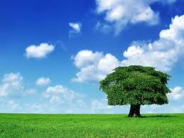
How would you find the height of this tree?

Slide 3
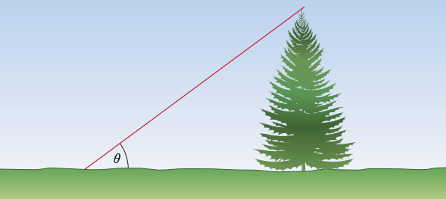
How would you find the height of a tree?

Slide 4
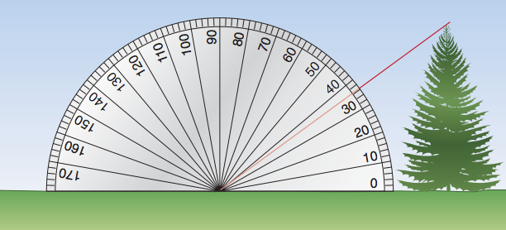
Height of a Tree - Clinometer

Slide 5
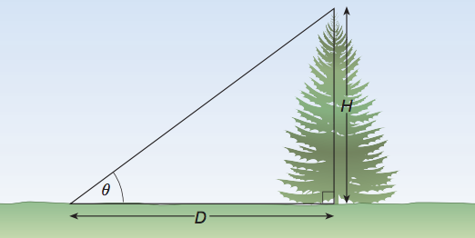
Height of a Tree – Tan Ratio

Slide 6
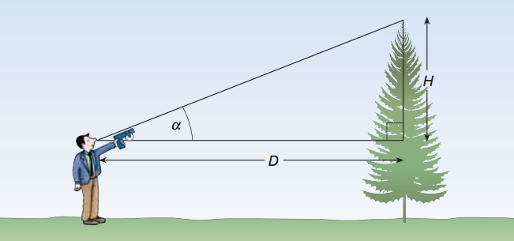
Height of a Tree – Accounting for height

