Slide 1
Whiteboarding!
Like snowboarding… but less cool!

Slide 2
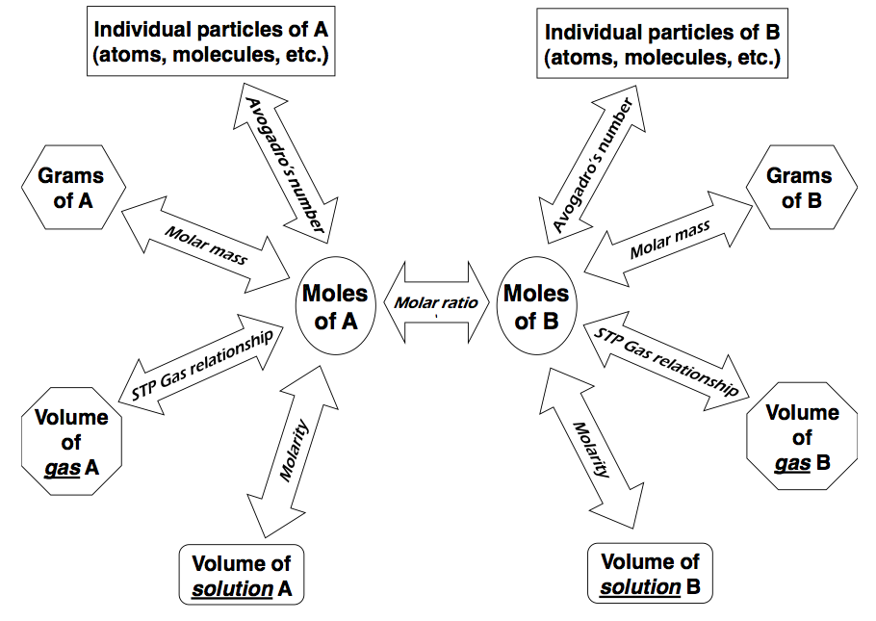
Gram A to Gram B
STOICHIOMETRY: Last Class

Slide 3
Gram A to Gram B
But we can go anywhere…

Slide 4
Gram A to Gram B
But we can go anywhere…

Slide 5
Mole Man and Strategy
The “Road Map”
You can’t always get from point A to point B directly!
Remember you during ALL Stoich problems you will have to cross a mole bridge…

Slide 6
Balance the following equation:
SO₂ + O₂ → SO₃

Slide 7
Balance the following equation:
2 SO₂ + O₂ → 2 SO₃

Slide 8
2 SO₂ + O₂ → 2 SO₃
At STP, What volume of oxygen is required to produce 742 L of SO₃?
? L O₂ | = | 742 L SO₃ | x | 1 mol SO₃ | x | 1 mol O₂ | x | 22.4 L O₂ | ₌ | 371 L O₂
 |  |  |  | 22.4 L SO₃ |  | 2 mol SO₃ |  | 1 mol O₂

Slide 9
N₂ + H₂ → NH₃

Slide 10
N₂ + 3 H₂ → 2 NH₃
What mass of nitrogen gas is required to produce 45L of ammonia at STP?
? g N₂ | = | 45 L NH₃ | x | 1 mol NH₃ | x | 1 mol N₂ | x | 28.02g N₂ | ₌ | 28 g N₂
 |  |  |  | 22.4 L NH₃ |  | 2 mol NH₃ |  | 1 mol N₂

Slide 11
Toughie!
If 23.44 g of Al reacts with an excess amount of Cl₂ how many atoms of product are formed?
2Al + 3Cl₂ → 2AlCl₃

Slide 12
Gram A to Gram B
STOICHIOMETRY: Everything's fair game!

Slide 13
Molar Concentration
STOICH

Slide 14
Molarity
Stoichiometric calculations involving Molarity follow the same procedure as described for Mass and Molar Volume

Slide 15
Solve the following Question
2 K(s) + 2 H₂O(l) ➝ 2 KOH(aq) + H₂(g)
What mass of potassium metal would be required to produce 250 mL of a 0.45 mol/L solution of potassium hydroxide?
K(s) + H₂O(l) ➝ KOH(aq) + H₂(g)
? g K | = | 250 mL | 1L | x | 0.45 mol KOH | x | 2 mol K | x | 39.10 g K | ₌ | 4.4 g K
 |  |  | 1000 mL |  | 1 L KOH |  | 2 mol KOH |  | 1 mol K

Slide 16
Solve the following Question
What volume of 0.80 mol/L sodium iodide solution would completely react with 2.4 × 10²⁴ molecules of chlorine gas?
2NaI_{(l)} + Cl_{2(g)} → 2NaCl_{(s)} + I_{2(g)}
? L NaI | = | 2.4 x 10²⁴ molec Cl₂ | x | 1 mol Cl₂ | x | 2 mol NaI | x | 1 L NaI | ₌ | 10. L NaI
 |  |  |  | 6.02 x 10²³ molec Cl₂ |  | 1 mol Cl₂ |  | 0.80 mol NaI

Slide 17
Solve the following Question
How many liters of carbon dioxide gas would be formed at STP if 1.5 L of 1.75 M phosphoric acid were reacted with excess potassium carbonate solution? Be cautious, as this question requires the use of both molar volume and molarity as conversion factors. Equation:
3K₂CO_{3(s)} + 2H₃PO_{4(aq)} → 3CO_{2(g)} + 2K₃PO_{4(aq)} + 3H₂O_{(l)}
? L CO₂ | = | 1.5 L H₃PO₄ | x | 1.75 mol H₃PO₄ | x | 3 mol CO₂ | x | 22.4 L CO₂ | ₌ | 88 L CO₂
 |  |  |  | 1 L H₃PO₄ |  | 2 mol H₃PO₄ |  | 1 mol CO₂

Slide 18
Chem 11 – Quiz!
Quiz 3: Multi-Step Stoich Conversions Beg
Please clear of your desks of everything except a pencil and calculator
Collect a scrap piece of paper and a periodic table
Set up dividers between yourself and your neighbour and wait quietly for the quiz!

