Slide 1
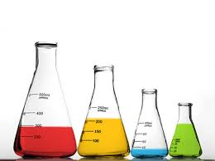
Chem 11 – Class Starter
Please hand in your Intro to Solutions Chem Labs at the front of the room
Make sure to write both names on the front
Form a group of 3
Collect a whiteboard and answer the question on the following slide!

Slide 2
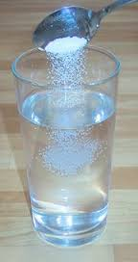
Question:
Which of the following compounds should generate the largest current from the same battery when placed in deionized water?
0.50 M NaCl
0.40 M CaF₂
0.60 M C₈H₁₈ (Octane)
0.25 M AlCl₃
Make sure to EXPLAIN your answer using diagrams and equations.

Slide 3
Question:
Which of the following compounds should generate the largest current from the same battery when placed in deionized water?
0.50 M NaCl
0.40 M CaF₂ But Why??
0.60 M C₈H₁₈ (Octane)
0.25 M AlCl₃
Make sure to EXPLAIN your answer using diagrams and equations.

Slide 4
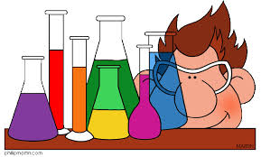
Solutions Chemistry – An Overview!
Branco!

