Slide 1
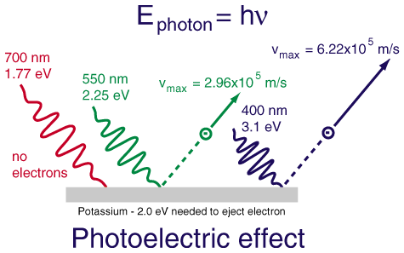
AP Phys 2 – Class Starter FR Question
Please grab a whiteboard, data sheets, markers and a friend to answer the following question! Conservation of Energy!

Slide 2
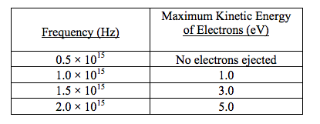
Q1:
In a photoelectric experiment, radiation of several different frequencies was made to shine on a metal surface and the maximum kinetic energy of the ejected electrons was measured at each frequency. Selected results of the experiment are presented in the table below:
Create a graph of the data:
Determine the threshold frequency of the metal surface
Determine the work function of the metal surface. (in eV)
When light of frequency 2.0 × 10¹⁵ hertz strikes the metal surface. What speed would an electron be emitted with?

Slide 3
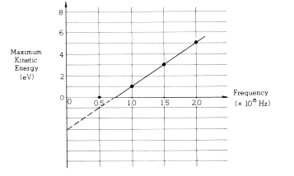
ANS:
a)
b)
7.5 x 10¹⁴ Hz
From Graph

Slide 4
ANS:
C)
D)

Slide 5
Quiz! …. Basically what we just did!
Quiz 2: Photoelectric Effect
Clear everything off your desk except a pencil and calculator
Collect formula sheets if you haven’t done so
Finished…? Sit quietly and wait for those around you to finish

Slide 6
Reading – Atomic Energy Levels
Please collect the reading from the front of the room
Read slowly… make notes on the article!

Slide 7
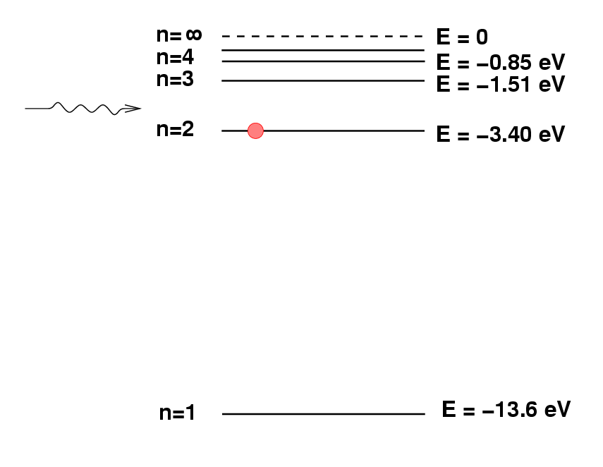
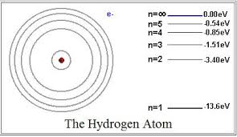
Atomic Energy Levels

Slide 8
Q2: The diagram below to the right shows the lowest four discrete energy levels of an atom. An electron in the n=4 state makes a transition to the n=2 state, emitting a photon of wavelength 121.9 nm.
Calculate the energy level of the n=4 state.
Calculate the momentum of the photon. Hint: E = mc²
The original photon is then incident on a silver surface in a photoelectric experiment, and the surface emits an electron with maximum possible kinetic energy. The work function of silver is 4.7 eV.
Calculate the kinetic energy, in eV, of the emitted electron.

Slide 9
The diagram below to the right shows the lowest four discrete energy levels of an atom. An electron in the n=4 state makes a transition to the n=2 state, emitting a photon of wavelength 121.9 nm.

Slide 10
Shape of the Day
Two sets of notes:
Notes - Atomic Energy Levels (Quantum Theory)
Extension – Atomic Energy Levels (Things get weird)
Review Package Section A MC: 5, 9, 13, 14, 18, 19, 23, 24, 29, 35

