Slide 1
Naming Covalent Compounds

Slide 2
Naming Covalent Compounds
Rule:
A prefix indicates the numbers of atoms of each element in the formula
Do not put a prefix when there is only one atom of the first element.
Charges are not important

Slide 3
Naming Covalent Compounds
Prefix | Number
mono | 1
di | 2
tri | 3
tetra | 4
penta | 5
hexa | 6
hepta | 7
octa | 8
nona | 9
deca | 10

Slide 4
Naming Covalent Compounds
Example 1: CO
What is the left most element? How many atoms are there? Identify with a prefix. Do not put a prefix when there is only one atom of the first element.
1 C – monocarbon
What is the second element? Change the ending to “ide”. How many atoms are there? Identify with a prefix.
1 O – monoxide
Name: CO = carbon monoxide

Slide 5
Naming Covalent Compounds
Example 2: N₂O₃
What is the left most element? How many atoms are there? Identify with a prefix. Do not put a prefix when there is only one atom of the first element.
2 N – dinitrogen
What is the second element? Change the ending to “ide”. How many atoms are there? Identify with a prefix.
3 O – trioxide
Name: N₂O₃ = dinitrogen trioxide

Slide 6
Naming Covalent Compounds
Example 3: CS₂
What is the left most element? How many atoms are there? Identify with a prefix. Do not put a prefix when there is only one atom of the first element.
1 C – carbon
What is the second element? Change the ending to “ide”. How many atoms are there? Identify with a prefix.
2 S – disulphide
Name: CS₂ = carbon disulphide

Slide 7
Naming Covalent Compounds
Common Names vs. Nomenclature
Example 4: CH₄ –
Example 5: NH₃ –
Example 6: H₂O –

Slide 8
Naming Covalent Compounds
Common Names vs. Nomenclature
Example 4: CH₄ – Carbon Tetrahydride
Example 5: NH₃ – Nitrogen Trihydride
Example 6: H₂O – Dihydrogen Monoxide

Slide 9
Elements Found in Pairs
Some elements are more stable in singular form and bond with each other to increase stability
H₂,O₂F₂,Br₂,I₂,N₂Cl₂
HOFBrINCl

Slide 10
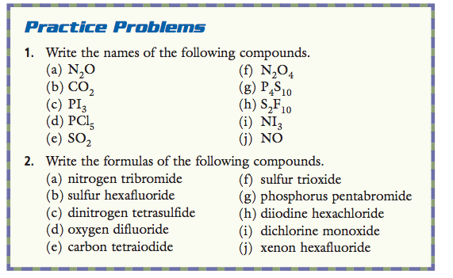
Naming Covalent Compounds

Slide 11
In-Class/Homework
Read 7.4 CYU 7.4 p. 195 Q’s 1 and 3
Covalent Compounds Worksheet
Review Chapter 7 p. 198 Q’s 1-21

Slide 12
Chapter 7 Review

