Slide 1
Assignment 2.1
Let’s take 10 minutes to finish the assignment from last class…

Slide 2
The Frequency of Eye Colour Math 11 A&W
To Start today’s class, travel around the room and create a list of ALL the eye colours in the class
First create possible groups:
Second collect data:
Third graph your data:

Slide 3
The Frequency of Eye Colour Math 11 A&W
To Start today’s class, travel around the room and create a list of ALL the eye colours in the class
First create possible groups: Blue, Brown, Green? Red!?
Second collect data: Frequency of Each Colour
Third graph your data: Using a BAR graph

Slide 4
Frequency of Eye Colour

Slide 5
Math 11 A&W
Please hand in Assignment 2.1 Broken Line Graphs
Collect graph paper at the front…
Create a double bar graph using the following data…

Slide 6
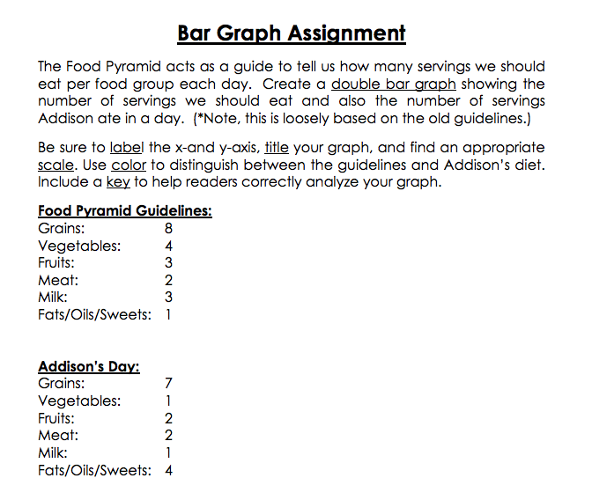
Math 11 A&W – Class Starter

Slide 8
Bar Graphs
A Chart with rectangular bars with length proportional to their values
Can be plotted vertically or horizontally
Provide visual presentation of categorical data
Data should be discrete (jump from whole number to whole number)
Examples: Months of the year, age group, shoe sizes, hair colour

Slide 9
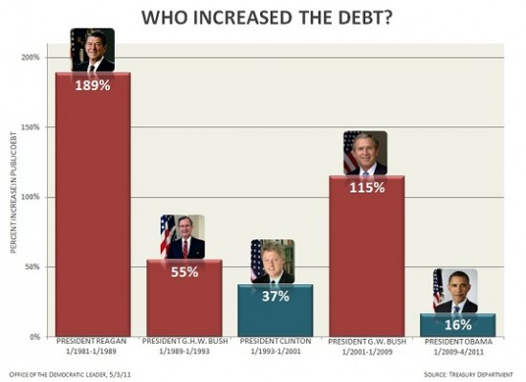
Creative Graphs

Slide 10
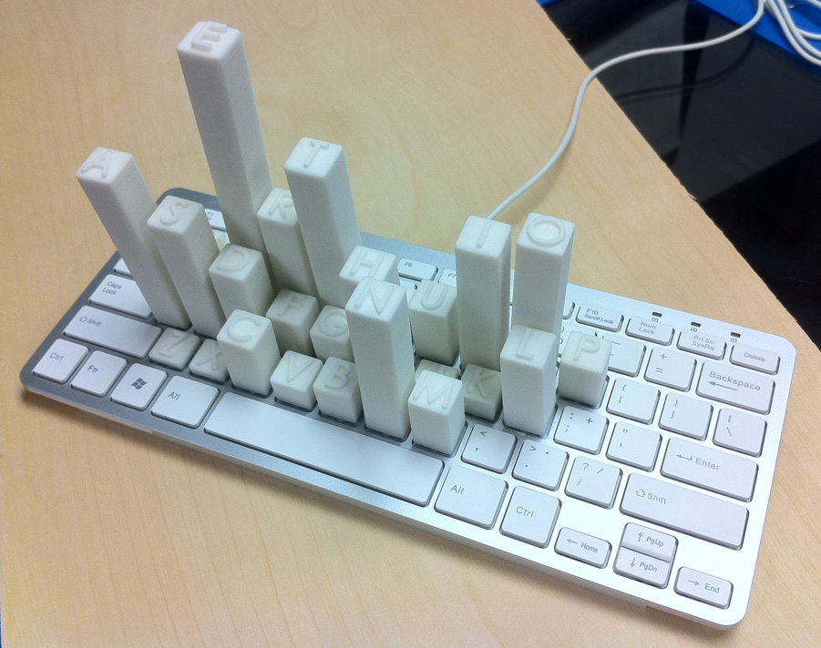
Creative Graphs

Slide 11
Notes: Bar Graphs
Copy down the notes for the first section
Try examples 1 and 2. We will review them in 10 minutes

