Slide 1
Physics 12 – Whiteboarding
Form a group of 2 or 3
Collect a white board and pens/eraser/meter stick from the front
Answer the problem on the following slide, showing all work
While you work on the problem, reflect on how you are helping your group

Slide 2
Q1 - The Sinking Sailboat
A Coast Guard ship is located 40 km away from a checkpoint in a direction 42º north of east. A distressed sailboat located in still water 25 km from the same checkpoint in a direction 36º south of east is about to sink.
Draw a diagram indicating the position of both ships (Use a ruler!)
How far must the Coast Guard ship travel to reach the sailboat?
In what direction must the Coast Guard ship travel to reach the sailboat?

Slide 3
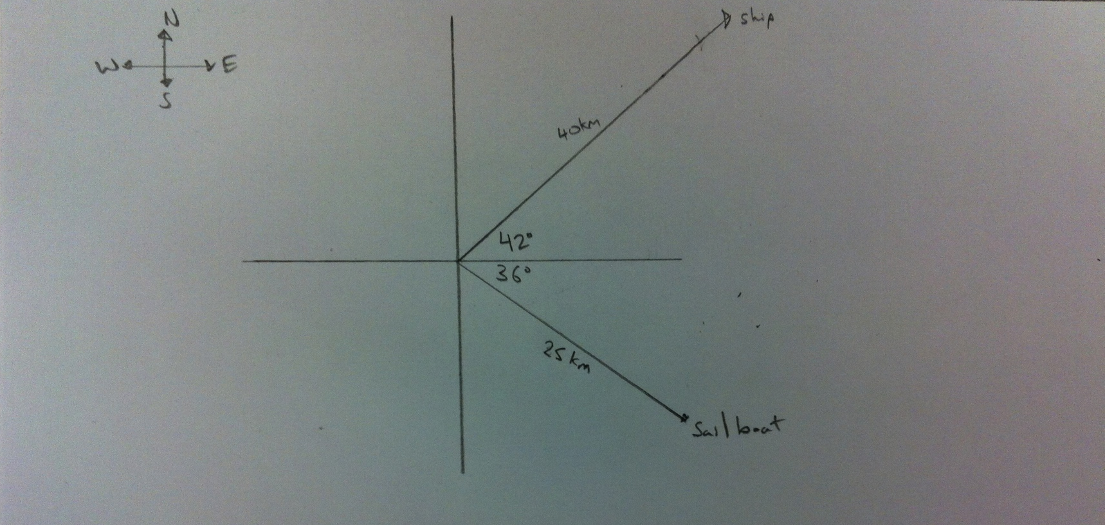
Diagram of the Ship and Sailboat’s position

Slide 4
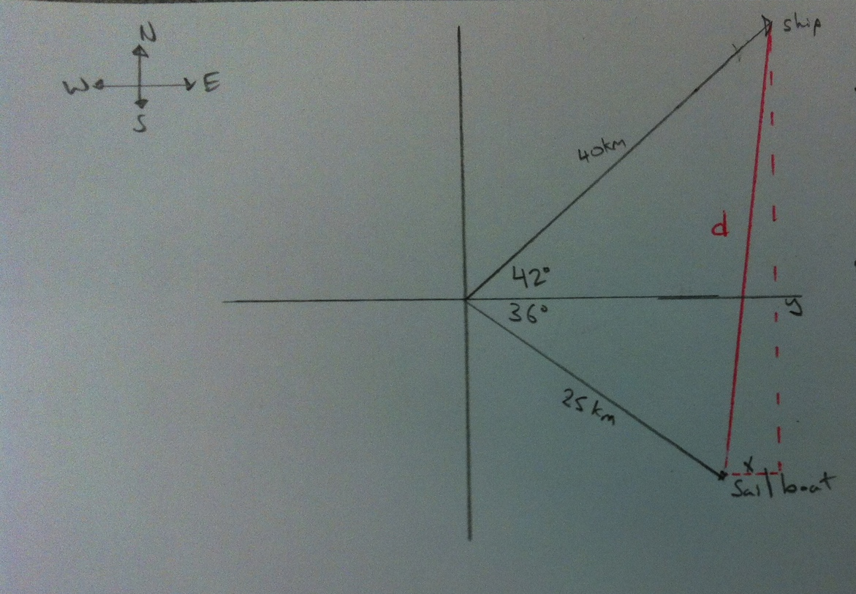
Displacement of Ship and Sailboat

Slide 5
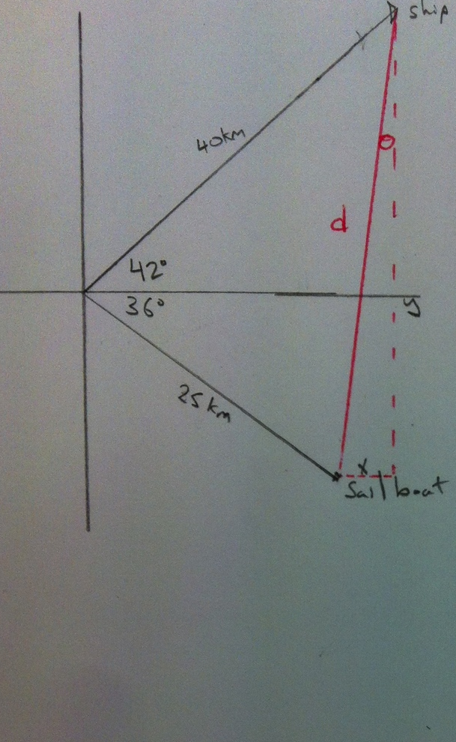
Direction of Travel

Slide 6
Final Answer
43 km 12.9º West of South
Magnitude
Units
Direction

Slide 7
Q2 – Vector Addition
A plane that can fly at 92 m/s in still air heads 40º S of W and encounters a cross-wind of 32 m/s 35º W of N. What is the total velocity of the plane? (Include vector diagram)

Slide 8
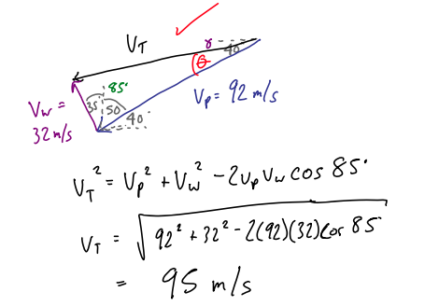
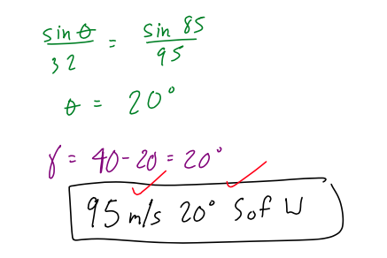
Q2 – Vector Addition

Slide 9
Vector Notes – Subtracting Vectors
Please clean off your Whiteboard and return all materials used
Take out your notes package and turn to the end of 1.4 Vectors
We will have a vector quiz at the end of class
Next Class: Vector Quiz + Intro to Projectiles

Slide 10
Worksheet Vectors
Note: Using Vectors is an ESSENTIAL part of AP Physics 1
It will be use THROUGHOUT AP Physics 1
Please take the time to work through the worksheet

