Slide 1
Math 11 A&W - Class Starter
Your balancing assignments were due at the end of class on Thursday.
I have received only 4 completed assignments
Please hand this in by the end of Wednesday afternoon
Without the assignment you will receive an I on your Report Card

Slide 2
Surface Area Warmup
Find the number of sides for each structure

Slide 3
Surface Area
The total area of ALL the sides of an object
Picture a blanket covering a 3D-object, if we lay the blanket flat the area would correspond to the Surface Area
The “blanket” is often referred to as a net
Draw Net’s of the following objects…

Slide 4
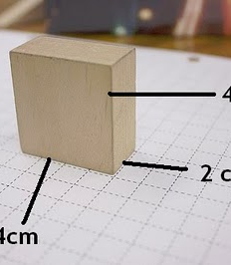
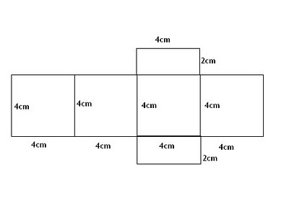
Cube

Slide 5
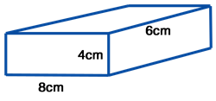
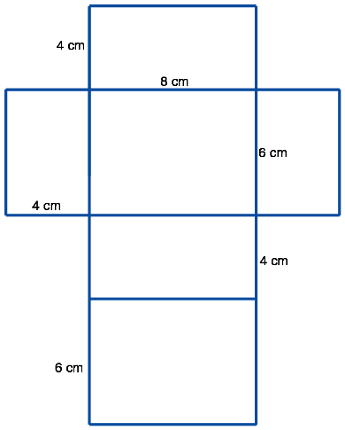
Rec Prism

Slide 6
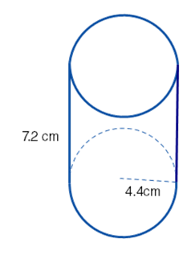
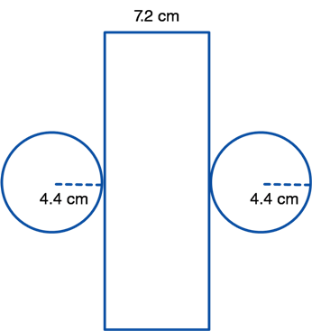
Cylinder

Slide 7
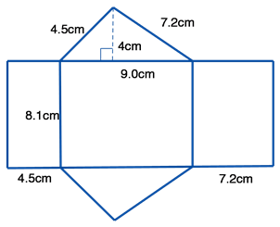
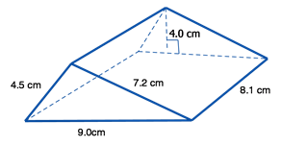
Triangular Prism

Slide 8
SA of 3D Objects
Find the Surface Area of the blocks you are about to receive
What information do you need?
What information can you find out?

Slide 9
Notes: Surface
Complete the notes on the board

