Slide 1
AP Physics 2 – Class Starter
Quiz 2: Electric Fields on a Single Charge
Please clear everything off your desks except a pencil and calculator
Set up dividers between yourself and your neighbour
Collect the two data sheets and a scrap piece of paper from the front of the room

Slide 2
Assign a charge (+, -, 0) for Q₁, Q₂ and Q₃

Slide 3
Assign a charge (+, -, 0) for Q₁, Q₂ and Q₃
Q₁ = + ; Q₂ = - ; Q₃ = +

Slide 4
What direction is the electric field at point P?

Slide 5
What direction is the electric field at point P?

Slide 6
Given below are arrangements of three fixed electric charges. In each figure, a point labeled P is also identified. All of the charges are the same size charge, q, but they can be either positive or negative as indicated. The charges and point P all lie on a straight line. The distances between adjacent items, either between two charges or between a charge and point P, are all the same. There are no other charges in this region. A test charge, +Q, is placed at point P. Rank these arrangements from greatest to least on the basis of the strength (magnitude) of the electric force on the test charge, +Q, at P.

Slide 7
Rank these arrangements from greatest to least on the basis of the strength (magnitude) of the electric force on the test charge, +Q, at P. D>C>A>F>E>B

Slide 8
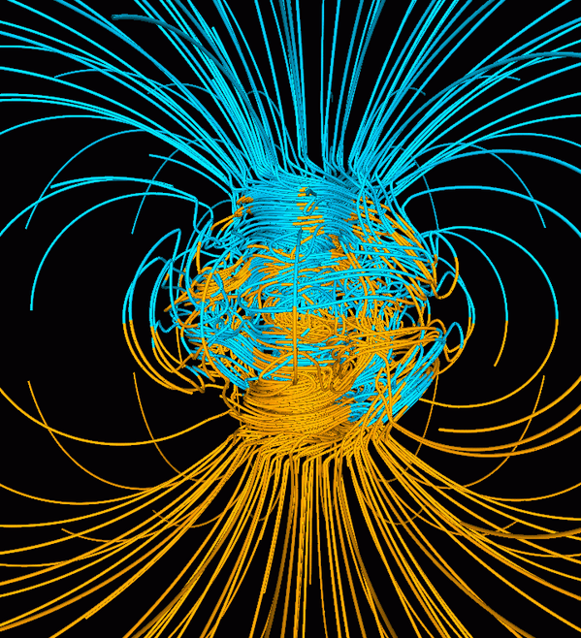
Please take out your notes!
Electric Fields on MULTIPLE CHARGES

Slide 9
Challenging Questions!
Please form a group of 2 or 3
Collect a whiteboard access the activity from my website (Unit 1 - Day 2)
Work your way through the question(s) on the whiteboard as a group
These are not easy questions, reflect on your understanding

