Slide 1
Notes!

Slide 2
Living Things
Living things can survive in almost any type of environment
All living things have special features that help them survive in their environment

Slide 3
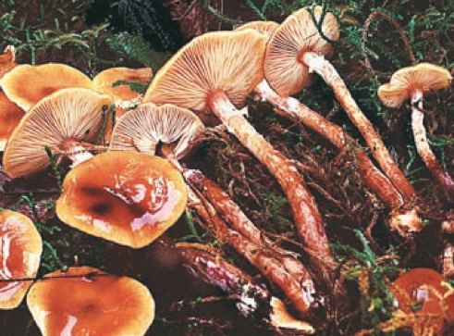
Honey Mushroom – largest living thing on Earth

Slide 4
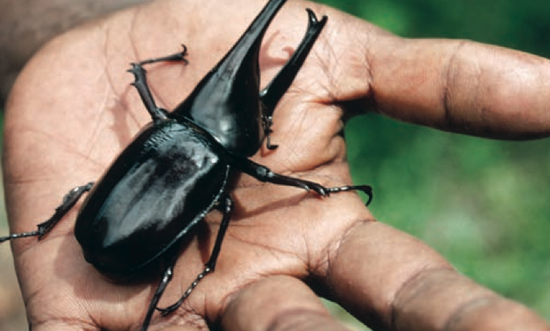
Rhinoceros Beetle – strongest living thing on Earth

Slide 5
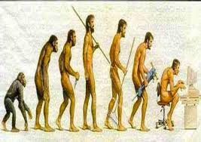
Characteristic of Living Things
Living things… need to respond and adapt to their environment
Anything that causes a living thing to respond is called a stimulus
Ex: Hunger and thirst – causes you to eat or drink

Slide 6
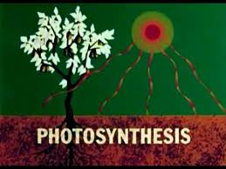
Characteristic of Living Things
Living things… require energy
To respond to the environment, living things require energy
Living things have different ways of getting energy
Ex: Food for humans, Carbon Dioxide/Water/Sunlight for plants (Photosynthesis)

Slide 7
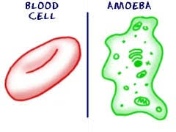
Characteristic of Living Things
Living things… are made of cells
Cells are the basic building blocks of ALL LIVING THINGS

Slide 8
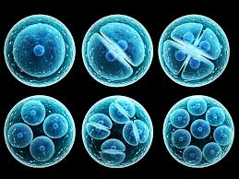
Characteristic of Living Things
Living things… grow/repair/reproduce
Growth is a result of cells in a body increasing in number
Cells are continually being replaced (repair)
Reproduction is a way for living things to replace older individuals that die

Slide 9
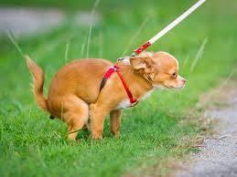
Characteristic of Living Things
Living things… must get rid of wastes
What living things consume are often not entirely always used by the body and therefore creates waste
Animals produce waste such as carbon dioxide, urine and feces.

Slide 10
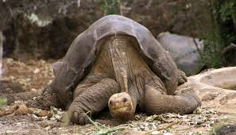
Characteristic of Living Things
Living things… must die….
Eventually the replacing old cells with new cells will no be sufficient and the organism will die.
Notes:
Lonesome George

Slide 11
Listed again!
Living Things…
Respond and adapt to their environment
Obtain and use energy
Are made of Cells! (more on this next class!)
Grow, Repair and Reproduce
Produce waste
Must eventually die… ☹

Slide 12
Complete complete the back page!

