Slide 1
SHM – Simple Harmonic Motion
Please pick the Learning Outcomes from the front of the room
Take a moment to review the Learning Outcomes

Slide 2
A Couple Things…
This is an EXTREMELY quick and somewhat easy unit (3 classes)
We will be done by Spring Break
1 Class: Springs
2 Classes: Pendulums
3 Classes: Unit Quiz
We will be BASICALLY done all Theory by the end of today

Slide 3
Oscillations and Simple Harmonic Motion:
AP Physics B

Slide 4
Oscillatory Motion – Can you think of an example of an Oscillator?
Oscillatory Motion is repetitive back and forth motion about an equilibrium position
Oscillatory Motion is periodic.
Swinging motion and vibrations are forms of Oscillatory Motion.
Objects that undergo Oscillatory Motion are called Oscillators.

Slide 5
Conditions for SHM
All objects that we look at are described the same mathematically.
Any system with a linear restoring force will undergo simple harmonic motion around the equilibrium position.

Slide 6
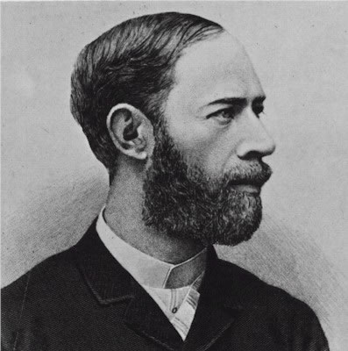
What is the oscillation period for the broadcast of a 100MHz FM radio station?
Heinrich Hertz produced the first artificial radio waves back in 1887!

Slide 7
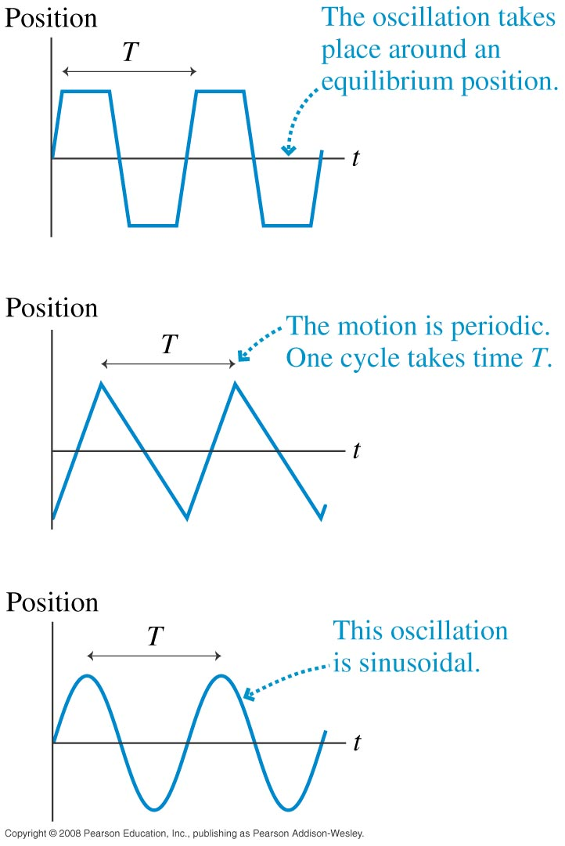
Simple Harmonic Motion
The most basic of all types of oscillation is depicted on the bottom sinusoidal graph. Motion that follows this pattern is called simple harmonic motion or SHM.

Slide 8
Simple Harmonic Motion
The time to complete one full cycle of oscillation is a Period.
The amount of oscillations per second is called frequency and is measured in Hertz.

Slide 9
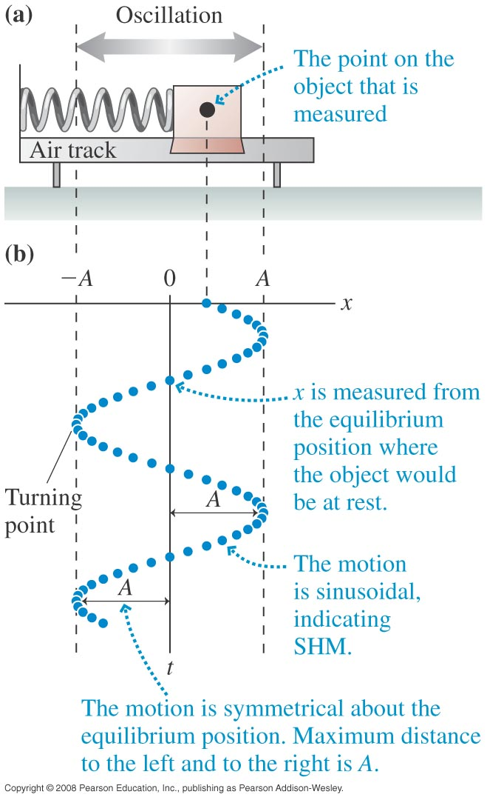
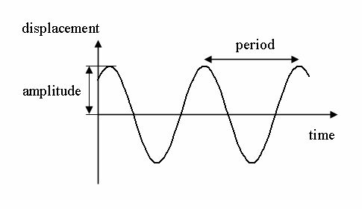
Simple Harmonic Motion
An objects maximum displacement from its equilibrium position is called the Amplitude (A) of the motion.

Slide 10
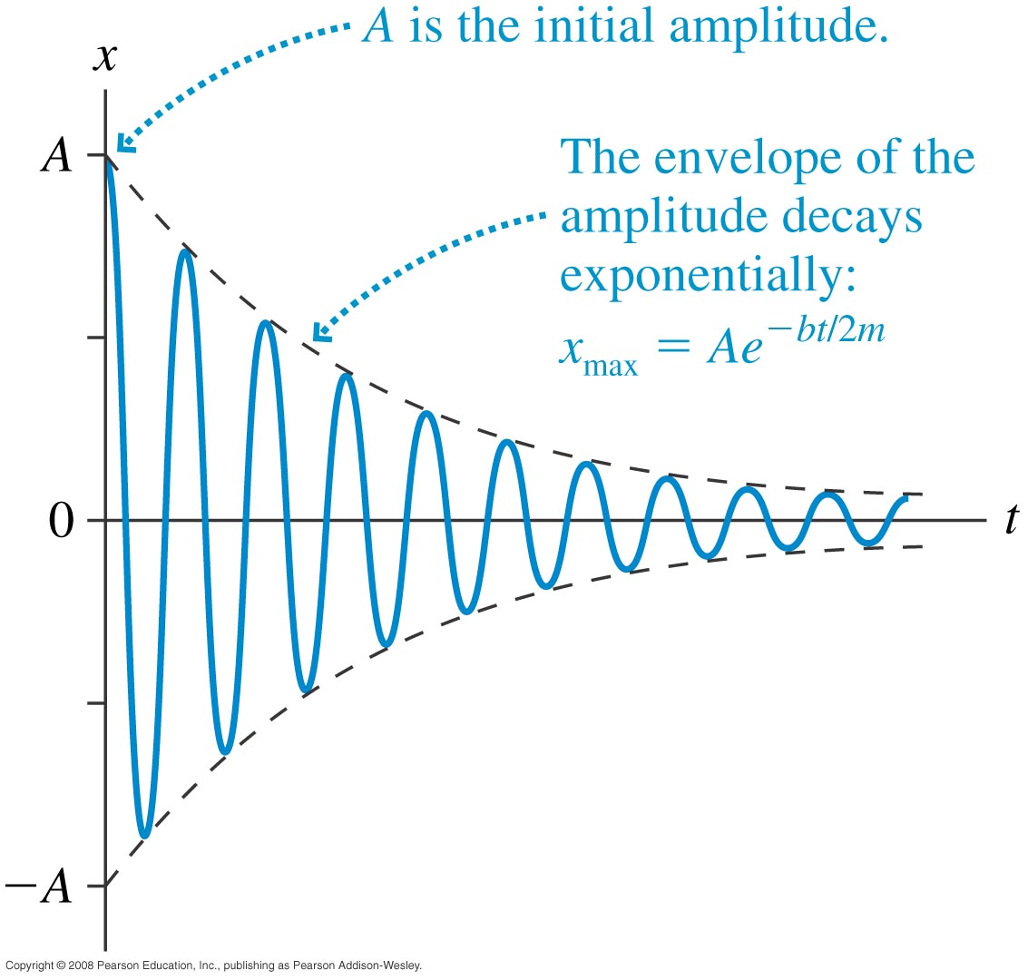
Damped (NOT DAMPENING) Oscillations – Real Life
A slowly changing line that provides a border to a rapid oscillation is called the envelope of the oscillations.

Slide 11
What would be the opposite of damping?
Resonance… a system that is “pushed” at just the right time
Think a child being pushed on a a swing

Slide 12
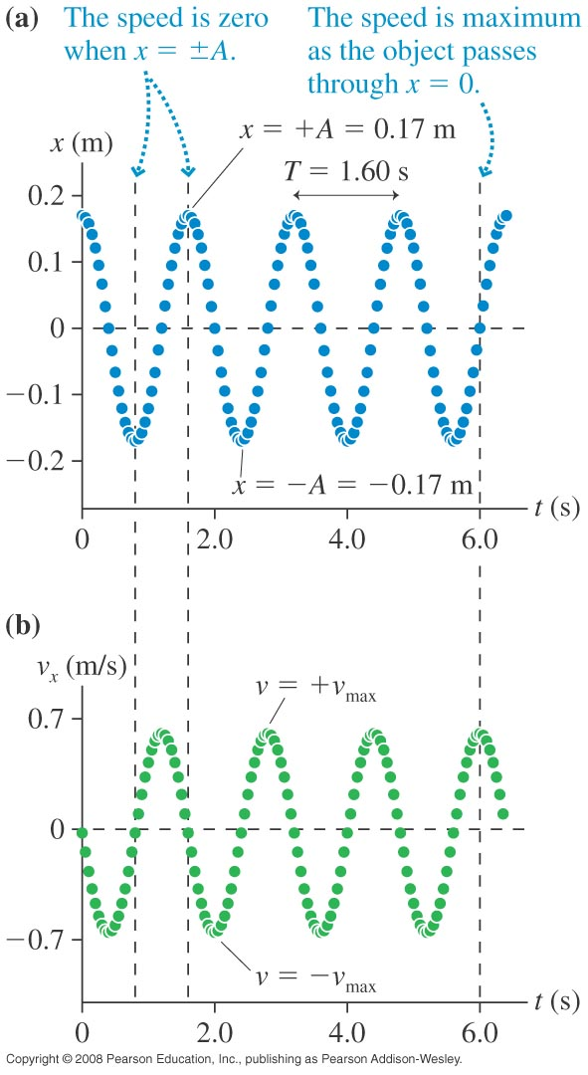
What shape will a velocity-time graph have for SHM? Draw it!
Everywhere the slope (first derivative) of the position graph is zero, the velocity graph crosses through zero.

Slide 13
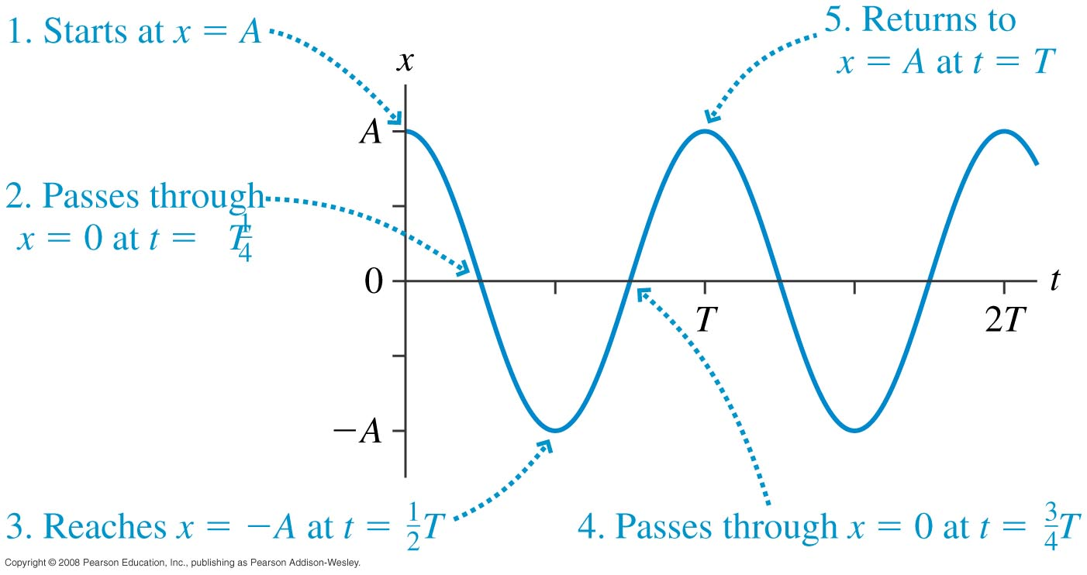
We need a position function to describe the motion above. Hmmm what could it be?

Slide 14
Algebra MAXED out
Just a note… you DO NOT need to derive any of the following equations, however you are NOT given them on your equation sheet

Slide 15
Mathematical Models of SHM
x(t) to symbolize position as a function of time
A=x_{max}=x_{min}
When t=T,
cos(2π)=cos(0)
x(t)=A

Slide 16
A Little Calculus! (the rate of change!
Find velocity (the rate of change of position) by taking the derivative of the position equation!

Slide 17
Mathematical Models of SHM
In this context we will call omega Angular Frequency
What is the physical meaning of the product (Aω)?
The maximum speed of an oscillation!

Slide 18
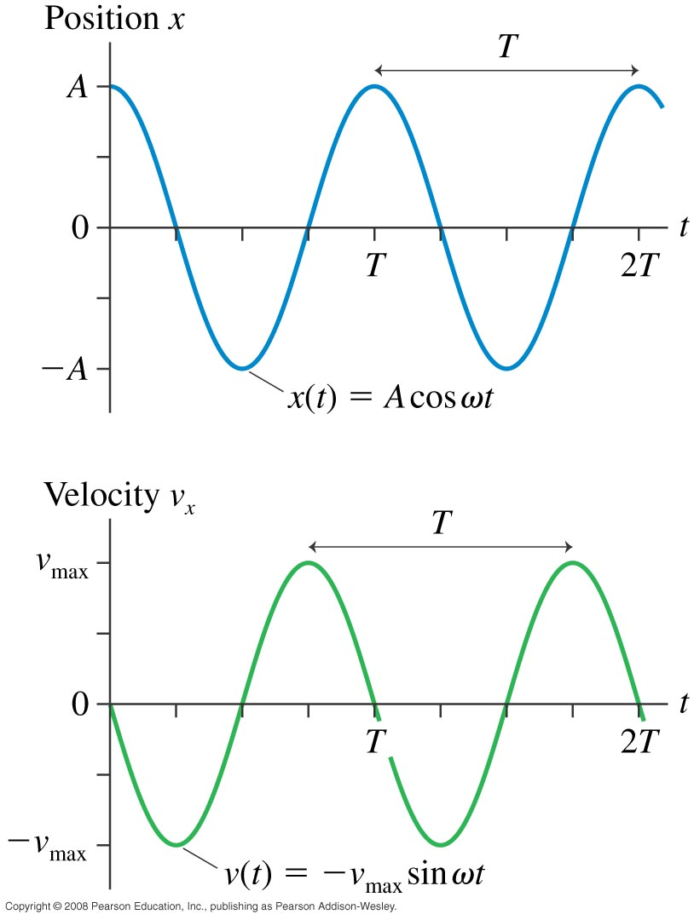
Makes sense when you look at the curves at a given position

Slide 19
Example: 1
An airtrack glider is attached to a spring, pulled 20cm to the right, and released at t=0s. It makes 15 oscillations in 10 seconds.
What is the period of oscillation?

Slide 20
Example: 2
An airtrack glider is attached to a spring, pulled 20cm to the right, and released at t=0s. It makes 15 oscillations in 10 seconds.
What is the object’s maximum speed?

Slide 21
Example: 3
An airtrack glider is attached to a spring, pulled 20cm to the right, and released at t=0s. It makes 15 oscillations in 10 seconds.
What are the position and velocity at t=0.8s?

Slide 22
Example: 4
A mass oscillating in SHM starts at x=A and has period T. At what time, as a fraction of T, does the object first pass through 0.5A?

Slide 23
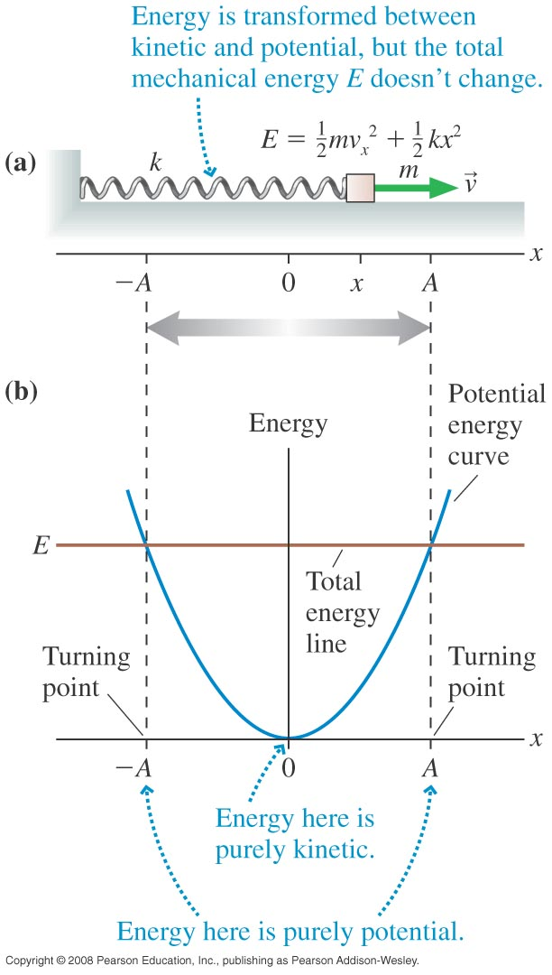
We have modeled SHM mathematically. Now comes the physics.
Total mechanical energy is conserved for our SHM example of a spring with constant k, mass m, and on a frictionless surface.
The particle has all potential energy at x=A and x=–A, and the particle has purely kinetic energy at x=0.

Slide 24
Total Energy Constant

Slide 25
At turning points:
At x=0:
From conservation:
Maximum speed as related to amplitude:

Slide 26
From energy considerations:
From kinematics:
Combine these:

Slide 27
A toughie… are you ready?

Slide 28
a 500g block on a spring is pulled a distance of 20cm and released. The subsequent oscillations are measured to have a period of 0.8s. at what position or positions is the block’s speed 1.0m/s?
The motion is SHM and energy is conserved.

Slide 29
If you didn’t get the last one… maybe this one…?
Find acceleration (the rate of change of velocity) by taking the derivative of the velocity equation!

Slide 30
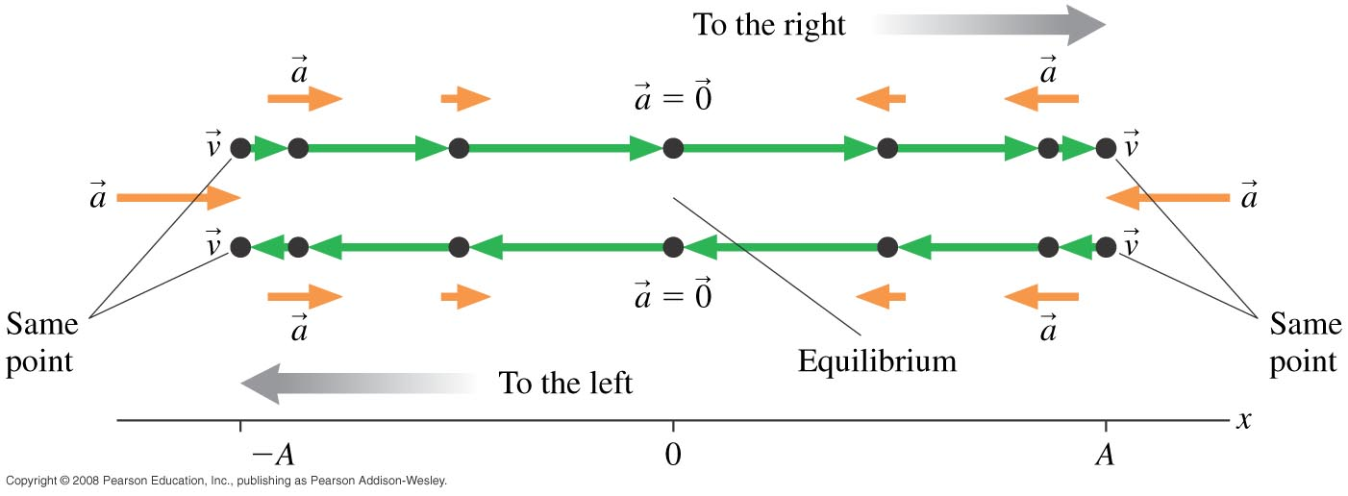
Dynamics of SHM
Acceleration is at a maximum when the particle is at maximum and minimum displacement from x=0.

Slide 31
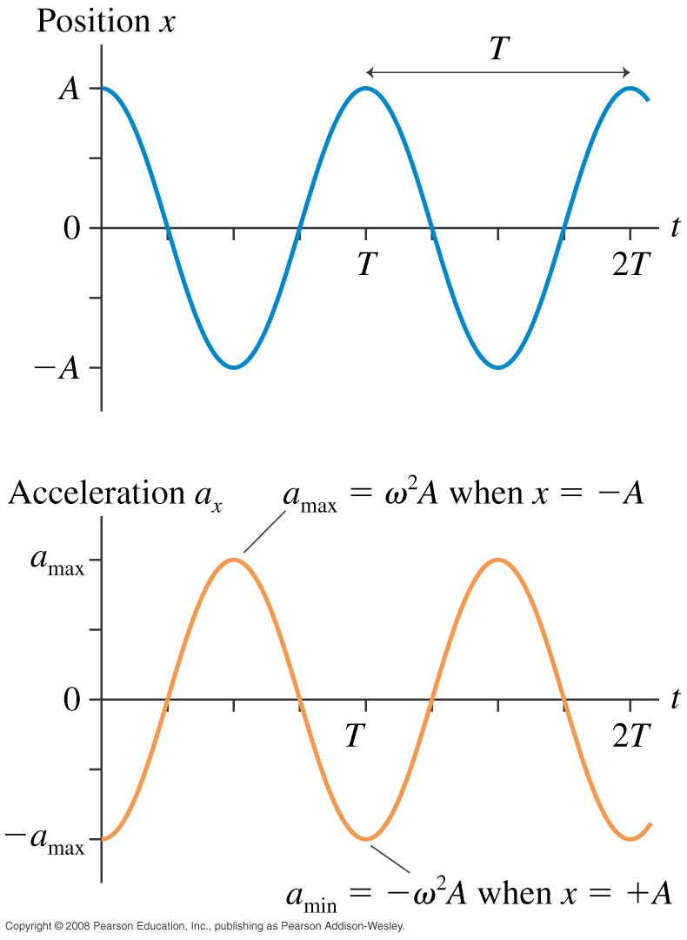
Dynamics of SHM
Acceleration is proportional to the negative of the displacement.

