Slide 1
Math 9 – Class Starter
Please hand in your Logo Projects at the front of the room
Return to your seats and take out a piece of paper
In a moment we will begin our new unit!
New Unit: Similarity!

Slide 2
Pizza!
How many ways could you mathematically describe the pizza to the right?
These terms are known as EQUAVALENT FRACTIONS

Slide 3
Equivalent Fractions
Fractions which have the same value, even though they may look different!

Slide 4
Reason?
Multiply top and bottom by the same number
OR Divide top and bottom by the same number

Slide 5
Your turn…..

Slide 6
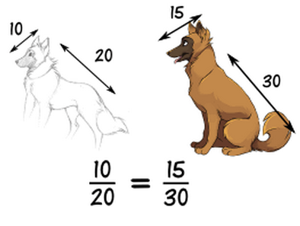
Question: When someone says things are “in proportion” what does s/he mean?
Answer: Their relative sizes are the same.
Remember the ratio!

Slide 7
Example: you want to draw the dog’s head, and would like to know long it should be

Slide 8
Create a proportion and solve… (always 1 or 2 steps!)

Slide 9
Example: Find the height of the tree

Slide 10
Set up and solve
Answer: 5.4 m

Slide 11
Example:
A typical mix of cement, sand and stones is written as a ratio such as 1:2:6
Question: If you have just put 12 buckets of stones in a wheelbarrow, how much cement and sand should you add?

Slide 12
Setting it up…

Slide 13
Solution

Slide 14
Scale Factors – how many times bigger is the ACTUAL horse than the drawn horse?

Slide 15
Scale
Scale Factor

Slide 16
Scale Factors

Slide 17
Scale Factor
A number used as a multiplier in scaling (moving up or down!)
What is the scale factor of the map?
1km/10cm = 0.1
Every cm on the map is equal to 0.1 km

Slide 18
Stations
In a moment I will give you a number between 1 and 8
You will then head to a station and complete several questions on Proportions and Scale

